Slide 1
Review of Previous Lesson
State as many Vocabulary words and Learning Objectives that you remember from the last lesson as you can.
Now complete the content learning objectives.
Remember to grade yourself from 0 – 3.

Slide 2
Newton's Universal Law of Gravitation
Grade 7

Slide 3
Vocabulary
Content: | Start | End
Newton
law
universal
gravitation
force
directly
proportional
inversely
Fg

Slide 4
Vocabulary
Language: | Start | End
calculate
variables

Slide 5
Learning Objectives
Content: | Start | End
Discuss the difference between acceleration due to gravity and the force due to gravity.
Calculate Fg given mass.
Rearrange to calculate mass given Fg.
Recognise increasing distance from source decreases force.

Slide 6
Learning Objectives
Language: | Start | End
Explain, using algebra and GFEMA, “working out”.

Slide 7
Newton's Law of Universal Gravitation
Newton's law of universal gravitation is about the universality of gravity.
Newton's place in the Gravity Hall of Fame is not due to his discovery of gravity, but rather due to his discovery that gravitation is universal.
  ALL objects attract each other with a force of gravitational attraction. Gravity is universal.

Slide 8
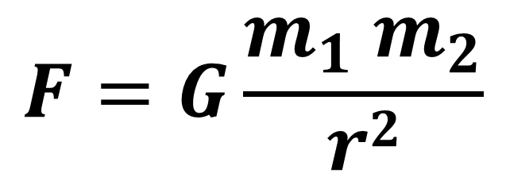
Newton's Law of Universal Gravitation
This force of gravitational attraction is directly dependent upon the masses of both objects and inversely proportional to the square of the distance that separates their centres.
$$F=G\frac{m_{1} m_{2}}{r2}$$
F = force applied on object 2 exerted by object 1
G = Gravitational Constant (6.673 x 10⁻¹¹ Nm²/kg²)
m₁ and m₂ = the masses of objects 1 and 2 respectively
r = distance between the object’s centres

Slide 9
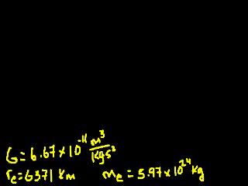
Newton's Law of Universal Gravitation
(Khan Academy) https://www.khanacademy.org/science/physics/centripetal-force-and-gravitation/gravity-newtonian/v/introduction-to-newton-s-law-of-gravitation

Slide 10
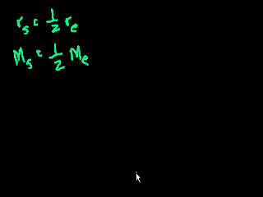
Newton's Law of Universal Gravitation
(Khan Academy) https://www.khanacademy.org/science/physics/centripetal-force-and-gravitation/gravity-newtonian/v/gravitation-part-2

Slide 11
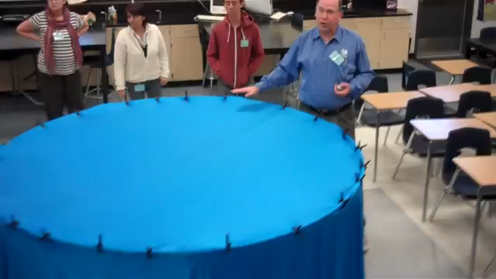
Newton's Law of Universal Gravitation
(apbiolghs - youtube) https://www.youtube.com/watch?v=MTY1Kje0yLg

Slide 12
Difference between weight and mass?
Mass:
  A measure of how much matter (kg) an object has.
  Does not change when an object's location changes.
Weight:
  A measure of the gravitational force (Newtons – N) acting on an object.
  Changes with location.
    https://www.nyu.edu/pages/mathmol/textbook/weightvmass.html
    http://www.physicsclassroom.com/class/newtlaws/Lesson-2/Types-of-Forces
W = mg or F_{grav} = mg
  W = weight, F_{grav} = Force of gravity = Weight
  m = mass
  g = acceleration of gravity
    Where does this equation come from?
      F = ma (Newton’s Second Law)

Slide 13
Problems and Solutions:
Weight vs Mass:
  Invent your questions regarding your weight on other planets using the following links:
    http://www.physicsclassroom.com/class/circles/Lesson-3/The-Value-of-g
    https://www.nyu.edu/pages/mathmol/textbook/weightvmass.html
    http://www.rapidtables.com/convert/weight/kg-to-pound.htm
  http://en.mcqslearn.com/o-level/physics/mcq/mass-weight-density.php?page=5
  https://www.proprofs.com/quiz-school/story.php?title=force-weight-mass
  https://quizizz.com/admin/quiz/54ef1aff1e246ab31e491b0a
  https://reviewgamezone.com/mc/candidate/test/?test_id=23043&title=Mass%20Vs%20Weight
  http://en.mcqlearn.com/science/g6/measuring-mass-mcqs.php
  https://www.thatquiz.org/tq/previewtest?Y/J/R/C/50721317644863

Slide 14
How to properly use GFEMA:
G: givens – write down every value that the problem gives you with a symbol and units, separated by commas
F: find – write down the variable of the quantity you are looking for
E: equation – write down the equation you are going to use
  I highly recommend writing it in its standard format first and then rearranging, that way if you rearrange it wrong, the right equation is still there to get you credit
M: Math – substitute numbers here and solve.
    Show your working out (algebra and numbers). More work means more chances to find simple mistakes.
  A: Answer – the answer, with units
    AND if you know the answer is wrong, and have no idea why – this is where you should tell me that.
    Please note: you DID the whole problem. Even if you got a wrong answer, it’s all here.

Slide 15
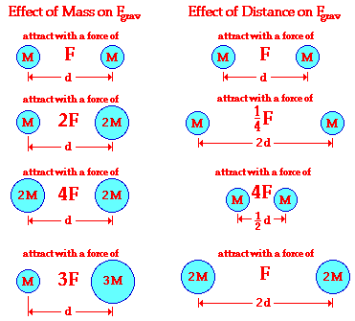
Plenary
?
?
?
?
?
?
http://www.physicsclassroom.com/class/circles/Lesson-3/Newton-s-Law-of-Universal-Gravitation

Slide 16
Plenary
http://www.physicsclassroom.com/class/circles/Lesson-3/Newton-s-Law-of-Universal-Gravitation

