Slide 1
Review of Previous Lesson
State as many Vocabulary words and Learning Objectives that you remember from the last lesson as you can.
Now complete the content learning objectives.
Remember to grade yourself from 0 – 3.

Slide 2
Newton's Third Law

Slide 3
Vocabulary
Content: | Start | End
Newton
law
action
reaction
force
balanced

Slide 4
Vocabulary
Language: | Start | End
describe
state
explain
pair

Slide 5
Learning Objectives
Content: | Start | End
Describe an action reaction pair.
State which object is applying the force and which is being acted on for the action and reaction.
Explain why action reaction pairs are not balanced forces.

Slide 6
Learning Objectives
Language: | Start | End
Describe and explain verbally and in writing.

Slide 7
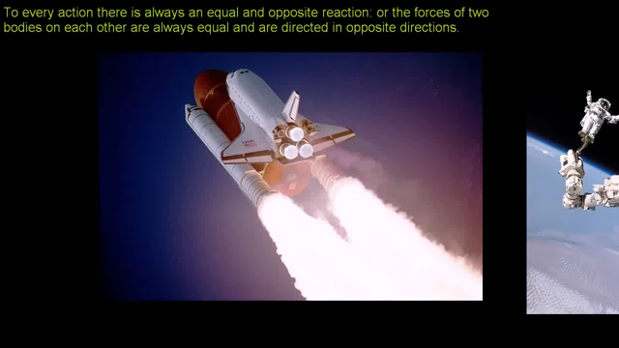
Newton's Third Law:
(Khan Academy) https://www.khanacademy.org/science/physics/forces-newtons-laws/newtons-laws-of-motion/v/newton-s-third-law-of-motion

Slide 8
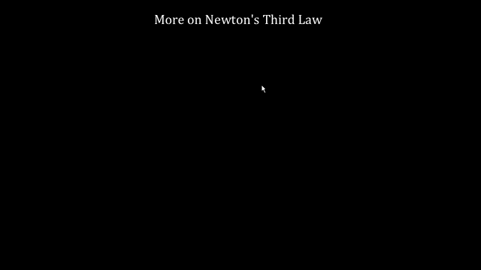
More on Newton's third law:
(Khan Academy) https://www.khanacademy.org/science/physics/forces-newtons-laws/newtons-laws-of-motion/v/more-on-newtons-third-law

Slide 9
Describe action reaction pairs.
Which object is applying the force and which is being acted on for the action and reaction
http://www.physicsclassroom.com/class/newtlaws/Lesson-4/Identifying-Action-and-Reaction-Force-Pairs

Slide 10
How does Newton's third law apply to a rifle firing a bullet?
https://socratic.org/questions/how-does-newton-s-third-law-apply-to-a-rifle-shooting-a-bullet

Slide 11
Explain why action reaction pairs are not balanced forces.
https://socratic.org/questions/do-action-and-reaction-pairs-of-forces-balance-one-another

Slide 12
Explain why action reaction pairs are not balanced forces.
How many objects are the forces acting on in the following pair of sentences?
  The earth is pulling down on you with the force of gravity.
  You are pulling up on the earth with the force of gravity.

Slide 13
Explain why action reaction pairs are not balanced forces.
How many objects are the forces acting on in the following pair of sentences?
  Two (you and the earth).
    The earth is pulling down on you with the force of gravity.
    You are pulling up on the earth with the force of gravity.
      Two different objects = No chance of cancelling each other out (balanced forces) and no chance of a net force causing movement in any direction.

Slide 14
Explain why action reaction pairs are not balanced forces.
How many objects are the forces acting on in the following pair of sentences?
  The earth is pulling down on you with the force of gravity.
  The ground is pushing up on you with a Normal force.

Slide 15
Explain why action reaction pairs are not balanced forces.
How many objects are the forces acting on in the following pair of sentences?
  One (you).
    The earth is pulling down on you with the force of gravity.
    The ground is pushing up on you with a Normal force.
      One object = Forces will either cancel each other out (balance) or, if one “wins”, there will be a net force causing movement in that direction.

Slide 16
Newton's Third Law:
http://www.physics247.com/physics-help/newtons-third-law.shtml
http://www.physics247.com/physics-homework-help/net-force.php
https://www.varsitytutors.com/ap_physics_1-help/newton-s-third-law
https://www.khanacademy.org/science/physics/forces-newtons-laws/newtons-laws-of-motion/e/newtons-third-law

