Slide 1
Review of Previous Lesson
State as many Vocabulary words and Learning Objectives that you remember from the last lesson as you can.
Now complete the content learning objectives.
Remember to grade yourself from 0 – 3.

Slide 2
Newton's First Law of Motion
Or Newton's law of inertia

Slide 3
Vocabulary
Content: | Start | End
Newton
law
inertia

Slide 4
Vocabulary
Language: | Start | End
define

Slide 5
Learning Objectives
Content: | Start | End
Apply Newton's first law (no acceleration on an object it will continue in its state of motion) by predicting the motion of objects in practical terms.

Slide 6
Learning Objectives
Language: | Start | End
Explain verbally.
Predict in writing and verbally.

Slide 7
Newton's First Law of Motion:
An object at rest remains at rest, or if in motion, remains in motion at a constant velocity unless acted on by a net external force.

Slide 8

Inertia
The property of an object that resists an acceleration (change in motion).

Slide 9
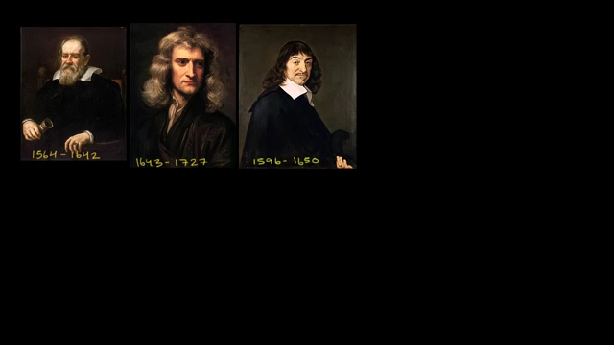
Newton's First Law of Motion:
(Khan Academy) https://www.khanacademy.org/science/physics/forces-newtons-laws/newtons-laws-of-motion/v/newton-s-1st-law-of-motion

Slide 10
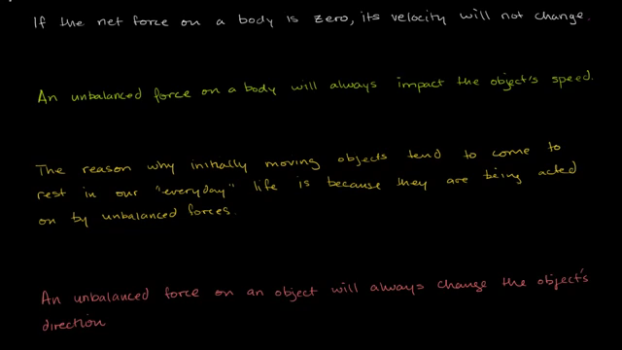
Newton's First Law of Motion concepts:
(Khan Academy) https://www.khanacademy.org/science/physics/forces-newtons-laws/newtons-laws-of-motion/v/newton-s-first-law-of-motion-concepts

Slide 11
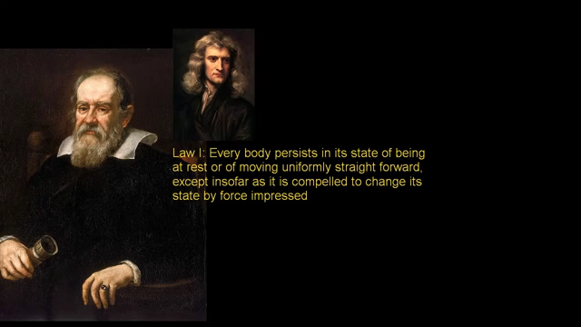
More on Newton's First Law of motion:
(Khan Academy) https://www.khanacademy.org/science/physics/forces-newtons-laws/newtons-laws-of-motion/v/newton-s-first-law-of-motion-concepts

Slide 12

Inertia (Newtons First Law) + Cool Physics Trick:
(Spencer Richard - youtube) https://www.youtube.com/watch?v=C1Fb7hTpVOk

Slide 13
No acceleration on an object means it will continue in its state of motion.
Animations:
  The Car and The Wall
    http://www.physicsclassroom.com/mmedia/newtlaws/cci.cfm
  The Truck and Ladder
    http://www.physicsclassroom.com/mmedia/newtlaws/il.cfm

Slide 14
Newton's first law:
https://www.varsitytutors.com/ap_physics_1-help/newton-s-first-law
https://www.proprofs.com/quiz-school/story.php?title=lesson-1-newtons-first-law-motion
https://www.khanacademy.org/science/physics/forces-newtons-laws/newtons-laws-of-motion/e/newtonsfirst
http://www.physicsclassroom.com/reviews/Newtons-Laws/Newtons-Laws-Review-Answers-1

