Slide 1
Review of Previous Lesson
State as many Vocabulary words and Learning Objectives that you remember from the last lesson as you can.
Now complete the content learning objectives.
Remember to grade yourself from 0 – 3.

Slide 2
Newton's Second Law

Slide 3
Vocabulary
Content: | Start | End
Newton
law
force
acceleration
mass
directly
inversely
proportional
net force

Slide 4
Vocabulary
Language: | Start | End
state
recognize
relates
multiple
variables
identify
explain
apply
variable
rearrange
calculate

Slide 5
Learning Objectives
Content: | Start | End
State Newton’s 2nd Law.
Recognize how it relates to multiple force systems.
Calculate net force given acceleration and mass.
Identify, explain, and apply variable relations.
Rearrange to calculate mass or acceleration.

Slide 6
Learning Objectives
Language: | Start | End
Identify, explain, and apply verbally and in writing.
Explain, using algebra and GFEMA, “working out”.

Slide 7
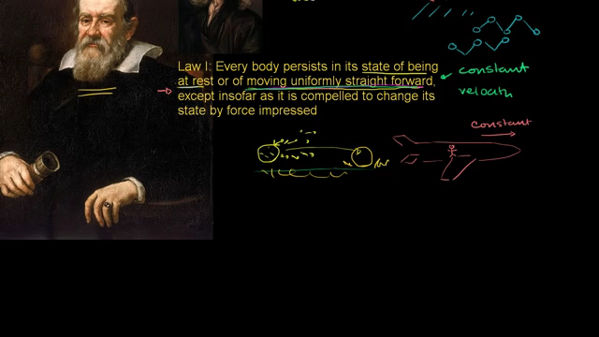
Newton’s Second Law

Slide 8
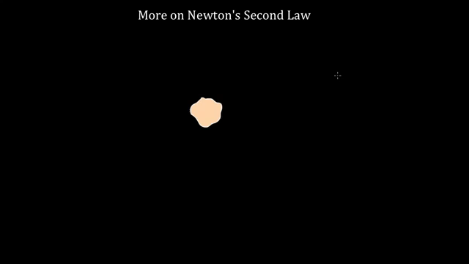
More on Newton’s Second Law

Slide 9
Newton's Second Law
The acceleration of an object as produced by a net force is directly proportional to the magnitude of the net force, in the same direction as the net force, and inversely proportional to the mass of the object.
F = ma
  F= Net Force
  m = mass
  a = acceleration
    http://www.physicsclassroom.com/class/newtlaws/Lesson-3/Newton-s-Second-Law

Slide 10
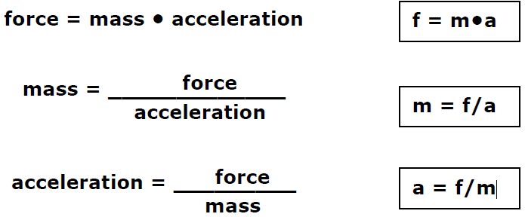
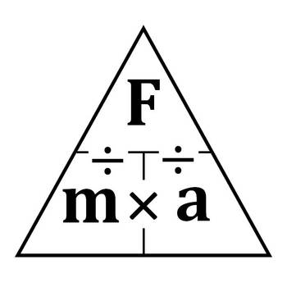
Newton's Second Law

Slide 11
How to properly use GFEMA:
G: givens – write down every value that the problem gives you with a symbol and units, separated by commas
F: find – write down the variable of the quantity you are looking for
E: equation – write down the equation you are going to use
  I highly recommend writing it in its standard format first and then rearranging, that way if you rearrange it wrong, the right equation is still there to get you credit
M: Math – substitute numbers here and solve.
    Show your working out (algebra and numbers). More work means more chances to find simple mistakes.
  A: Answer – the answer, with units
    AND if you know the answer is wrong, and have no idea why – this is where you should tell me that.
    Please note: you DID the whole problem. Even if you got a wrong answer, it’s all here.

Slide 12
Sample Problems and Solutions
http://www.quizmoz.com/quizzes/Science-Quizzes/n/Newtons-Second-Law-of-Motion-Quiz.asp
https://www.easycalculation.com/physics/classical-physics/newtons-second-law-examples.php
http://www.batesville.k12.in.us/physics/phynet/mechanics/newton2/numerical_pro.htm
http://glencoe.mheducation.com/sites/0078617707/student_view0/chapter2/section2/self-check_quiz-eng_.html
https://www.quibblo.com/quiz/e5MmrWr/Forces-Quiz-Newtons-SECOND-Law-Easier
http://www.physicsclassroom.com/class/newtlaws/Lesson-3/Newton-s-Second-Law

Slide 13
Plenary
http://www.physicsclassroom.com/class/newtlaws/Lesson-3/Newton-s-Second-Law

