Slide 1
Review of Previous Lesson
State as many Vocabulary words and Learning Objectives that you remember from the last lesson as you can.
Now complete the content learning objectives.
Remember to grade yourself from 0 – 3.

Slide 2
Newton's Second & Universal Gravitation Laws

Slide 3
Vocabulary
Content: | Start | End
Newton
law
universal
gravitation
force
directly
proportional
inversely

Slide 4
Vocabulary
Language: | Start | End
calculate
variables

Slide 5
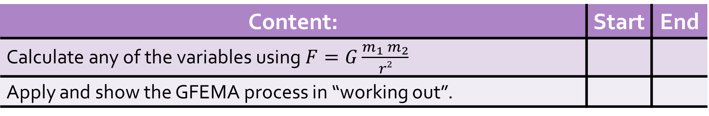
Learning Objectives
Content: | Start | End
Calculate any of the variables using $F=G\frac{m_{1} m_{2}}{r2}$
Apply and show the GFEMA process in “working out”.

Slide 6
Learning Objectives
Language: | Start | End
Explain, using algebra and GFEMA, “working out”.

Slide 7
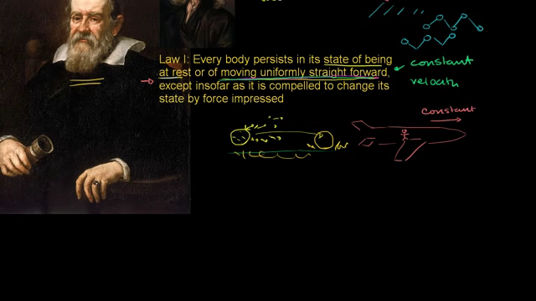
Newton’s Second Law

Slide 8
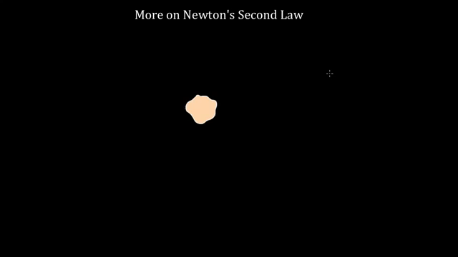
More on Newton’s Second Law

Slide 9
Newton's Second Law
The acceleration of an object as produced by a net force is directly proportional to the magnitude of the net force, in the same direction as the net force, and inversely proportional to the mass of the object.
F = ma
  F= Net Force
  m = mass
  a = acceleration
    http://www.physicsclassroom.com/class/newtlaws/Lesson-3/Newton-s-Second-Law

Slide 10
Newton's Law of Universal Gravitation
Newton's law of universal gravitation is about the universality of gravity.
Newton's place in the Gravity Hall of Fame is not due to his discovery of gravity, but rather due to his discovery that gravitation is universal.
  ALL objects attract each other with a force of gravitational attraction. Gravity is universal.

Slide 11
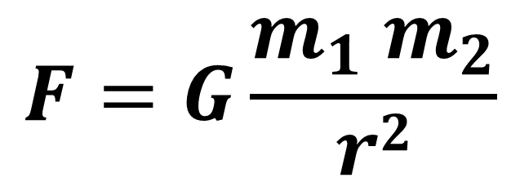
Newton's Law of Universal Gravitation
This force of gravitational attraction is directly dependent upon the masses of both objects and inversely proportional to the square of the distance that separates their centres.
$$F=G\frac{m_{1} m_{2}}{r2}$$
F = force applied on object 2 exerted by object 1
G = Gravitational Constant (6.673 x 10⁻¹¹ Nm²/kg²)
m₁ and m₂ = the masses of objects 1 and 2 respectively
r = distance between the object’s centres

Slide 12
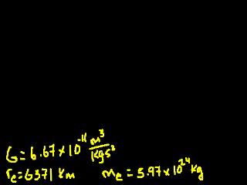
Newton's Law of Universal Gravitation
(Khan Academy) https://www.khanacademy.org/science/physics/centripetal-force-and-gravitation/gravity-newtonian/v/introduction-to-newton-s-law-of-gravitation

Slide 13
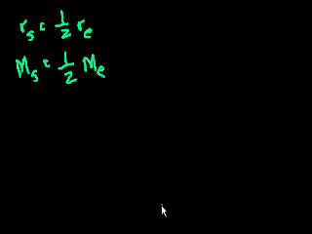
Newton's Law of Universal Gravitation
(Khan Academy) https://www.khanacademy.org/science/physics/centripetal-force-and-gravitation/gravity-newtonian/v/gravitation-part-2

Slide 14
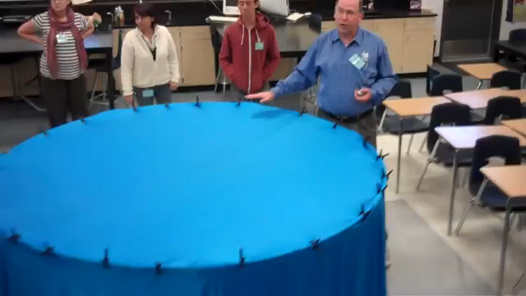
Newton's Law of Universal Gravitation
(apbiolghs - youtube) https://www.youtube.com/watch?v=MTY1Kje0yLg

Slide 15
How to properly use GFEMA:
G: givens – write down every value that the problem gives you with a symbol and units, separated by commas
F: find – write down the variable of the quantity you are looking for
E: equation – write down the equation you are going to use
  I highly recommend writing it in its standard format first and then rearranging, that way if you rearrange it wrong, the right equation is still there to get you credit
M: Math – substitute numbers here and solve.
    Show your working out (algebra and numbers). More work means more chances to find simple mistakes.
  A: Answer – the answer, with units
    AND if you know the answer is wrong, and have no idea why – this is where you should tell me that.
    Please note: you DID the whole problem. Even if you got a wrong answer, it’s all here.

Slide 16
Sample Problems and Solutions
http://www.physicsclassroom.com/class/circles/Lesson-3/Newton-s-Law-of-Universal-Gravitation
https://www.varsitytutors.com/ap_physics_1-help/universal-gravitation?page=2
https://www.easycalculation.com/physics/classical-physics/learn-newtons-law.php
https://hemantmore.org/physics-1/p11202003/3866/

Slide 17
Plenary
http://www.physicsclassroom.com/class/newtlaws/Lesson-3/Newton-s-Second-Law

Slide 18
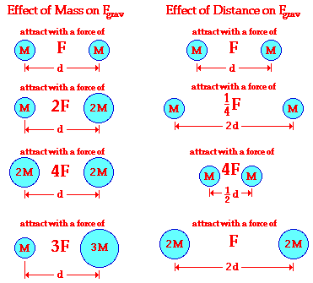
Plenary
?
?
?
?
?
?
http://www.physicsclassroom.com/class/circles/Lesson-3/Newton-s-Law-of-Universal-Gravitation

Slide 19
Plenary
http://www.physicsclassroom.com/class/circles/Lesson-3/Newton-s-Law-of-Universal-Gravitation

Slide 20
Plenary
Data required:
  G = 6.67 × 10⁻¹¹ N m² kg⁻²,
  mass of the Earth = 6.0 × 10²⁴ kg,
  radius of the Earth = 6.4 × 10⁶ m,
  mass of the Sun = 2.0 × 10³⁰ kg,
  average distance from the Earth to the Sun = 1.5 × 10¹¹ m.
Can you use standard form correctly on a scientific calculator.
Do you know how to use the EXP button?

Slide 21
Plenary
G = 6.67 × 10⁻¹¹ N m² kg⁻²,
mass of the Earth = 6.0 × 10²⁴ kg,
radius of the Earth = 6.4 × 10⁶ m,
mass of the Sun = 2.0 × 10³⁰ kg,
average distance from the Earth to the Sun = 1.5 × 10¹¹ m.
Communications satellites orbit the Earth at a height of 36 000 km. How far is this from the centre of the Earth? If such a satellite has a mass of 250 kg, what is the force of attraction on it from the Earth?

Slide 22
Plenary
G = 6.67 × 10⁻¹¹ N m² kg⁻²,
mass of the Earth = 6.0 × 10²⁴ kg,
radius of the Earth = 6.4 × 10⁶ m,
mass of the Sun = 2.0 × 10³⁰ kg,
average distance from the Earth to the Sun = 1.5 × 10¹¹ m.
It is (3.6 x 10⁷ m + 6.4 x 10⁶ m) = 4.2 x 10⁷ m from the centre of the Earth.
The force is F = Gm₁m₂/r² = (6.67 x 10⁻¹¹ x 6.0 x 10²⁴ x 250)/ (4.24 x 10⁷)².
  This gives an answer of about 56 N, which for information is about less than the weight as a one year old toddler.

Slide 23
Plenary
G = 6.67 × 10⁻¹¹ N m² kg⁻²,
mass of the Earth = 6.0 × 10²⁴ kg,
radius of the Earth = 6.4 × 10⁶ m,
mass of the Sun = 2.0 × 10³⁰ kg,
average distance from the Earth to the Sun = 1.5 × 10¹¹ m.
What is the force of attraction from the Earth on you? What do we call this force? What is the force of attraction on the Earth from you?

Slide 24
Plenary
G = 6.67 × 10⁻¹¹ N m² kg⁻²,
mass of the Earth = 6.0 × 10²⁴ kg,
radius of the Earth = 6.4 × 10⁶ m,
mass of the Sun = 2.0 × 10³⁰ kg,
average distance from the Earth to the Sun = 1.5 × 10¹¹ m.
You will need to estimate your own mass in kg.
Then use F=Gm₁m₂/r² where r is the radius of the Earth.
  This force is usually called your weight.
The force on the Earth from you is exactly the same as the first answer, but in the opposite direction.

Slide 25
Plenary
G = 6.67 × 10⁻¹¹ N m² kg⁻²,
mass of the Earth = 6.0 × 10²⁴ kg,
radius of the Earth = 6.4 × 10⁶ m,
mass of the Sun = 2.0 × 10³⁰ kg,
average distance from the Earth to the Sun = 1.5 × 10¹¹ m.
What is the force of attraction from the Sun on you? How many times smaller is this than the force of attraction from the Earth on you?

Slide 26
Plenary
G = 6.67 × 10⁻¹¹ N m² kg⁻²,
mass of the Earth = 6.0 × 10²⁴ kg,
radius of the Earth = 6.4 × 10⁶ m,
mass of the Sun = 2.0 × 10³⁰ kg,
average distance from the Earth to the Sun = 1.5 × 10¹¹ m.
Again, you will need to use your own mass, and the equation F=Gm₁m₂/r², but this time r is the average distance from the Sun to the Earth.
This force should be about 1650 times less than your weight, of the order of 0.3-0.5 N.
  Small, but not negligible.

Slide 27
Plenary
G = 6.67 × 10⁻¹¹ N m² kg⁻²,
mass of the Earth = 6.0 × 10²⁴ kg,
radius of the Earth = 6.4 × 10⁶ m,
mass of the Sun = 2.0 × 10³⁰ kg,
average distance from the Earth to the Sun = 1.5 × 10¹¹ m.
The average force of attraction on the Moon from the Sun is 4.4 × 10²⁰ N. Taking the distance from the Sun to the Moon to be about the same as that from the Sun to the Earth, what value of mass does this give for the Moon?

Slide 28
Plenary
G = 6.67 × 10⁻¹¹ N m² kg⁻²,
mass of the Earth = 6.0 × 10²⁴ kg,
radius of the Earth = 6.4 × 10⁶ m,
mass of the Sun = 2.0 × 10³⁰ kg,
average distance from the Earth to the Sun = 1.5 × 10¹¹ m.
m₂ = Fr²/Gm₁ = (4.4 x 10²⁰ x (1.5 x 10¹¹)²)/(6.67 x 10⁻¹¹ x 2.0 x 10³⁰) = 7.4 x 10²² kg

Slide 29
Plenary
G = 6.67 × 10⁻¹¹ N m² kg⁻²,
mass of the Earth = 6.0 × 10²⁴ kg,
radius of the Earth = 6.4 × 10⁶ m,
mass of the Sun = 2.0 × 10³⁰ kg,
average distance from the Earth to the Sun = 1.5 × 10¹¹ m.
Using the mass of the Moon you calculated in question 4, what is the pull of the Earth on the Moon, if the Moon is 380 000 km away? How does this compare with the pull of the Sun on the Moon?

Slide 30
Plenary
G = 6.67 × 10⁻¹¹ N m² kg⁻²,
mass of the Earth = 6.0 × 10²⁴ kg,
radius of the Earth = 6.4 × 10⁶ m,
mass of the Sun = 2.0 × 10³⁰ kg,
average distance from the Earth to the Sun = 1.5 × 10¹¹ m.
F = Gm₁m₂/r² = (6.67 x 10⁻¹¹ x 6.0 x 10²⁴ x 7.4 x 10²²)/ (3.8 x 10⁸)² = 2.1 x 10²⁰ N
  This is actually smaller than the pull of the Sun on the Moon. Does this mean the Moon is orbiting the Sun rather than the Earth?
    In fact, it depends on the most useful frame of reference in a particular situation – from the Sun’s point of view, the Moon and the Earth orbit the Sun, in a way that is affected by the presence of the other; from the Moon’s point of view, both the Sun and the Earth orbit the Moon, in a way that is affected by the presence of the other, etc.

Slide 31
Plenary
G = 6.67 × 10⁻¹¹ N m² kg⁻²,
mass of the Earth = 6.0 × 10²⁴ kg,
radius of the Earth = 6.4 × 10⁶ m,
mass of the Sun = 2.0 × 10³⁰ kg,
average distance from the Earth to the Sun = 1.5 × 10¹¹ m.
What is the force of attraction between two people, one of mass 80 kg and the other 100 kg if they are 0.5m apart?

Slide 32
Plenary
G = 6.67 × 10⁻¹¹ N m² kg⁻²,
mass of the Earth = 6.0 × 10²⁴ kg,
radius of the Earth = 6.4 × 10⁶ m,
mass of the Sun = 2.0 × 10³⁰ kg,
average distance from the Earth to the Sun = 1.5 × 10¹¹ m.
F = Gm₁m₂/r²
F = G x 100 x 80 / 0.5² = 2.14 x 10⁻⁶ N.
  This is a very small force but it does increase as the people get closer together!
    Actually this example is not accurate because Newton's law really only applies to spherical objects, or at least objects so far apart that they can be effectively considered as spherical.

Slide 33
Plenary
G = 6.67 × 10⁻¹¹ N m² kg⁻²,
mass of the Earth = 6.0 × 10²⁴ kg,
radius of the Earth = 6.4 × 10⁶ m,
mass of the Sun = 2.0 × 10³⁰ kg,
average distance from the Earth to the Sun = 1.5 × 10¹¹ m.
What is the force of attraction between the Earth and the Sun?

Slide 34
Plenary
G = 6.67 × 10⁻¹¹ N m² kg⁻²,
mass of the Earth = 6.0 × 10²⁴ kg,
radius of the Earth = 6.4 × 10⁶ m,
mass of the Sun = 2.0 × 10³⁰ kg,
average distance from the Earth to the Sun = 1.5 × 10¹¹ m.
F = Gm₁m₂/r²
F = G x 2 x 10³⁰ x 6 x 10²⁴/ [1.5 x 10¹¹]² = 6.7 x 10¹¹ N
  an enormous force!

