Slide 1
Review of Previous Lesson
State as many Vocabulary words and Learning Objectives that you remember from the last lesson as you can.
Now complete the content learning objectives.
Remember to grade yourself from 0 – 3.

Slide 2
Net Force
Resultant

Slide 3
Vocabulary
Content: | Start | End
net
force
axis
vector addition
parallel

Slide 4
Vocabulary
Language: | Start | End
define
calculate
resulting
recognize

Slide 5
Learning Objectives
Grade 7:
Content: | Start | End
Calculate net force given multiple parallel forces.
Identify and calculate acceleration of a system with multiple parallel forces acting.
Grade 8:
Content: | Start | End
Define and calculate the net force on an object along one axis.
Calculate the net force, including direction, resulting from forces along two axes using vector addition.

Slide 6
Learning Objectives
Language: | Start | End
Define verbally and in writing.

Slide 7
How to find the resultant force acting on an object:
(phyley) http://www.phyley.com/find-resultant-force
http://www.phyley.com/find-resultant-force

Slide 8
Problems and Solutions:
1D:
  https://www.introduction-to-physics.com/net-force-word-problems.html
  http://formulas.tutorvista.com/physics/net-force-formula.html
  http://www.physicsclassroom.com/Concept-Builders/Newtons-Laws/Balanced-Unbalanced-Forces/Interactive
  http://highered.mheducation.com/sites/0072509775/student_view0/chapter4/practice_problems.html
2D:
  http://www.physicsclassroom.com/class/newtlaws/Lesson-2/Determining-the-Net-Force
  http://www.physicsclassroom.com/class/vectors/Lesson-3/Resolution-of-Forces
  http://www.physicsclassroom.com/class/vectors/Lesson-3/Net-Force-Problems-Revisited

Slide 9
Plenary:
What can you say about the motion of a body that is in static equilibrium?
What can you say about the motion of a body that is in dynamic equilibrium?

Slide 10
Plenary:
What can you say about the motion of a moving body that is in static equilibrium?
  Velocity = 0 m/s (not moving).
What can you say about the motion of a moving body that is in dynamic equilibrium?
  It is moving with constant velocity.
  Acceleration = 0 m/s² (it is not accelerating).

Slide 11
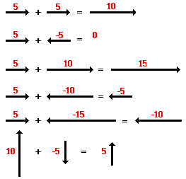
Resultant Force
http://www.physicsclassroom.com/class/newtlaws/Lesson-2/Determining-the-Net-Force
?
?
?
?
?
?

Slide 12
Resultant Force
http://www.physicsclassroom.com/class/newtlaws/Lesson-2/Determining-the-Net-Force

Slide 13
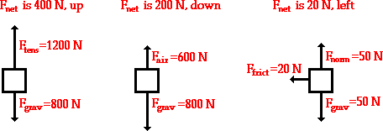
Resultant Force
http://www.physicsclassroom.com/class/newtlaws/Lesson-2/Determining-the-Net-Force
?
?
?

Slide 14
Resultant Force
http://www.physicsclassroom.com/class/newtlaws/Lesson-2/Determining-the-Net-Force

