Slide 1
Review of Previous Lesson
State as many Vocabulary words and Learning Objectives that you remember from the last lesson as you can.
Now complete the content learning objectives.
Remember to grade yourself from 0 – 3.

Slide 2
Mass

Slide 3
Vocabulary
Content: | Start | End
inertia
gravitational
mass
gravitation

Slide 4
Vocabulary
Language: | Start | End
define

Slide 5
Learning Objectives
Grade 7
Content: | Start | End
Discuss the difference between acceleration due to gravity and the force due to gravity.
Calculate Fg given mass.
Rearrange to calculate mass given Fg.
Grade 8
Content: | Start | End
Define inertial mass.
Define gravitational mass.
Explain the difference between inertial and gravitational mass.

Slide 6
Learning Objectives
Language: | Start | End
Verbally define.
Use equations to define in writing.

Slide 7

Inertial Mass
(Bozeman Science - youtube) https://www.youtube.com/watch?v=6zEMEuvBuXQ&t=170s
  F = ma

Slide 8
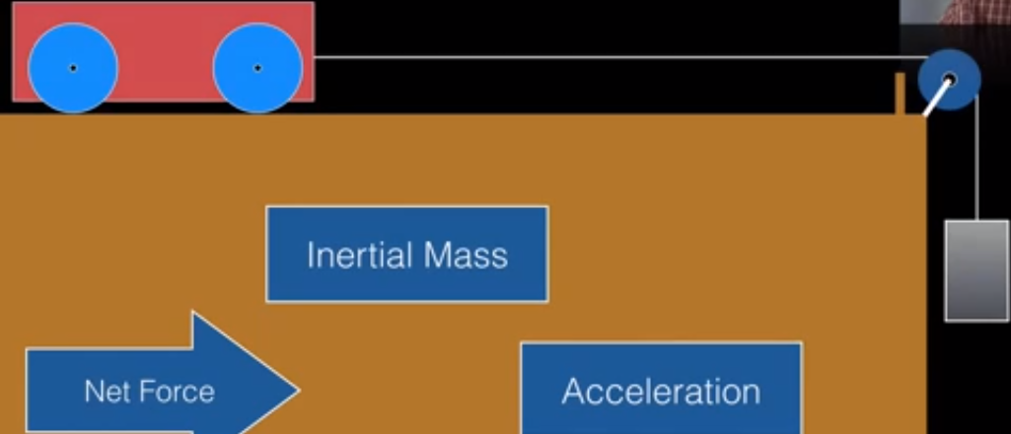
Inertial Mass – Prelab
Determine the inertial mass of an object.
List the experimental Variables:
Create a table to record the data you think you will need.

Slide 9
Inertial Mass - Prelab
Variables:
  Independent
  Dependent
  Control

Slide 10
Inertial Mass - Prelab
Variables:
  Independent
    Inertial Mass
  Dependent
    Acceleration
  Control
    Net Force

Slide 11
Inertial Mass - Experiment
Inertial Mass (kg) | Acceleration (m/s²)

Slide 12
Inertial Mass - Experiment
Perform the experiment and calculate the masses.

Slide 13

Gravitational Mass
(Bozeman Science - youtube) https://www.youtube.com/watch?v=4LnFqUWthOU&t=4s
$$F=G\frac{m_{1} m_{2}}{r2}$$

Slide 14
Difference between weight and mass?
Mass:
  A measure of how much matter (kg) an object has.
  Does not change when an object's location changes.
Weight:
  A measure of the gravitational force (Newtons – N) acting on an object.
  Changes with location.
    https://www.nyu.edu/pages/mathmol/textbook/weightvmass.html
    http://www.physicsclassroom.com/class/newtlaws/Lesson-2/Types-of-Forces
W = mg or F_{grav} = mg
  W = weight, F_{grav} = Force of gravity = Weight
  m = mass
  g = acceleration of gravity
    Where does this equation come from?
      F = ma (Newton’s Second Law)

Slide 15
Problems and Solutions:
Inertial & Gravitational Mass:
  http://www.ducksters.com/science/quiz/mass_and_weight_questions.php
  https://quizizz.com/admin/quiz/584504ba5ce8f9933dd93238
Weight vs Mass:
  Invent your questions regarding your weight on other planets using the following links:
    http://www.physicsclassroom.com/class/circles/Lesson-3/The-Value-of-g
    https://www.nyu.edu/pages/mathmol/textbook/weightvmass.html
    http://www.rapidtables.com/convert/weight/kg-to-pound.htm
  http://en.mcqslearn.com/o-level/physics/mcq/mass-weight-density.php?page=5
  https://www.proprofs.com/quiz-school/story.php?title=force-weight-mass
  https://quizizz.com/admin/quiz/54ef1aff1e246ab31e491b0a
  https://reviewgamezone.com/mc/candidate/test/?test_id=23043&title=Mass%20Vs%20Weight
  http://en.mcqlearn.com/science/g6/measuring-mass-mcqs.php
  https://www.thatquiz.org/tq/previewtest?Y/J/R/C/50721317644863

Slide 16
Plenary
Define inertial and gravitational mass.

Slide 17
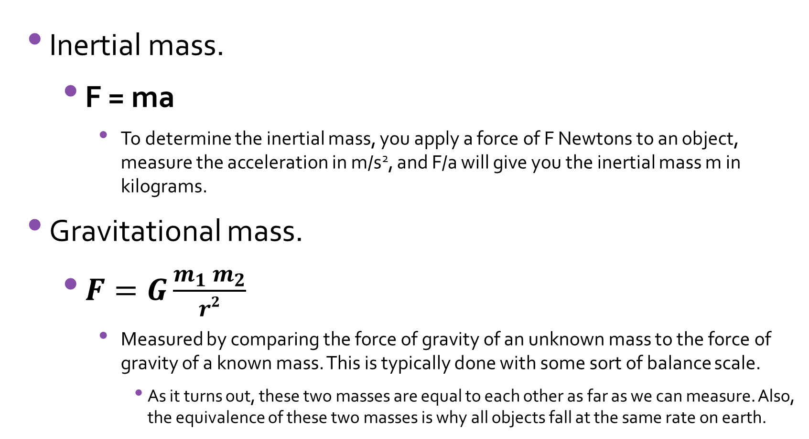
Plenary
Inertial mass.
  F = ma
    To determine the inertial mass, you apply a force of F Newtons to an object, measure the acceleration in m/s², and F/a will give you the inertial mass m in kilograms.
Gravitational mass.
  $F=G\frac{m_{1} m_{2}}{r2}$
    Measured by comparing the force of gravity of an unknown mass to the force of gravity of a known mass. This is typically done with some sort of balance scale.
      As it turns out, these two masses are equal to each other as far as we can measure. Also, the equivalence of these two masses is why all objects fall at the same rate on earth.

