Slide 1
Review of Previous Lesson
State as many Vocabulary words and Learning Objectives that you remember from the last lesson as you can.
Now complete the content learning objectives.
Remember to grade yourself from 0 – 3.

Slide 2
Friction

Slide 3
Vocabulary
Content: | Start | End
force
friction
horizontal
motion
mass

Slide 4
Vocabulary
Language: | Start | End
calculate
define
identify
distinguish
draw
calculate
determine
centre/center
square/dot

Slide 5
Learning Objectives
Content: | Start | End
Calculate frictional force given mass for horizontal motion.

Slide 6
Learning Objectives
Language: | Start | End
Calculate and determine.

Slide 7

Two kinds of coefficient of friction:
1. Static Friction
2. Kinetic Friction

Slide 8

Two kinds of coefficient of friction:
1. Static Friction
2. Kinetic Friction

Slide 9
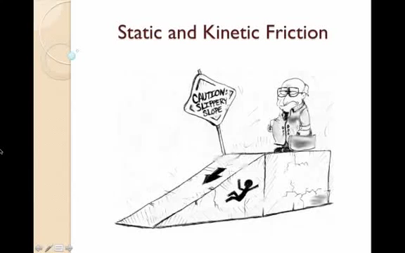
Friction Equations

Slide 10
Friction Equation
F_{f} = μF_{N}
  F_{f} is the resistive force of friction
  μ is the coefficient of friction for the two surfaces (Greek letter "mu")
  N is the normal or perpendicular force pushing the two objects together
  μN is μ times N

Slide 11
How do you calculate coefficient of friction?
To calculate the coefficient of static friction between two materials:
  Place an object made of one material on a surface made of the other material.
  Slowly incline the surface and measure the angle of elevation, θ_{c}, when the object first begins to break free and slide down the surface.
  The inverse tangent of that "critical angle" will be the coefficient of static friction.
    tan⁻¹(θ_{c})=μ_{s}

Slide 12
How do you calculate coefficient of friction?
To calculate the coefficient of kinetic friction between two materials:
  Steps 1 & 2 on the last slide to measure the static friction.
  Now lower the angle slightly and measure this slightly smaller angle of elevation θ_{sc}, when giving the object a very slight push causes it to slide down the plane at constant velocity.
  The inverse tangent of that slightly smaller angle is the coefficient of kinetic friction.
    tan⁻¹(θ_{sc})=μ_{k}

Slide 13
Problems and Solutions:
https://www.khanacademy.org/science/physics/forces-newtons-laws/inclined-planes-friction/a/what-is-friction
http://www.softschools.com/formulas/physics/static_friction_formula/30/
https://sciencenotes.org/friction-example-problem-physics-homework-help/
https://www.varsitytutors.com/ap_physics_1-help/force-of-friction
http://formulas.tutorvista.com/physics/friction-formula.html
http://www.physicslessons.com/quiz/quiz4.html
http://www.bbc.co.uk/bitesize/quiz/q83969509
http://www.ducksters.com/science/quiz/friction_questions.php
https://quizizz.com/admin/quiz/57f55f7698fce5f703cc6dd2

