Slide 1
Review of Previous Lesson
State as many Vocabulary words and Learning Objectives that you remember from the last lesson as you can.
Now complete the content learning objectives.
Remember to grade yourself from 0 – 3.

Slide 2
Equilibrium
Static & Dynamic

Slide 3
Vocabulary
Content: | Start | End
equilibrium
static
dynamic
acceleration

Slide 4
Vocabulary
Language: | Start | End
define
distinguish
explain
recognize

Slide 5
Learning Objectives
Content: | Start | End
Define equilibrium, static equilibrium and dynamic equilibrium.
Distinguish between static and dynamic equilibrium.
Recognize that an object in equilibrium has a zero acceleration.

Slide 6
Learning Objectives
Language: | Start | End
Define, distinguish and recognise verbally and in writing.

Slide 7
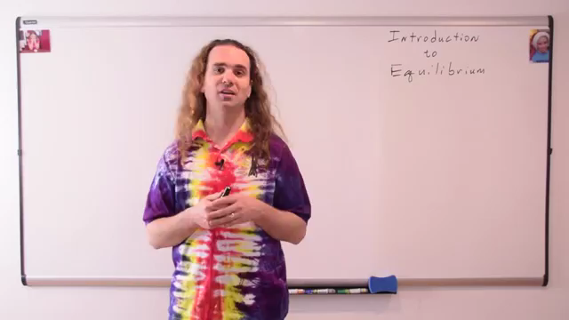
Introduction to Equilibrium:
(Flipping Physics) https://www.youtube.com/watch?v=KJ6Zg9NiDas

Slide 8
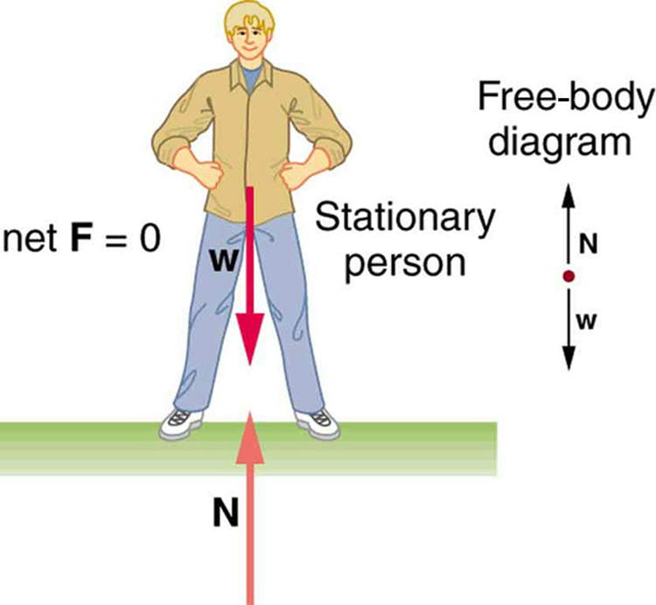
Equilibrium
Static Equilibrium:

Slide 9
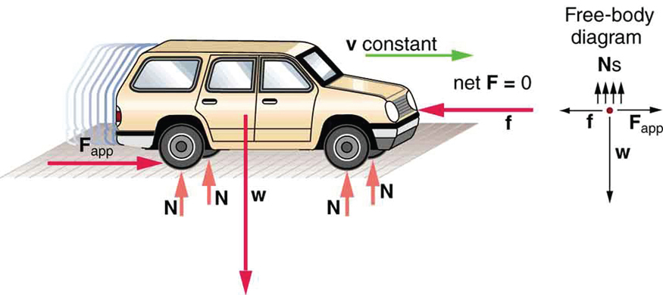
Equilibrium
Dynamic Equilibrium:

Slide 10
Equilibrium - What is it?
If an object is not accelerating, it is in equilibrium.
  Equilibrium is often considered as two separate cases:
    Static Equilibrium - An object is at rest and not accelerating.
    Dynamic Equilibrium - An object is moving (relative to us) and not accelerating.
http://www.batesville.k12.in.us/physics/PhyNet/Mechanics/Newton1/Statics.html

Slide 11
Plenary:
What can you say about the motion of a body that is in static equilibrium?
What can you say about the motion of a body that is in dynamic equilibrium?

Slide 12
Plenary:
What can you say about the motion of a moving body that is in static equilibrium?
  Velocity = 0 m/s (not moving).
What can you say about the motion of a moving body that is in dynamic equilibrium?
  It is moving with constant velocity.
  Acceleration = 0 m/s² (it is not accelerating).

