Slide 1
Review of Previous Lesson
State as many Vocabulary words and Learning Objectives that you remember from the last lesson as you can.
Now complete the content learning objectives.
Remember to grade yourself from 0 – 3.

Slide 2
Work, Force & Displacement
Grade 7
Work Done & Work Energy Theorem
Grade 8

Slide 3
Vocabulary
Content: | Start | End
Work Done
base units
equation/relationship
energy
Joule
rearrange
scenario
force

Slide 4
Vocabulary
Language: | Start | End
state
identify
explain
definition
equation/relationship
rearrange
calculate
derive
various
scenarios
definition

Slide 5
Learning Objectives
Grade 7
Content: | Start | End
State the definition of Work.
Identify the conditions for work to be done.
Explain work needed to lift an object.
State the equation/relationship for Work Done and rearrange to solve for force or displacement.
Derive base units of a Joule.
Calculate Work Done in various scenarios.

Slide 6
Learning Objectives
Grade 8
Content: | Start | End
State the definition of Work.
Use the full equation for work (W=Fd cos(θ)) and be able to describe the effect of the directions of the forces on the work done on an object.
State the work energy theorem.
Use the work energy theorem to calculate the energy change on a system given an amount of work done.

Slide 7
Learning Objectives
Language: | Start | End
Define, identify and state verbally and in writing.
Calculate in writing.

Slide 8
State the definition of Work.
When a force acts upon an object to cause a displacement of the object, it is said that work was done upon the object.
  http://www.physicsclassroom.com/Class/energy/u5l1a.cfm

Slide 9
Identify the conditions for work to be done.
In order for a force to qualify as having done work on an object, there must be a displacement and the force must cause the displacement.
  http://www.physicsclassroom.com/Class/energy/u5l1a.cfm

Slide 10
Identify the conditions for work to be done.
Read the following five statements and determine whether or not they represent examples of work.
Then click on the See Answer button to view the answer.
  http://www.physicsclassroom.com/Class/energy/u5l1a.cfm

Slide 11
State the equation/relationship for Work Done.
Grade 7:
  W = Fd
Grade 8:
  W = Fdcosθ
    W = Work Done (J)
    F = Force (N)
    d = displacement (in the direction of the force)
    Θ = angle between the force and the displacement vector

Slide 12

State the equation/relationship for Work Done and rearrange to solve for force or displacement.
Calculate Work Done in various scenarios.
https://www.youtube.com/watch?v=JHEmPZ-YnrU

Slide 13

Explain work needed to lift an object.
Calculate Work Done in various scenarios.
https://www.youtube.com/watch?v=MXtt4C543-8

Slide 14

Grade 8
Work and the work-energy principle (Khan Academy) https://www.khanacademy.org/science/physics/work-and-energy/work-and-energy-tutorial/v/work-and-the-work-energy-principle

Slide 15
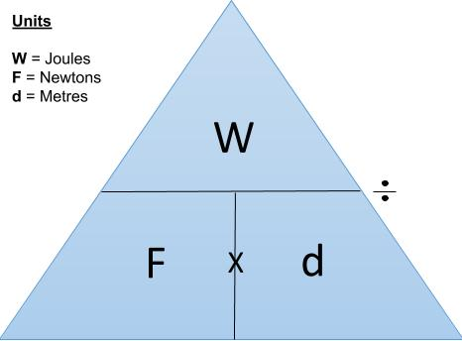
Work Done
Grade 7
W = Fd
  W = Work Done [Joules (J) or Nm]
  F = force (N)
  d (sometimes s) = displacement in the direction of the force (m)
http://physics.fisikastudycenter.com/junior-high-school-physics/82-10-common-problems-of-work-and-power-junior-physics
http://www.sparknotes.com/physics/workenergypower/review/quiz.html

Slide 16
Work Done
Grade 8
W=Fd cos(θ)
  W = Work Done [Joules (J) or Nm]
  F = force (N)
  d (sometimes s) = displacement in the direction of the force (m)
  θ = the angle between the force and the displacement vectors
http://www.physicsclassroom.com/class/energy/Lesson-1/Calculating-the-Amount-of-Work-Done-by-Forces

Slide 17
Derive base units of a Joule.
One Joule is equivalent to one Newton of force causing a displacement of one meter. In other words,
The Joule (J) is the unit of work.
  W = Fd
  1 Joule = 1 Newton * 1 metre
  1 J = 1 N * m

Slide 18
Problems and Solutions (Grade 7):
http://physics.fisikastudycenter.com/junior-high-school-physics/82-10-common-problems-of-work-and-power-junior-physics
http://www.softschools.com/quizzes/science/work/quiz1692.html
http://www.softschools.com/quizzes/science/work_and_energy/quiz880.html
https://www.thatquiz.org/tq/previewtest?Z/N/P/W/76751351185623
http://www.sparknotes.com/physics/workenergypower/review/quiz.html
https://www.goconqr.com/p/451062-work--energy---power--quiz-quizzes

Slide 19
Problems and Solutions (Grade 8):
http://www.physicsclassroom.com/class/energy/Lesson-2/Application-and-Practice-Questions
http://gauss.vaniercollege.qc.ca/pwiki/index.php/Exercises_on_Work-Energy_Theorem
http://theory.uwinnipeg.ca/physics/work/node12.html
https://www.clutchprep.com/physics/net-work-kinetic-energy
https://www.clutchprep.com/physics/more-work-energy-problems
http://www.sparknotes.com/physics/workenergypower/workpower/problems_1.html

