Slide 1
Review of Previous Lesson
State as many Vocabulary words and Learning Objectives that you remember from the last lesson as you can.
Now complete the content learning objectives.
Remember to grade yourself from 0 – 3.

Slide 2
Spring Potential Energy

Slide 3
Vocabulary
Content: | Start | End
potential
energy
spring
elastic

Slide 4
Vocabulary
Language: | Start | End
define
calculate
determine
situation

Slide 5
Learning Objectives
Content: | Start | End
Define spring (elastic) potential energy and calculate it.
Determine in a given situation whether an object has a spring (elastic) potential energy or not.

Slide 6
Learning Objectives
Language: | Start | End
Define, calculate and determine verbally and in writing.

Slide 7
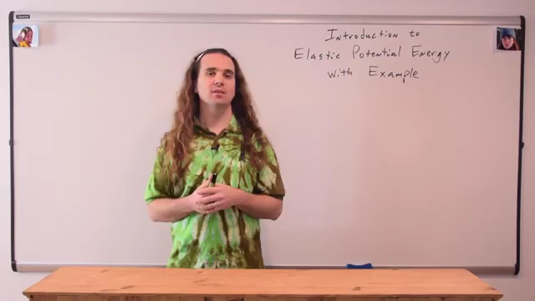
Introduction to Elastic Potential Energy with Examples
Flipping Physics https://www.youtube.com/watch?v=7ZnpsCV2GSY

Slide 8
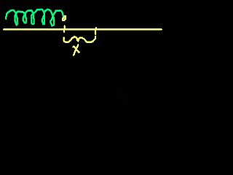
Potential energy stored in a spring
Khan Academy https://www.khanacademy.org/science/physics/work-and-energy/hookes-law/v/potential-energy-stored-in-a-spring

Slide 9
Problems and Solutions:
http://www.batesville.k12.in.us/physics/phynet/mechanics/energy/elastic_pe.htm
http://formulas.tutorvista.com/physics/elastic-potential-energy-formula.html
http://electron6.phys.utk.edu/101/CH3/elastic_potential_energy.htm
http://www.physics247.com/physics-homework-help/elastic-potential.php
http://formulas.mathcaptain.com/physics/elastic-potential-energy-formula.html
http://www.softschools.com/formulas/physics/potential_energy_elastic_formula/31/

