Slide 1
Review of Previous Lesson
State as many Vocabulary words and Learning Objectives that you remember from the last lesson as you can.
Now complete the content learning objectives.
Remember to grade yourself from 0 – 3.

Slide 2
Mechanical Energy
&
Conservation of Energy

Slide 3
Vocabulary
Content: | Start | End
energy
mechanical
potential
isolated/closed
conservation of energy
Joule

Slide 4
Vocabulary
Language: | Start | End
define
identify
state
recognise
transformations
rearrange
calculate
derive
various
scenarios
definition

Slide 5
Learning Objectives
Content: | Start | End
Define mechanical energy and identify potential and kinetic energy as types of mechanical energy.
State the conservation of energy law and apply it to isolated systems.
Recognise transformations of energy from one type to another and be able to state what types of energy are being transformed.
State when the law of conservation of energy does not apply.

Slide 6
Learning Objectives
Language: | Start | End
Define, identify and recognise verbally and in writing.

Slide 7
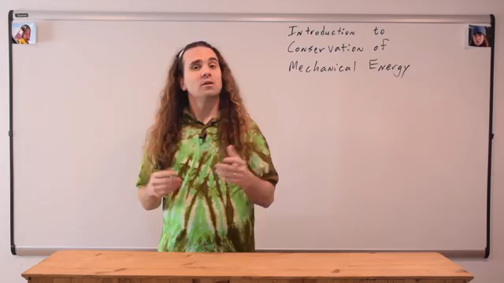
Introduction to Conservation of Mechanical Energy with Demonstrations
Flipping Physics https://www.youtube.com/watch?v=AnuLW0ZX7-Q

Slide 8

Conservation of energy
Khan Academy https://www.khanacademy.org/science/physics/work-and-energy/work-and-energy-tutorial/v/conservation-of-energy

Slide 9
Problems and Solutions:
Mechanical Energy:
  http://www.dummies.com/education/science/physics/mechanical-energy-in-physics-problems/
  http://formulas.tutorvista.com/physics/mechanical-energy-formula.html
  https://byjus.com/mechanical-energy-formula
Conservation of Energy:
  http://www.physicsclassroom.com/class/energy/Lesson-2/Application-and-Practice-Questions
  http://www.physicstutorials.org/home/energy-work-power/conservation-of-energy
  https://assignment.essayshark.com/blog/law-of-conservation-of-energy-problems-with-solutions/
  http://www.sparknotes.com/physics/workenergypower/conservationofenergy/problems_1.html
  https://www.sophia.org/concepts/the-law-of-conservation-of-energy

