Slide 1
Review of Previous Lesson
State as many Vocabulary words and Learning Objectives that you remember from the last lesson as you can.
Now complete the content learning objectives.
Remember to grade yourself from 0 – 3.

Slide 2
Light

Slide 3
Learning Objectives
Content: | Start | End
Review light as an electromagnetic wave.
Define: transparent and opaque, as well as absorption.

Slide 4

Electromagnetic Waves
(Bozeman Science) https://www.youtube.com/watch?v=WNkB8IY-k04
Dora noticed that the first time the electromagnetic spectrum is shown in the video, the order is incorrect. In decreasing frequency it should be: Gamma Rays, X-Rays, Ultraviolet, Visible light, Infrared, Microwaves, Radio waves.

Slide 5
Raging Martians Invaded Venus Using X-ray Guns
The electromagnetic spectrum, in terms of increasing frequency is:
  Radio waves, Microwaves, Infrared, Visible light, Ultraviolet, X-Rays, Gamma Rays

Slide 6
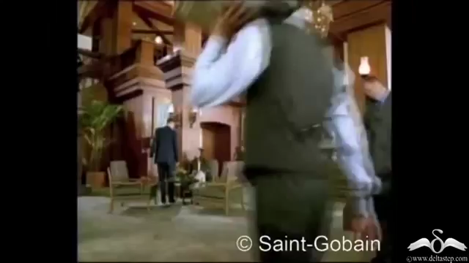
Transparent, Translucent & Opaque objects
(DeltaStep) https://www.youtube.com/watch?v=lLawYGDSyDs

Slide 7

Why Are Some Things Transparent?
(The Science Asylum) https://www.youtube.com/watch?v=wDu0KMdDD1I
Recommended

Slide 8

ROY G BIV
http://www.physicsclassroom.com/Class/light/u12l2a.cfm#p3
Dispersion of visible light produces the colours red (R), orange (O), yellow (Y), green (G), blue (B), and violet (V).
It is because of this that visible light is sometimes referred to as ROY G. BIV.
  (Incidentally, the indigo is not actually observed in the spectrum but is traditionally added to the list so that there is a vowel in Roy's last name.)

Slide 9
Light Absorption, Reflection, and Transmission
(Bozeman Science) https://www.youtube.com/watch?v=DOsro2kGjGc

Slide 10
Plenary:
Electromagnetic Waves:
  http://www.physicsclassroom.com/Class/light/u12l2a.cfm
  http://www.ducksters.com/science/quiz/types_of_electromagnetic_waves_questions.php
  https://www.proprofs.com/quiz-school/story.php?title=electromagnetic-spectrum-quiz
  https://quizizz.com/admin/quiz/5730e5caa1c4f029abdf5a6f
  https://quizizz.com/admin/quiz/570bcef93469f3622b5b54fc

Slide 11
Plenary:
Transparent, Translucent & Opaque:
  http://www.physicsclassroom.com/class/light/Lesson-2/Light-Absorption,-Reflection,-and-Transmission
  https://quizizz.com/admin/quiz/56d7a06540a317331954de2f
  https://quizizz.com/admin/quiz/5817f6ce189d6d936e49dc32
  https://www.quia.com/quiz/2839429.html?AP_rand=1172757297
  https://www.thatquiz.org/tq/previewtest?GPHR5554
  https://www.quiz.biz/quizz-921047.html

