Slide 1
Review of Previous Lesson
State as many Vocabulary words and Learning Objectives that you remember from the last lesson as you can.
Now complete the content learning objectives.
Remember to grade yourself from 0 – 3.

Slide 2
Law of Reflection
&
Mirrors
Light

Slide 3
Learning Objectives
Content: | Start | End
Define the normal.
Produce ray diagrams for plane mirrors and curved mirrors (concave and convex).
Define focal length, focal point, principle axis, and image.
Determine whether an image will be magnified or inverted based on the location of the object.
  The distinctions between real and virtual images will not be covered on the common.

Slide 4
Language Learning Objectives
Content: | Start | End
Define verbally and in writing.
Draw diagrams.
Determine.

Slide 5
What is the relationship between the angle of incidence and the angle of reflection?

Slide 6
What is the relationship between the angle of incidence and the angle of reflection?
angle of incidence (º) | angle of reflection (º)
Independent Variable:
  angle of incidence
Dependent Variable:
  angle of reflection
Control Variables:
  light ray, shape of mirror, environmental conditions

Slide 7

Ray Diagrams - Mirrors
(Bozeman Science) https://www.youtube.com/watch?v=WNkB8IY-k04

Slide 8
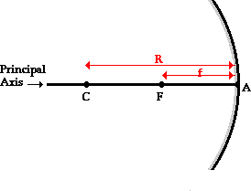
The Anatomy of a Curved Mirror
F = the distance from the mirror to the focal point is known as the focal length. Since the focal point is the midpoint of the line segment adjoining the vertex and the centre of curvature, the focal length would be one-half the radius of curvature.
R = The distance from the vertex to the centre of curvature is known as the radius of curvature. The radius of curvature is the radius of the sphere from which the mirror was cut.
If a concave mirror were thought of as being a slice of a sphere, then there would be a line passing through the centre of the sphere and attaching to the mirror in the exact centre of the mirror. This line is known as the principal axis.
A = The point on the mirror's surface where the principal axis meets the mirror is known as the vertex.
C = The point in the centre of the sphere from which the mirror was sliced is known as the centre of curvature.
F = Midway between the vertex and the centre of curvature is a point known as the focal point.
http://www.physicsclassroom.com/class/refln/Lesson-3/The-Anatomy-of-a-Curved-Mirror

Slide 9
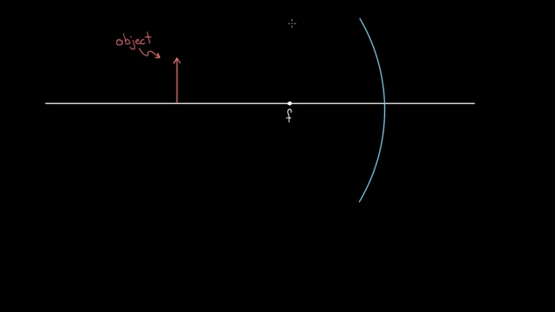
Derivation of the mirror equation
(Khan Academy) https://www.youtube.com/watch?v=OIkD1viOMWk
Recommended

Slide 10
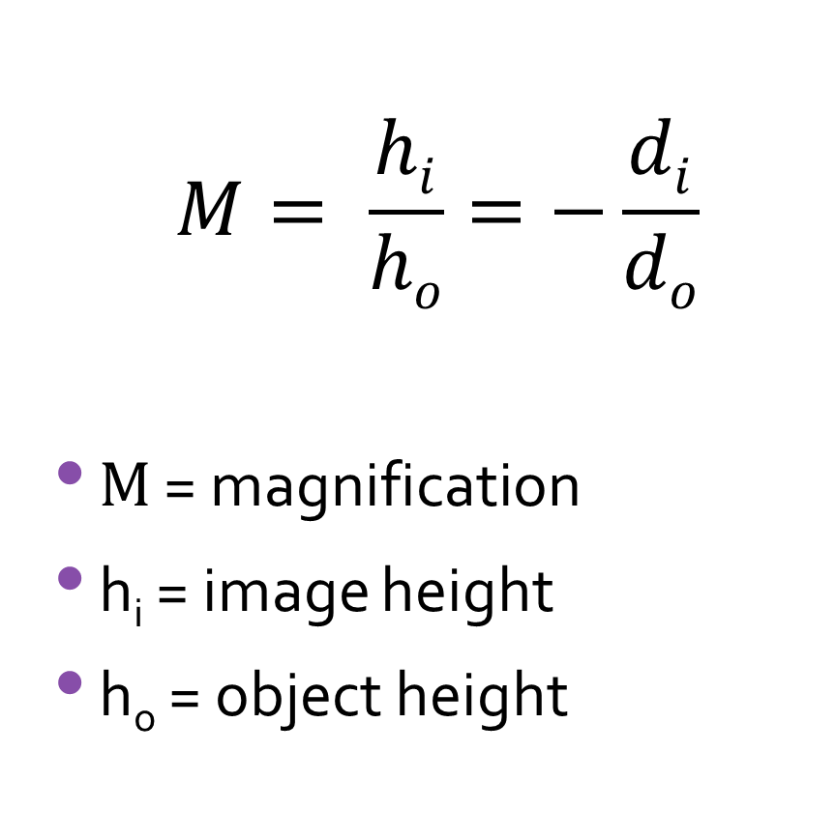
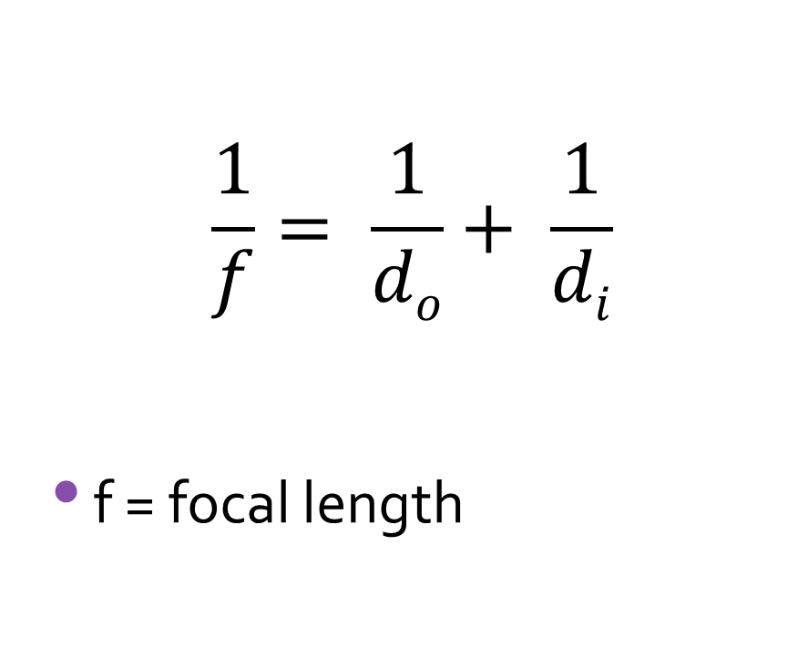
Mirror Equation
Magnification Equation
$$\frac{1}{f}= \frac{1}{do}+ \frac{1}{di}$$
f = focal length
$$M= \frac{hi}{ho}=−\frac{di}{do}$$
$M$ = magnification
h_{i} = image height
h_{o} = object height
d_{o} = object distance
d_{i} = image distance

Slide 11
Mirror equation example problems
(Khan Academy) https://www.youtube.com/watch?v=4VfDXitHaH8
Recommended

Slide 12
Mirror Equation Vs Ray Diagrams
The mirror equation is actually only an approximation as the mirror equation angles (see derivation) relates to a straight line through the mirror.
  However, an actual concave or convex mirror is curved.
There are a few “cheats” to get a ray diagram to come up with the same information as the mirror equation.

Slide 13
“Cheats” to get a ray diagram to come up with the same information as the mirror equation
Focus in on the “middle” part of the mirror and “pretend” it is almost a straight line.
If you can draw your own mirror make it curve very gently so that the “middle” part of the mirror is as straight as possible.
Reduce the scale and use squared paper to help make the ray diagram as accurate as possible.
If you are not given an object or image size, use a small object or image so that the rays only hit “middle” part of the mirror.
Note: the more curve a mirror has, the more a ray diagram will differ from the mirror equation.

Slide 14
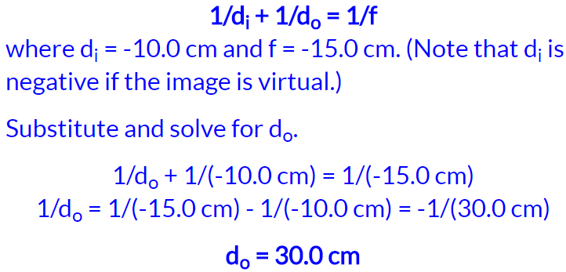
d_{i} = 10 cm
f
c
f = 15 cm
scale: 1 square = 5 cm * 5 cm

Slide 15
c
f

Slide 16
c
f

Slide 17
c
f

Slide 18
c
f

Slide 19
c
f

Slide 20
c
f

Slide 21
Sim Bucket Simulation
https://simbucket.com/lensesandmirrors/

Slide 22
LOST
Describes an image:
  Location (relative to focal point f or centre of curvature c)
  Orientation (upright or inverted)
  Size (relative - larger or smaller than object)
  Type (real or virtual)

Slide 23
https://simbucket.com/lensesandmirrors/
f = focal point, C = centre of curvature
Mirror Type | Object Location | L | O | S | T
Concave | > C
 | C
 | C -> f
 | f
 | f -> mirror
Convex | anywhere
What can you say about all virtual images?
Can Convex mirrors produce a magnified image?
When can a concave mirror produce a magnified image?
  Location (relative to focal point f or centre of curvature C)
  Orientation (upright or inverted)
  Size (relative - larger or smaller than object – reduced/magnified/same size)
  Type (real or virtual)

Slide 24
https://simbucket.com/lensesandmirrors/
f = focal point, C = centre of curvature
Mirror Type | Object Location | L | O | S | T
Concave | > C | C -> f | upright | reduced | real
 | C | C | inverted | same size | real
 | C -> f | > C | inverted | magnified | real
 | f | no image / blurry (parallel lines)
 | f -> mirror | opposite side of mirror | upright | magnified | virtual
Convex | anywhere | opposite side of mirror | upright | reduced | virtual
All virtual images are upright!
A convex mirror cannot produce an image that is larger than the object!
A concave mirror produces an image larger than the object only when the object is between the mirror and twice the focal length (C).
Draw ray diagrams for each of the situations above.

Slide 25
Plenary:
http://www.physicsclassroom.com/class/refln/Lesson-3/The-Anatomy-of-a-Curved-Mirror
http://www.physicsclassroom.com/reviews/Reflection-and-Mirrors/Reflection-and-Mirrors-Review-Printable-Version
https://quizizz.com/admin/quiz/58778657fa340e5102614912
https://sciencesource2.pearsoncanada.ca/resources/hotpotato_quiz_10_11_1.htm

