Slide 1
Review of Previous Lesson
State as many Vocabulary words and Learning Objectives that you remember from the last lesson as you can.
Now complete the content learning objectives.
Remember to grade yourself from 0 – 3.

Slide 2
Electric Circuits

Slide 3
Learning Objectives
Content: | Start | End
Construct a circuit diagram including the symbols for batteries, bulbs, resistors, and switches to represent a real circuit.
Define resistance and voltage.
Explain how resistance is related to thickness or length of a wire.
Differentiate total resistance from the individual resistance of each component.

Slide 4
Learning Objectives
Content: | Start | End
Calculate equivalent resistances in series and in parallel and use them to analyse a circuit.
State Ohm's law and use it to calculate any quantity.
Calculate using Ohm's law both for a total circuit and for each individual component.
Distinguish between a series and parallel circuit.
Apply Ohm's law to any series circuit and simple parallel circuits.
Describe the behaviour of current and voltage drop around each.
Construct a VIR chart from a circuit diagram.
  Note: make students aware that series and parallel, despite common usage, refer to the arrangement of components within the circuit, and that you can have a complete circuit that is neither series nor parallel because both arrangements are used within the circuit.

Slide 5
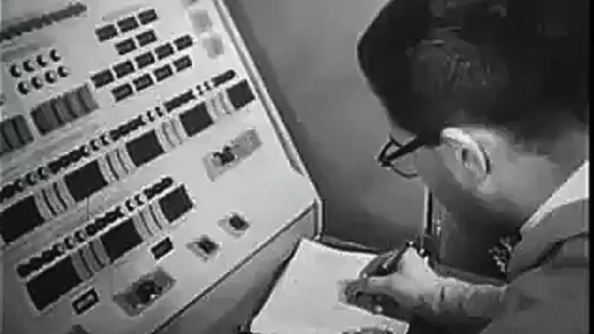
How to Use a Multimeter
(SparkFun Electronics) https://www.youtube.com/watch?v=SLkPtmnglOI&t=8s

Slide 6

Introduction to circuits and Ohm's law
(Khan Academy) https://www.khanacademy.org/science/physics/circuits-topic/circuits-resistance/v/circuits-part-1

Slide 7
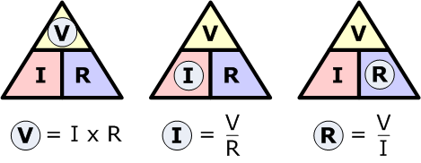
Ohm’s Law
Voltage, ( V )
Current, ( I )
Resistance, ( R )

Slide 8

Resistors in series
(Khan Academy) https://www.khanacademy.org/science/physics/circuits-topic/circuits-resistance/v/circuits-part-2

Slide 9
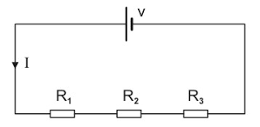
Resistors in series
R_{eq} = R₁ + R₂ + R₃ + ...

Slide 10
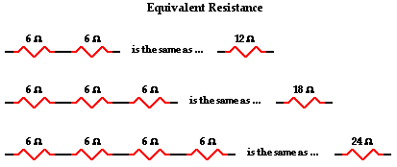
Resistors in series http://www.physicsclassroom.com/class/circuits/Lesson-4/Series-Circuits

Slide 11
Resistors in series http://www.physicsclassroom.com/class/circuits/Lesson-4/Series-Circuits

Slide 12
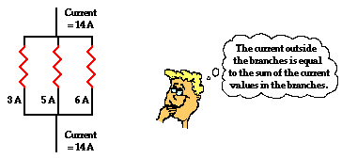
Resistors in parallel http://www.physicsclassroom.com/class/circuits/Lesson-4/Series-Circuits
I_{total} = I₁ + I₂ + I₃ + ...

Slide 13

Resistors in parallel
(Khan Academy) https://www.khanacademy.org/science/physics/circuits-topic/circuits-resistance/v/circuits-part-3

Slide 14
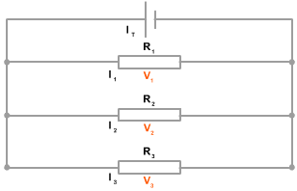
Resistors in parallel
1 / R_{eq} = 1 / R₁ + 1 / R₂ + 1 / R₃ + ...

Slide 15
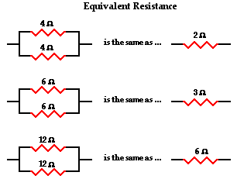
Resistors in parallel http://www.physicsclassroom.com/class/circuits/Lesson-4/Series-Circuits

Slide 16
Resistors in parallel http://www.physicsclassroom.com/class/circuits/Lesson-4/Series-Circuits

Slide 17
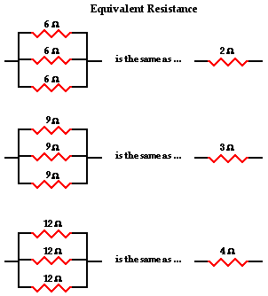
Resistors in parallel http://www.physicsclassroom.com/class/circuits/Lesson-4/Series-Circuits

Slide 18
Resistors in parallel http://www.physicsclassroom.com/class/circuits/Lesson-4/Series-Circuits

Slide 19
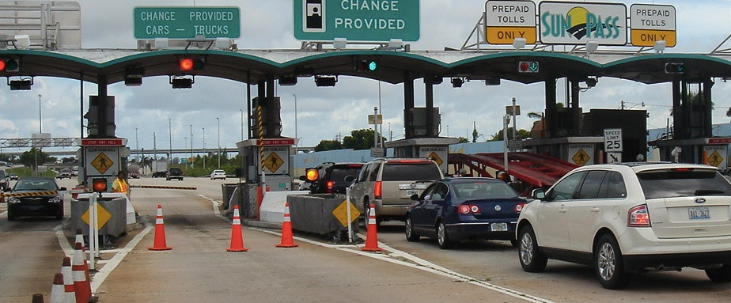
Resistors in parallel http://www.physicsclassroom.com/class/circuits/Lesson-4/Series-Circuits
Suppose a tollbooth is the main location of resistance to car flow on a toll way.
Adding additional tollbooths within their own branch on a toll way will provide more pathways for cars to flow through the toll station.
These additional tollbooths will decrease the overall resistance to car flow and increase the rate at which they flow.

Slide 20
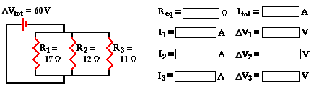
Resistors in parallel http://www.physicsclassroom.com/class/circuits/Lesson-4/Series-Circuits

Slide 21
Resistors in parallel http://www.physicsclassroom.com/class/circuits/Lesson-4/Series-Circuits
4.29
14.0
14.0 amp
3.53
60
5.00
60
5.45
60
Is I_{tot} = I₁ + I₂ + I₃ ?

Slide 22
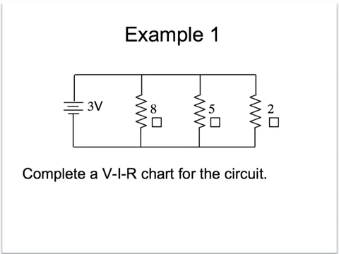
V-I-R chart
(Ryan Melvin) https://www.youtube.com/watch?v=mt4K7FT42w0

Slide 23
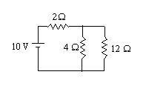
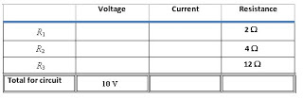
VIR charts and basic circuits
(Jacobs Physics) https://jacobsphysics.blogspot.hk/2009/03/i-got-email-from-geoff-clarion-other.html
R₁
Note: Ohm's law can ONLY be used when two of the 3 entries in a single row are known.
But we have only been given 1 value in each row at this point.
R₃
R₂
R₁
R₂
R₃

Slide 24
VIR charts and basic circuits
(Jacobs Physics) https://jacobsphysics.blogspot.hk/2009/03/i-got-email-from-geoff-clarion-other.html
R₁
R₃
What is the equivalent resistance of the whole circuit?
R₂
R₁
R₂
R₃

Slide 25
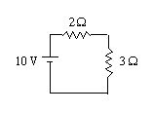
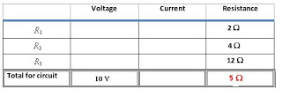
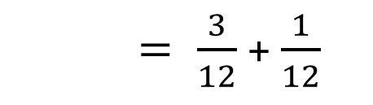
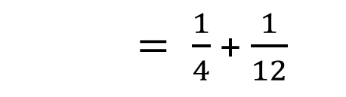
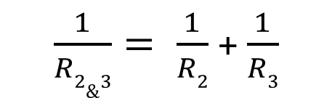
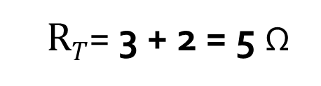
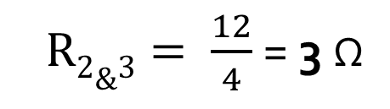

VIR charts and basic circuits
(Jacobs Physics) https://jacobsphysics.blogspot.hk/2009/03/i-got-email-from-geoff-clarion-other.html
R₁
$\frac{1}{R2\&3}= \frac{1}{R2}$ + $\frac{1}{R3}$
R₁
$= \frac{1}{4}$ + $\frac{1}{12}$
R₃
=
$= \frac{3}{12}$ + $\frac{1}{12}$
R₂
$= \frac{4}{12}$
$R2\&3= \frac{12}{4}$ = 3 Ω
R₁
R₂
$RT$= 3 + 2 = 5 Ω
R₃
R_{T}

Slide 26
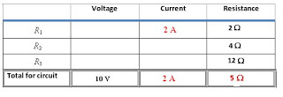
VIR charts and basic circuits
(Jacobs Physics) https://jacobsphysics.blogspot.hk/2009/03/i-got-email-from-geoff-clarion-other.html
R₁
R₁
R₃
=
R₂
R₁
R₂
R₃
What is I_{T}?

Slide 27
VIR charts and basic circuits
(Jacobs Physics) https://jacobsphysics.blogspot.hk/2009/03/i-got-email-from-geoff-clarion-other.html
R₁
R₁
R₃
=
R₂
R₁
R₂
R₃
I_{T} (Ohm’s Law ) V = IR

Slide 28
VIR charts and basic circuits
(Jacobs Physics) https://jacobsphysics.blogspot.hk/2009/03/i-got-email-from-geoff-clarion-other.html
R₁
R₁
R₃
=
R₂
What is the current across I₁?
R₁
R₂
R₃

Slide 29
VIR charts and basic circuits
(Jacobs Physics) https://jacobsphysics.blogspot.hk/2009/03/i-got-email-from-geoff-clarion-other.html
R₁
R₁
R₃
=
R₂
As R₁ is in series so same as I_{T}.
R₁
R₂
=
R₃

Slide 30
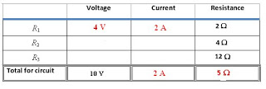
VIR charts and basic circuits
(Jacobs Physics) https://jacobsphysics.blogspot.hk/2009/03/i-got-email-from-geoff-clarion-other.html
R₁
R₁
R₃
=
R₂
What is the Voltage across R₁?
R₁
R₂
R₃

Slide 31
VIR charts and basic circuits
(Jacobs Physics) https://jacobsphysics.blogspot.hk/2009/03/i-got-email-from-geoff-clarion-other.html
R₁
R₁
R₃
=
R₂
Ohm’s Law
V = IR
R₁
R₂
R₃

Slide 32
VIR charts and basic circuits
(Jacobs Physics) https://jacobsphysics.blogspot.hk/2009/03/i-got-email-from-geoff-clarion-other.html
R₁
R₁
R₃
=
R₂
R₁
What are the voltages across R₂ & R₃?
R₂
R₃

Slide 33
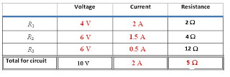
VIR charts and basic circuits
(Jacobs Physics) https://jacobsphysics.blogspot.hk/2009/03/i-got-email-from-geoff-clarion-other.html
R₁
R₁
R₃
=
R₂
The voltage across series resistors adds to the total.
R₁
+
The voltage across parallel resistors is the same.
R₂
=
R₃

Slide 34
VIR charts and basic circuits
(Jacobs Physics) https://jacobsphysics.blogspot.hk/2009/03/i-got-email-from-geoff-clarion-other.html
R₁
R₁
R₃
=
R₂
R₁
What are the currents through R₂ & R₃?
R₂
R₃

Slide 35
VIR charts and basic circuits
(Jacobs Physics) https://jacobsphysics.blogspot.hk/2009/03/i-got-email-from-geoff-clarion-other.html
R₁
R₁
R₃
=
R₂
R₁
R₂
Ohm’s Law
V = IR
R₃

Slide 36
Common Misconceptions Regarding Electric Circuits http://www.physicsclassroom.com/class/circuits/Lesson-2/Common-Misconceptions-Regarding-Electric-Circuits
Statement | True or False?
a. When an electrochemical cell no longer works, it is out of charge and must be recharged before it can be used again. | TorF
b. An electrochemical cell can be a source of charge in a circuit. The charge that flows through the circuit originates in the cell. | TorF
c. Charge becomes used up as it flows through a circuit. The amount of charge that exits a light bulb is less than the amount that enters the light bulb. | TorF
d. Charge flows through circuits at very high speeds. This explains why the light bulb turns on immediately after the wall switch is flipped. | TorF
e. The local electrical utility company supplies millions and millions of electrons to our homes everyday. | TorF

Slide 37
Common Misconceptions Regarding Electric Circuits http://www.physicsclassroom.com/class/circuits/Lesson-2/Common-Misconceptions-Regarding-Electric-Circuits
Statement | True or False?
a. When an electrochemical cell no longer works, it is out of charge and must be recharged before it can be used again. | TorF
b. An electrochemical cell can be a source of charge in a circuit. The charge that flows through the circuit originates in the cell. | TorF
c. Charge becomes used up as it flows through a circuit. The amount of charge that exits a light bulb is less than the amount that enters the light bulb. | TorF
d. Charge flows through circuits at very high speeds. This explains why the light bulb turns on immediately after the wall switch is flipped. | TorF
e. The local electrical utility company supplies millions and millions of electrons to our homes everyday. | TorF
Each of these statements is false.

Slide 38
Common Misconceptions Regarding Electric Circuits http://www.physicsclassroom.com/class/circuits/Lesson-2/Common-Misconceptions-Regarding-Electric-Circuits
An electrochemical cell (‘battery’) supplies the energy needed to move a charge from a low potential location to a high potential location.
The charge that flows through a circuit originates in the wires (the electrons possessed by the atoms that make up the wires).
Charge moves abnormally slowly (~ 1 m/hour) through a circuit. But as soon as a switched is turned to ON, charge located everywhere within the circuit begins to move.
The rate at which charge flows into a light bulb = charge flows out.
An electrical appliance (e.g. light bulb) transforms electrical energy into other forms (e.g. light energy and thermal energy). Thus, the amount of electrical energy possessed by a charge as it exits an appliance is < when it entered the appliance (voltage drop).

Slide 39
Plenary:
Electric Circuits:
  http://www.physicsclassroom.com/class/circuits/Lesson-4/Series-Circuits
  http://www.physicsclassroom.com/class/circuits/Lesson-4/Parallel-Circuits
  http://www.physicsclassroom.com/class/circuits/Lesson-4/Combination-Circuits
  https://quizizz.com/admin/quiz/571635b80619d9281647e94d
  http://www.softschools.com/quizzes/science/series_circuit/quiz3663.html
  http://www.twothirtyvolts.org.uk/education/revision-quiz/electric-circuits-11to14.html

Slide 40
Plenary:
Ohm’s Law:
  http://www.physicsclassroom.com/class/circuits/Lesson-3/Ohm-s-Law
  https://www.allaboutcircuits.com/worksheets/ohms-law/
  https://en.wikiversity.org/wiki/Electric_Circuit_Analysis/Circuit_Analysis_Quiz_1
  http://www.learnabout-electronics.org/Resistors/resistors_12.php
  http://www.twothirtyvolts.org.uk/education/revision-quiz/ohms-law.html
  https://quizizz.com/admin/quiz/56d596ad5aea7a8959bef885
  https://www.bbc.co.uk/education/guides/z8b2pv4/test
  https://sciencesource2.pearsoncanada.ca/resources/hotpotato_quiz_09_11_3.htm
  https://quizizz.com/admin/quiz/570159651d0fce5d796cf77a

Slide 41
Plenary:
VIR tables:
  https://jacobsphysics.blogspot.hk/2009/03/i-got-email-from-geoff-clarion-other.html
  https://www.wikihow.com/Solve-Parallel-Circuits
  https://www.allaboutcircuits.com/textbook/direct-current/chpt-5/simple-parallel-circuits/

