Slide 1
Precomp Review
Day 3
Energy

Slide 2
Question 1
The law of conversation of energy tell us that energy cannot be:
changed in form.
created or destroyed.
measured.
calculated.

Slide 3
Question 1
The law of conversation of energy tell us that energy cannot be:
changed in form.
created or destroyed.
measured.
calculated.

Slide 4
Question 2
Under what conditions would a 50kg cannonball have the most kinetic energy?
The cannonball is at rest at ground level
The cannonball has a speed of 10 m/s and is at ground level.
The cannonball is at rest 10 meters above the ground.
The cannonball has a speed of 5 m/s and is 5 meters above the ground.

Slide 5
Question 2
Under what conditions would a 50kg cannonball have the most kinetic energy?
The cannonball is at rest at ground level
The cannonball has a speed of 10 m/s and is at ground level.
The cannonball is at rest 10 meters above the ground.
The cannonball has a speed of 5 m/s and is 5 meters above the ground.
KE = ½ mv²

Slide 6
Question 3
Under what conditions would a 50kg cannonball have the most potential energy?
The cannonball is at rest at ground level
The cannonball has a speed of 10 m/s and is at ground level.
The cannonball is at rest 10 meters above the ground.
The cannonball has a speed of 5 m/s and is 5 meters above the ground.

Slide 7
Question 3
Under what conditions would a 50kg cannonball have the most potential energy?
The cannonball is at rest at ground level
The cannonball has a speed of 10 m/s and is at ground level.
The cannonball is at rest 10 meters above the ground.
The cannonball has a speed of 5 m/s and is 5 meters above the ground.
GPE = mgh

Slide 8
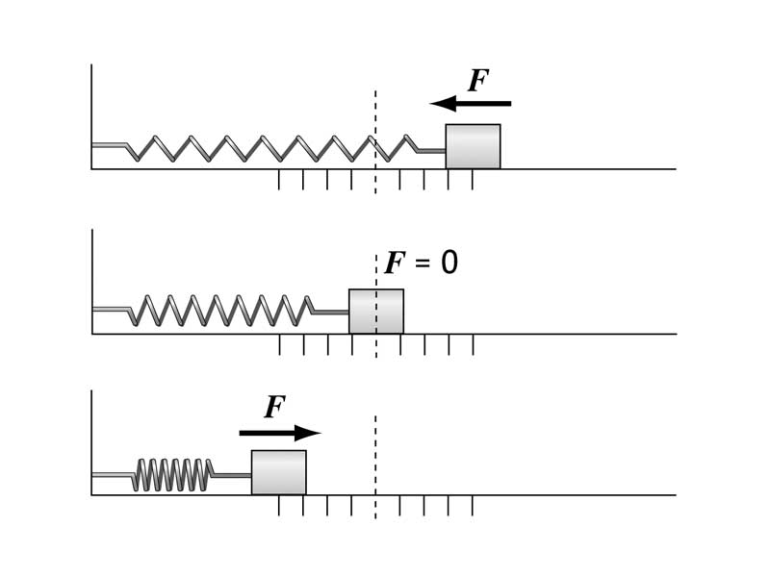
Question 4
Grade 8 Only
A 20 kg mass is attached a spring at rest as in the image above. The spring is then stretched 1 m to the right, and is released. At the instant the mass has moved 0.5 m back, what types of mechanical energy does the mass possess?
Gravitational potential only.
Kinetic only
Spring potential only.
Kinetic and spring potential only

Slide 9
Question 4
Grade 8 Only
A 20 kg mass is attached a spring at rest as in the image above. The spring is then stretched 1 m to the right, and is released. At the instant the mass has moved 0.5 m back, what types of mechanical energy does the mass possess?
Gravitational potential only.
Kinetic only
Spring potential only.
Kinetic and spring potential only
Obviously still moving and not yet back to its equilibrium position so still has SPE.

Slide 10
Question 5
A box of old textbooks is on the middle shelf in the bookroom 1.3 m from the floor. If the janitor relocates the box to a shelf that is 2.6 m from the floor, how much work does he do on the box? m = 10 kg.
13 J
26 J
130 J
60 J

Slide 11
Question 5
A box of old textbooks is on the middle shelf in the bookroom 1.3 m from the floor. If the janitor relocates the box to a shelf that is 2.6 m from the floor, how much work does he do on the box? m = 10 kg.
13 J
26 J
130 J
60 J
GPE = mgh = 10kg * 10m/s² * 1.3m

Slide 12
Question 6
Momentum so Grade 8 Only for now
A skateboard moves along a frictionless level road at a constant speed. A kid falls straight down onto it. What happens to the velocity of the skateboard?
It increases
It remains the same
It decreases
it stops immediately

Slide 13
Question 6
Momentum so Grade 8 Only for now
A skateboard moves along a frictionless level road at a constant speed. A kid falls straight down onto it. What happens to the velocity of the skateboard?
It increases
It remains the same
It decreases
it stops immediately
Conservation of momentum
m_{s}v_{i} = (m_{s} + m_{k})v_{f}
As total mass has increased so v_{f} < v_{i} to keep the momentum the same.

Slide 14
Question 7
If you push for a half hour or a whole hour against a stationary wall
twice as much work is done during the half hour.
no work on the wall is done in either case.
half as much work is done during the half hour.
it is impossible to determine how much work is done.

Slide 15
Question 7
If you push for a half hour or a whole hour against a stationary wall
twice as much work is done during the half hour.
no work on the wall is done in either case.
half as much work is done during the half hour.
it is impossible to determine how much work is done.
W = Fd

Slide 16
Question 8
If you push an object twice as far while applying the same force, you do
four times as much work.
twice as much work.
the same amount of work.
half as much work.

Slide 17
Question 8
If you push an object twice as far while applying the same force, you do
four times as much work.
twice as much work.
the same amount of work.
half as much work.
W = Fd

Slide 18
Question 9
Grade 8 Only
A bow is drawn so that it has 50 J of potential energy stored in the bow. Neglecting air resistance, when the bow is fired, the arrow will have a kinetic energy that is
less than 50 J.
50 J.
more than 50 J.
impossible to predict without additional information

Slide 19
Question 9
Grade 8 Only
A bow is drawn so that it has 50 J of potential energy stored in the bow. Neglecting air resistance, when the bow is fired, the arrow will have a kinetic energy that is
less than 50 J.
50 J.
more than 50 J.
impossible to predict without additional information
Conservation of Mechanical Energy
ME_{i} = ME_{f}
SPE_{i} = KE_{f} (initially no KE, after firing no SPE)

Slide 20
Question 10
A skier skiing down a frictionless incline has its maximum speed
halfway down.
at the top.
at the bottom.
depends upon the incline of the ramp.

Slide 21
Question 10
A skier skiing down a frictionless incline has its maximum speed
halfway down.
at the top.
at the bottom.
depends upon the incline of the ramp.
Conservation of Mechanical Energy
ME_{i} = ME_{f}
GPE_{i} = KE_{f} (initially no KE, at the bottom no GPE)

Slide 22
Question 11
It takes 40 J to push a large box 4 m across a floor. Assuming the push is in the same direction as the move, what is the magnitude of the force on the box?
10 N
40 N
160 N
4 N

Slide 23
Question 11
It takes 40 J to push a large box 4 m across a floor. Assuming the push is in the same direction as the move, what is the magnitude of the force on the box?
10 N
40 N
160 N
4 N
W = Fd
F = W/d = 40J/4m =

Slide 24
Question 12
A truck moves 4 times as fast as another identical truck. Compared to the slower truck, the faster truck has
8 times the KE.
16 times the KE.
12 times the KE.
4 times the KE.

Slide 25
Question 12
A truck moves 4 times as fast as another identical truck. Compared to the slower truck, the faster truck has
8 times the KE.
16 times the KE.
12 times the KE.
4 times the KE.
KE = ½ mv²

Slide 26
Question 13
Grade 8 Only
Spring A is extended 4 times as far as another identical spring, called spring B. Compared to the spring B, spring A has
8 times the PE­spring.
16 times the PE­spring.
12 times the PE­spring.
4 times the PE­spring.

Slide 27
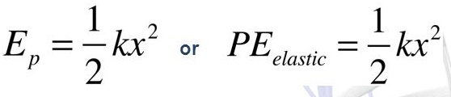
Question 13
Grade 8 Only
Spring A is extended 4 times as far as another identical spring, called spring B. Compared to the spring B, spring A has
8 times the PE­spring.
16 times the PE­spring.
12 times the PE­spring.
4 times the PE­spring.

Slide 28
Question 14
Which has greater kinetic energy, a car traveling at 30 km/hr or a car of half the mass traveling at 60 km/hr?
the 30 km/hr car
the 60 km/hr car
Both have the same kinetic energy.
More information is needed about the distance traveled.

Slide 29
Question 14
Which has greater kinetic energy, a car traveling at 30 km/hr or a car of half the mass traveling at 60 km/hr?
the 30 km/hr car
the 60 km/hr car
Both have the same kinetic energy.
More information is needed about the distance traveled.
KE = ½ mv²

Slide 30
Question 15
A diver who has a mass of 50 kg steps off a diving board that is 10 m above the water. The diver hits the water with kinetic energy of
500 J.
510 J.
5000 J.
10 J.

Slide 31
Question 15
A diver who has a mass of 50 kg steps off a diving board that is 10 m above the water. The diver hits the water with kinetic energy of
500 J.
510 J.
5000 J.
10 J.
Conservation of Mechanical Energy
ME_{i} = ME_{f}
GPE_{i} = KE_{f} (initially no KE, when hits the water no GPE)

Slide 32

Question 16
Which of the following represents the units for energy in base SI units?
$\frac{kgm}{s}$
$\frac{kgm}{s^{2}}$
$\frac{kgm^{2}}{s}$
$\frac{kgm^{2}}{s^{2}}$

Slide 33

Question 16
Which of the following represents the units for energy in base SI units?
$\frac{kgm}{s}$
$\frac{kgm}{s^{2}}$
$\frac{kgm^{2}}{s}$
$\frac{kgm^{2}}{s^{2}}$
F = ma = kgm/s²
W = Fd = kgm/s² . m = kgm²/s²
KE = ½ mv² = kgm/s . m/s = kgm²/s²
GPE = mgh = kg . m/s² . m = kgm²/s²

Slide 34
Question 17
Which of the following is the energy stored in an object by virtue of its position?
Potential energy
Gravitational potential energy
Spring potential energy
Kinetic energy

Slide 35
Question 17
Which of the following is the energy stored in an object by virtue of its position?
Potential energy
Gravitational potential energy
Spring potential energy
Kinetic energy

Slide 36
Question 18
Grade 8 Only
A force of 10 N stretches a spring that has a spring constant of 20 N/m. The spring obeys Hooke’s law.
What is the extension of the spring?
0.5 m
200 m
2 m
20 m

Slide 37
Question 18
Grade 8 Only
A force of 10 N stretches a spring that has a spring constant of 20 N/m. The spring obeys Hooke’s law.
What is the extension of the spring?
0.5 m
200 m
2 m
20 m
F = kx
x = F/k
= 10N / 20 N/m

Slide 38
Question 19
Grade 8 Only
A force of 10 N stretches a spring that has a spring constant of 20 N/m. The spring obeys Hooke’s law.
What is the potential energy stored in the spring?
2.5 J
5.0 J
10 J
200 J

Slide 39
Question 19
Grade 8 Only
A force of 10 N stretches a spring that has a spring constant of 20 N/m. The spring obeys Hooke’s law.
What is the potential energy stored in the spring?
2.5 J
5.0 J
10 J
200 J
F = kx
x = F/k
= 10N / 20 N/m
E_{spring} = ½ kx² = ½ * 20 * 0.5²

