Slide 1
Precomp Review
Day 1
Kinematics and graphs

Slide 2
Question 1
An object moves at a constant speed of 6 m/s. This means that the object:
A. Increases its speed by 6 m/s every second
B. Decreases its speed by 6 m/s every second
C. Doesn’t move
D. Has a positive acceleration
E. Moves 6 meters every second

Slide 3
Question 1
An object moves at a constant speed of 6 m/s. This means that the object:
A. Increases its speed by 6 m/s every second
B. Decreases its speed by 6 m/s every second
C. Doesn’t move
D. Has a positive acceleration
E. Moves 6 meters every second

Slide 4
Question 2
A toy car moves 8 m in 4 s at a constant velocity. What is the car’s velocity?
1 m/s
2 m/s
3 m/s
4 m/s
5 m/s

Slide 5
Question 2
A toy car moves 8 m in 4 s at a constant velocity. What is the car’s velocity?
1 m/s
2 m/s
3 m/s
4 m/s
5 m/s

Slide 6
Question 3
A train moves at a constant velocity of 50 km/h. How far will it move in 0.5 h?
10 km
20 km
25 km
45 km
50 km

Slide 7
Question 3
A train moves at a constant velocity of 50 km/h. How far will it move in 0.5 h?
10 km
20 km
25 km
45 km
50 km

Slide 8
Question 4
A boat can move at a constant velocity of 8 km/h in still water. How long will it take for the boat to move 24 km?
2 h
3 h
4 h
6 h
8 h

Slide 9
Question 4
A boat can move at a constant velocity of 8 km/h in still water. How long will it take for the boat to move 24 km?
2 h
3 h
4 h
6 h
8 h

Slide 10
Question 5
Starting from the origin, a person walks 6 km east during the first day, and 3 km east the next day. What is the net displacement of the person from the initial point in two days?
6 km, west
3 km, east
10 km, east
5 km, west
9 km, east

Slide 11
Question 5
Starting from the origin, a person walks 6 km east during the first day, and 3 km east the next day. What is the net displacement of the person from the initial point in two days?
6 km, west
3 km, east
10 km, east
5 km, west
9 km, east

Slide 12
Question 6
An object moves with a constant acceleration of 5 m/s². Which of the following statements is true?
A. The object’s velocity stays the same
B. The object moves 5 m each second
C. The object’s acceleration increases by 5 m/s² each second
D. The object’s acceleration decreases by 5 m/s² each second
E. the object’s velocity increases by 5 m/s each second

Slide 13
Question 6
An object moves with a constant acceleration of 5 m/s². Which of the following statements is true?
A. The object’s velocity stays the same
B. The object moves 5 m each second
C. The object’s acceleration increases by 5 m/s² each second
D. The object’s acceleration decreases by 5 m/s² each second
E. the object’s velocity increases by 5 m/s each second

Slide 14
Question 7

Slide 15
Question 7

Slide 16
Question 8

Slide 17
Question 8

Slide 18
Question 9

Slide 19
Question 9

Slide 20
Question 10
A car and a delivery truck both start from rest and accelerate at the same rate. However, the car accelerates for twice the amount of time as the truck. What is the final speed of the car compared to the truck?
A. Half as much
B. The same
C. Twice as much
D. Four times as much
E. One quarter as much

Slide 21
Question 10
A car and a delivery truck both start from rest and accelerate at the same rate. However, the car accelerates for twice the amount of time as the truck. What is the final speed of the car compared to the truck?
A. Half as much
B. The same
C. Twice as much
D. Four times as much
E. One quarter as much

Slide 22
Question 11
An object is released from rest and falls in the absence of air resistance. Which of the following is true about its motion?
A. Its acceleration is zero
B. Its acceleration is constant
C. Its velocity is constant
D. Its acceleration is increasing
E. Its velocity is decreasing

Slide 23
Question 11
An object is released from rest and falls in the absence of air resistance. Which of the following is true about its motion?
A. Its acceleration is zero
B. Its acceleration is constant
C. Its velocity is constant
D. Its acceleration is increasing
E. Its velocity is decreasing

Slide 24
Question 12
The graph represents the relationship between velocity and time for an object moving in a straight line. Which of the following statements is true about the graph?
A. The object speeds up
B. The object slows down
C. The object moves with a constant
velocity
D. The object stays at rest
E. The object is in free fall

Slide 25
Question 12
The graph represents the relationship between velocity and time for an object moving in a straight line. Which of the following statements is true about the graph?
A. The object speeds up
B. The object slows down
C. The object moves with a constant
velocity
D. The object stays at rest
E. The object is in free fall

Slide 26
Question 13
The graph represents the relationship between velocity and time for an object moving in a straight line. What is the velocity of the object at
5 s?
1 m/s
2 m/s
3 m/s
4 m/s
5 m/s

Slide 27
Question 13
The graph represents the relationship between velocity and time for an object moving in a straight line. What is the velocity of the object at
5 s?
1 m/s
2 m/s
3 m/s
4 m/s
5 m/s

Slide 28
Question 14
The graph represents the relationship between velocity and time for an object moving in a straight line. What is the traveled distance of the
object from zero to 9s?
10 m
24 m
36 m
48 m
56 m

Slide 29
Question 14
The graph represents the relationship between velocity and time for an object moving in a straight line. What is the traveled distance of the
object from zero to 9s?
10 m
24 m
36 m
48 m
56 m

Slide 30
Question 15
The graph represents the position as a function of time for a moving object. Which of the following is true?
The object increases its velocity
The object decreases its velocity
The object’s velocity stays unchanged
The object stays at rest

Slide 31
Question 15
The graph represents the position as a function of time for a moving object. Which of the following is true?
The object increases its velocity
The object decreases its velocity
The object’s velocity stays unchanged
The object stays at rest

Slide 32
Question 16
The graph represents the position as a function of time for a moving object
What is the velocity of the object?
4 m/s
20 m/s
8 m/s
40 m/s
5 m/s

Slide 33
Question 16
The graph represents the position as a function of time for a moving object
What is the velocity of the object?
4 m/s
20 m/s
8 m/s
40 m/s
5 m/s

Slide 34
Question 17
The graph represents the position as a function of time for a moving object. What is the initial position of the object?
2 m
4 m
6 m
8 m
10 m

Slide 35
Question 17
The graph represents the position as a function of time for a moving object. What is the initial position of the object?
2 m
4 m
6 m
8 m
10 m

Slide 36
Question 18
The graph represents the position as a function of time for a moving object. What is the velocity of the object?
2 m/s
4 m/s
6 m/s
8 m/s
10 m/s

Slide 37
Question 18
The graph represents the position as a function of time for a moving object. What is the velocity of the object?
2 m/s
4 m/s
6 m/s
8 m/s
10 m/s

Slide 38
Question 19
The graph represents the position as a function of time for a moving object What is the initial position of the object?
2 m
4 m
6 m
8 m
10 m

Slide 39
Question 19
The graph represents the position as a function of time for a moving object What is the initial position of the object?
2 m
4 m
6 m
8 m
10 m

Slide 40
Question 20
The graph represents the position as a function of time for a moving object. What is the velocity of the object?
5 m/s
-5 m/s
10 m/s
-10 m/s
0 m/s

Slide 41
Question 20
The graph represents the position as a function of time for a moving object. What is the velocity of the object?
5 m/s
-5 m/s
10 m/s
-10 m/s
0 m/s

Slide 42
Question 21
Which of the following is a vector quantity?
Speed
Time
Traveled distance
Velocity
Area

Slide 43
Question 21
Which of the following is a vector quantity?
Speed
Time
Traveled distance
Velocity
Area

Slide 44
Question 22
Grade 8 Only
If an object is rolled down an inclined plane, it will accelerate at a constant rate, but one that is…
Smaller than g
Bigger than g
Equal to g

Slide 45
Question 22
Grade 8 Only
If an object is rolled down an inclined plane, it will accelerate at a constant rate, but one that is…
Smaller than g
Bigger than g
Equal to g
http://www.batesville.k12.in.us/physics/phynet/mechanics/RotMechanics/fall_slide_roll.htm

Slide 46
Question 23
Grade 8 Only
If an object is rolled down an inclined plane, it will accelerate at a constant rate. An object rolled from rest down an inclined rolls 1 m in the first 1 second. What is the acceleration of the object?
½ m/s²
1 m/s²
2 m/s²

Slide 47

Question 23
Grade 8 Only
If an object is rolled down an inclined plane, it will accelerate at a constant rate. An object rolled from rest down an inclined rolls 1 m in the first 1 second. What is the acceleration of the object?
½ m/s²
1 m/s²
2 m/s²
$$Δx=v_{i}t + \frac{1}{2}at^{2}$$
$$Δx=\frac{1}{2}at^{2}$$
$$a=\frac{2Δx}{t^{2}}$$
https://www.quora.com/If-I-am-at-rest-and-I-start-to-move-with-constant-acceleration-2-m-s-2-wouldnt-I-have-traveled-2-m-in-the-first-second

Slide 48
Question 24
Grade 8 Only
If an object is rolled down an inclined plane, it will accelerate at a constant rate. An object rolled from rest down an inclined rolls 1 m in the first 1 second. (in the last problem we learned a = 2 m/s²) What is the velocity of the object after that 1 second?
0 m/s
½ m/s
1 m/s
2 m/s

Slide 49
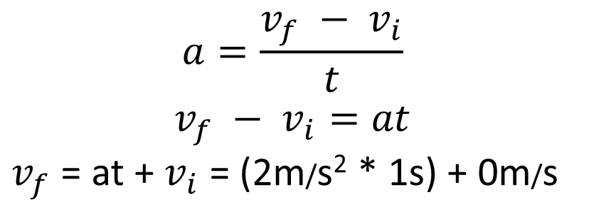
Question 24
Grade 8 Only
If an object is rolled down an inclined plane, it will accelerate at a constant rate. An object rolled from rest down an inclined rolls 1 m in the first 1 second. (in the last problem we learned a = 2 m/s²) What is the velocity of the object after that 1 second?
0 m/s
½ m/s
1 m/s
2 m/s
$$a=\frac{v_{f} − v_{i}}{t}$$
$$v_{f} − v_{i}=at$$
$v_{f}$ = at + $v_{i}$ = (2m/s² * 1s) + 0m/s

Slide 50
Question 25
Grade 8 Only
If an object is rolled down an inclined plane, it will accelerate at a constant rate, but one that is smaller than g.
An object rolled from rest down an inclined rolls 1 m in the first 1 second. (now we know a=2 m/s² and v₁=2 m/s) how far does it roll in the next 1 second (from t = 1 to t = 2)
1 m
2 m
3 m
4 m

Slide 51
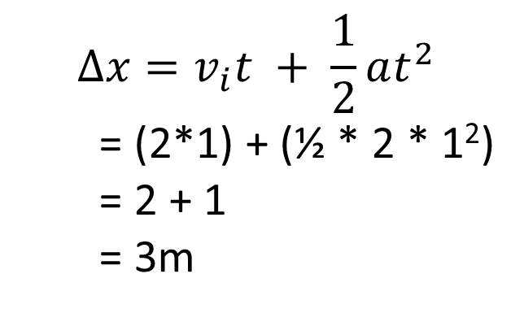
Question 25
Grade 8 Only
If an object is rolled down an inclined plane, it will accelerate at a constant rate, but one that is smaller than g.
An object rolled from rest down an inclined rolls 1 m in the first 1 second. (now we know a=2 m/s² and v₁=2 m/s) how far does it roll in the next 1 second (from t = 1 to t = 2)
1 m
2 m
3 m
4 m
$$Δx=v_{i}t + \frac{1}{2}at^{2}$$
= (2*1) + (½ * 2 * 1²)
= 2 + 1
= 3m

Slide 52
Question 26
Grade 8 Only
An elephant, initially at rest on a frictionless ice pond, burps and recoils with a constant acceleration. After it has moved through a distance of 2.4 meters, its speed is 0.3 m/s.
What was its acceleration?
0 m/s²
0.019 m/s²
0.09 m/s²
0.432 m/s²

Slide 53
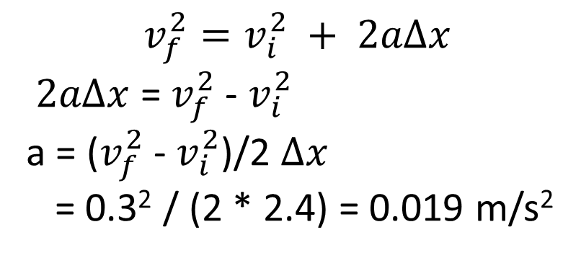
Question 26
Grade 8 Only
An elephant, initially at rest on a frictionless ice pond, burps and recoils with a constant acceleration. After it has moved through a distance of 2.4 meters, its speed is 0.3 m/s.
What was its acceleration?
0 m/s²
0.019 m/s²
0.09 m/s²
0.432 m/s²
$$v_{f}^{2}=v_{i}^{2} + 2aΔx$$
$2aΔx$ = $v_{f}^{2}$ - $v_{i}^{2}$
a = ($v_{f}^{2}$ - $v_{i}^{2}$)/2 $Δx$
= 0.3² / (2 * 2.4) = 0.019 m/s²

Slide 54
Question 27
What acceleration must a car have if its speed is to change from 11.6 m/s to 16.4 m/s in 3.6 seconds?
0 m/s²
1.33 m/s²
4.5 m/s²
17.28 m/s²

Slide 55

Question 27
What acceleration must a car have if its speed is to change from 11.6 m/s to 16.4 m/s in 3.6 seconds?
0 m/s²
1.33 m/s²
4.5 m/s²
17.28 m/s²
$$a=\frac{v_{f} − v_{i}}{t}$$

Slide 56
Question 28
Grade 8 Only
How many seconds will it take a car to travel 45.3 meters if it starts at rest and it accelerates at 3.7 m/s².
2.8 s
4.9 s
7.9 s
15.9 s

Slide 57

Question 28
Grade 8 Only
How many seconds will it take a car to travel 45.3 meters if it starts at rest and it accelerates at 3.7 m/s².
2.8 s
4.9 s
7.9 s
15.9 s
$$Δx=v_{i}t + \frac{1}{2}at^{2}$$
$=$ $\frac{1}{2}at^{2}$
t = √(2$Δx/a)$
= √((2*45.3)/3.7)

Slide 58
Question 29
The speed of an object one second after it has been dropped from rest out of a high office window on the planet Mitochondria is 8 m/s. What will its speed be 3 seconds after it was first dropped?
A. 8 m/s
B. 24 m/s
C. 12 m/s
D. 72 m/s
E. 36 m/s

Slide 59
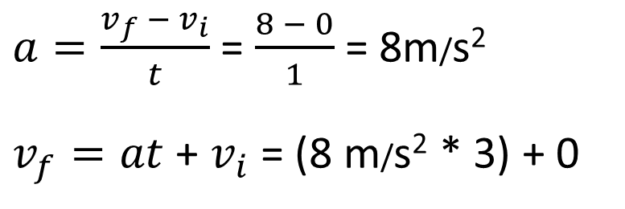
Question 29
The speed of an object one second after it has been dropped from rest out of a high office window on the planet Mitochondria is 8 m/s. What will its speed be 3 seconds after it was first dropped?
A. 8 m/s
B. 24 m/s
C. 12 m/s
D. 72 m/s
E. 36 m/s
$a=\frac{v_{f} − v_{i}}{t}$ = $\frac{8 − 0}{1}$ = 8m/s²
$v_{f}=at$ + $v_{i}$ = (8 m/s² * 3) + 0

Slide 60
Question 30
An object is thrown upward from the ground at sea level on Earth with an initial speed of 30 m/s. Which of the following is closest to the total time that the object will be in the air before it strikes the ground again?
A. 2.5 seconds
B. 6.0 seconds
C. 3.0 seconds
D. 5.0 seconds
E. 30 seconds

Slide 61
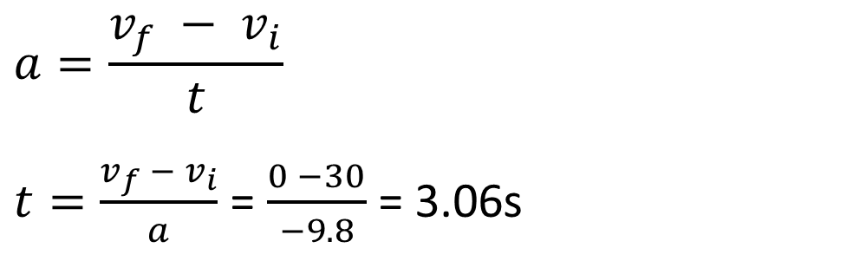
Question 30
An object is thrown upward from the ground at sea level on Earth with an initial speed of 30 m/s. Which of the following is closest to the total time that the object will be in the air before it strikes the ground again?
A. 2.5 seconds
B. 6.0 seconds
C. 3.0 seconds
D. 5.0 seconds
E. 30 seconds
$$a=\frac{v_{f} − v_{i}}{t}$$
$t=\frac{v_{f} − v_{i}}{a}$ = $\frac{0 −30}{−9.8}$ = 3.06s

Slide 62
Question 31
A ball is thrown vertically up and is caught when it returns to the same vertical position from which it was thrown. The ball takes 3 seconds to reach its maximum height. For what total time interval is the ball in the air? Neglect air friction.
A. between 3 seconds and 6 seconds
B. 6 seconds
C. longer than 6 seconds
D. 9.8 seconds
E. 19.6 seconds

Slide 63
Question 31
A ball is thrown vertically up and is caught when it returns to the same vertical position from which it was thrown. The ball takes 3 seconds to reach its maximum height. For what total time interval is the ball in the air? Neglect air friction.
A. between 3 seconds and 6 seconds
B. 6 seconds
C. longer than 6 seconds
D. 9.8 seconds
E. 19.6 seconds

Slide 64
Question 32
Grade 8 Only
A physics teacher finds a scrap of paper on which one of his students has written the following equation: (0)² - (27)² = 2(-9.8)x
For which of the following problems would this equation be part of the correct solution?
A. Find the speed of an object 27 seconds after it was dropped from rest.
B. Find the distance an object has fallen 27 seconds after it was released from rest on Earth.
C. Find the maximum height to which a ball will rise if it is thrown upward with an initial speed of 27 m/s.
D. Find the distance an object travels if it accelerates uniformly from rest and reaches a speed of 27 m/s after 9.8 seconds have elapsed
E. Find the time it takes an object to hit the ground if it is dropped from a height of 27 meters

Slide 65

Question 32
Grade 8 Only
$$v_{f}^{2}=v_{i}^{2} + 2aΔx$$
$$v_{f}^{2}−v_{i}^{2}= 2aΔx$$
A physics teacher finds a scrap of paper on which one of his students has written the following equation: (0)² - (27)² = 2(-9.8)x
For which of the following problems would this equation be part of the correct solution?
A. Find the speed of an object 27 seconds after it was dropped from rest.
B. Find the distance an object has fallen 27 seconds after it was released from rest on Earth.
C. Find the maximum height to which a ball will rise if it is thrown upward with an initial speed of 27 m/s.
D. Find the distance an object travels if it accelerates uniformly from rest and reaches a speed of 27 m/s after 9.8 seconds have elapsed
E. Find the time it takes an object to hit the ground if it is dropped from a height of 27 meters

Slide 66
Question 33
What is the net displacement of the person from the initial point in two days?
6 km, east
3 km, east
10 km, west
5 km, west
9 km, east

Slide 67
Question 33
What is the net displacement of the person from the initial point in two days?
6 km, east
3 km, east
10 km, west
5 km, west
9 km, east

Slide 68
Question 34
What is the traveled distance of the person from the initial point in two days?
13 km
3 km
10 km
5 km
9 km

Slide 69
Question 34
What is the traveled distance of the person from the initial point in two days?
13 km
3 km
10 km
5 km
9 km

Slide 70
Question 35
What is the average speed from 0 s to 4 s?
0.5 m/s
1 m/s
2 m/s
3 m/s
4 m/s

Slide 71
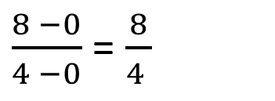
Question 35
What is the average speed from 0 s to 4 s?
0.5 m/s
1 m/s
2 m/s
3 m/s
4 m/s
$\frac{8 −0}{4 −0}$ = $\frac{8}{4 }$

Slide 72
Question 36
What is the average speed from 4 s to 8 s?
0.5 m/s
1 m/s
2 m/s
3 m/s
4 m/s

Slide 73
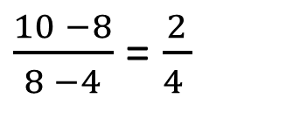
Question 36
What is the average speed from 4 s to 8 s?
0.5 m/s
1 m/s
2 m/s
3 m/s
4 m/s
$\frac{10 −8}{8 −4}$ = $\frac{2}{4 }$

Slide 74
Question 37
What is the object’s position at 6 s?
2 m
1 m
3 m
7 m
9 m

Slide 75
Question 37
What is the object’s position at 6 s?
2 m
1 m
3 m
7 m
9 m

Slide 76
Question 38
What is the average acceleration from 4 s to 8 s?
0 m/s²
1 m/s²
2 m/s²
3 m/s²
4 m/s²

Slide 77
Question 38
What is the average acceleration from 4 s to 8 s?
0 m/s²
1 m/s²
2 m/s²
3 m/s²
4 m/s²
constant velocity (not a curve)

Slide 78
Question 40
What is the acceleration of the object between 0 s
and 2 s?
0 m/s²
1 m/s²
2 m/s²
3 m/s²
4m/s²

Slide 79
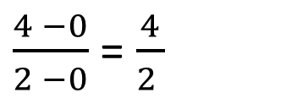
Question 40
What is the acceleration of the object between 0 s
and 2 s?
0 m/s²
1 m/s²
2 m/s²
3 m/s²
4m/s²
$\frac{4 −0}{2 −0}$ = $\frac{4}{2 }$

Slide 80
Question 41
What is the acceleration of the object between 2 s
and 6 s?
0 m/s²
1 m/s²
2 m/s²
3 m/s²
4m/s²

Slide 81
Question 41
What is the acceleration of the object between 2 s
and 6 s?
0 m/s²
1 m/s²
2 m/s²
3 m/s²
4m/s²
constant velocity (horizontal line)

Slide 82
Question 42
What is the magnitude of the acceleration of the object between 6 s
and 10 s?
0 m/s²
1 m/s²
2 m/s²
3 m/s²
4m/s²

Slide 83
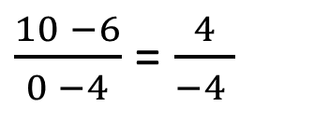
Question 42
What is the magnitude of the acceleration of the object between 6 s
and 10 s?
0 m/s²
1 m/s²
2 m/s²
3 m/s²
4m/s²
$\frac{10 −6}{0 −4}$ = $\frac{4}{−4 }$

Slide 84
Question 43
How far from the origin does the object move in first 2 s?
A. 4 m
B. 16 m
C. 20 m
D. 28 m
E. 36 m

Slide 85
Question 43
How far from the origin does the object move in first 2 s?
A. 4 m
B. 16 m
C. 20 m
D. 28 m
E. 36 m
area under the graph in 1st 2s
= ½ * 2 * 4 = 1 * 4

Slide 86
Question 44
How far from the origin does the object move in first 6 s?
4 m
16 m
20 m
28 m
36 m

Slide 87
Question 44
How far from the origin does the object move in first 6 s?
4 m
16 m
20 m
28 m
36 m
area under the graph from 2s – 6s
= 4 * (6 – 2) = 4 * 4 = 16
area under the graph from 0s – 2s = 4
total displacement = 16 + 4

Slide 88
Question 45
How far from the origin does the object move in first 10 s?
4 m
16 m
20 m
28 m
36 m

Slide 89
Question 45
How far from the origin does the object move in first 10 s?
4 m
16 m
20 m
28 m
36 m
area under the graph from 6s – 10s
= ½ * 4 * 4 = 8
area under the graph from 0s – 6s = 20
total displacement = 20 + 8

Slide 90
Question 46
What is the average velocity of the motorbike during the first 5 s?
0 m/s
5 m/s
10 m/s
15 m/s
20 m/s

Slide 91

Question 46
What is the average velocity of the motorbike during the first 5 s?
0 m/s
5 m/s
10 m/s
15 m/s
20 m/s
$$v=\frac{d}{t}=\frac{50}{5}$$

Slide 92
Question 47
Grade 8 Only
What is the acceleration of the motorbike?
A. 0 m/s²
B. 2 m/s²
C. 4 m/s²
D. 6 m/s²
E. 8 m/s²

Slide 93

Question 47
Grade 8 Only
What is the acceleration of the motorbike?
A. 0 m/s²
B. 2 m/s²
C. 4 m/s²
D. 6 m/s²
E. 8 m/s²
$Δx=v_{i}t + \frac{1}{2}at^{2}$ = $\frac{1}{2}at^{2}$
$a$ =$\frac{2Δx}{t^{2}}= \frac{2 ∗50}{5^{2}}= \frac{100}{25}$

