Slide 1
Review of Previous Lesson
State as many Vocabulary words and Learning Objectives that you remember from the last lesson as you can.
Now complete the content learning objectives.
Remember to grade yourself from 0 – 3.

Slide 2
Hooke's Law

Slide 3
Vocabulary
Content: | Start | End
Hooke's
law
spring constant
force extension graph
spring force

Slide 4
Vocabulary
Language: | Start | End
state
determine
define

Slide 5
Learning Objectives
Content: | Start | End
State Hooke's Law both in words and mathematically.
Calculate the spring constant of a spring given a force and the extension or compression it causes.
Determine the spring constant of a spring from a force extension graph.
Define the spring force and use it in problems.

Slide 6
Learning Objectives
Language: | Start | End
Define verbally and in writing.
Use equations to define in mathematically.

Slide 7

How is the extension of an elastic object (like a spring) related to the force added?
Define the variables.
List possible error sources.
Create a table.
List the equipment you will need.
Predict what will happen (rough sketch of graph)
Carry out the experiment.
Create a graph.
Write a conclusion.

Slide 8
How is the extension of an elastic object (like a spring) related to the force added?
Variables:
  Independent
  Dependent
  Control

Slide 9
How is the extension of an elastic object (like a spring) related to the force added?
Variables:
  Independent:
    Force (Mass)
  Dependent:
    Extension
  Control:
    Spring, retort stand and its height, environment, the way the spring moves, ……

Slide 10
How is the extension of an elastic object (like a spring) related to the force added?
Possible error sources.
  Parallax errors
  Zero errors
  The movement of the spring
  ….

Slide 11
How is the extension of an elastic object (like a spring) related to the force added?
Table:
Mass used (g) | Force (N) | Spring Length (cm) | Extension Adding(cm) | Extension Removing (cm) | Average Extension (cm)

Slide 12
How is the extension of an elastic object (like a spring) related to the force added?
Equipment:
  spring
  ring stand
  ring-stand clamps
  c-clamp
  ruler or meter stick
  set of known masses
  straight edge (e.g. small ruler)

Slide 13
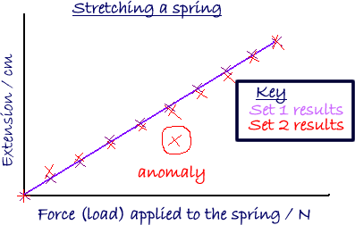
How is the extension of an elastic object (like a spring) related to the force added?
Graph:

Slide 14
How is the extension of an elastic object (like a spring) related to the force added?
Conclusion:
  The extension of an elastic object (like a spring) is directly proportional to the force added.
Equation ?:
  F = kx
    F = force applied
    k = spring constant
      proportionality constant k is specific for each spring
    x = extension

Slide 15
Calculating the spring constant
How can we do this from the graph?

Slide 16
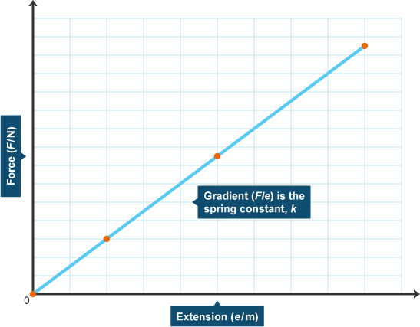
Calculating the spring constant
How can we do this from the graph?
  The spring constant is the slope of the line.
Notes:
As F = kx, k = F/x so to make life easier, really we need a graph with Extension in m on the x-axis and Force in N on the y-axis.
To use our graph (see next slide) we will need to convert the rise from cm to m, then 1/the slope (with the rise in m).

Slide 17
Calculating the spring constant
How can we do this from the graph?
  The spring constant is the slope of the line.
Note: to use our graph we will need to convert the rise from cm to m, then 1/the slope (with the rise in m).

Slide 18
Calculating the spring constant
How can we do this from a force and extension reading
  F = kx
    k = F/x

Slide 19
Hooke’s Law
The extension of an elastic object (like a spring) is directly proportional to the force added.
F = - kx
  The negative sign is customarily added to signify that the restoring force due to the spring is in the opposite direction to the force which caused the displacement.
  Pulling down on a spring will cause an extension of the spring downward, which will in turn result in an upward force due to the spring.
  F = force applied, k = spring constant, x = extension
What is Hooke's Law? (Khan Academy)

Slide 20

Experiment procedure for Hookes Law
(Liew Seng Choy – youtube) https://www.youtube.com/watch?v=X3zuwusUyi0

Slide 21

Intro to springs and Hooke's law
(Khan Academy) https://www.khanacademy.org/science/physics/work-and-energy/hookes-law/v/intro-to-springs-and-hooke-s-law

Slide 22
Plenary
http://www.problemsphysics.com/forces/hookes_law.html
https://www.introduction-to-physics.com/elasticity-problems.html
http://formulas.tutorvista.com/physics/hooke-s-law-formula.html
http://www.solvephysics.com/topic_dynamics_hooke.shtml

