Slide 1
Review of Previous Lesson
State as many Vocabulary words and Learning Objectives that you remember from the last lesson as you can.
Now complete the content learning objectives.
Remember to grade yourself from 0 – 3.

Slide 2
1D Kinematics Equations

Slide 3
Vocabulary
Content: | Start | End
kinematic
equations
formula
velocity
acceleration
constant
variables
interval
displacement

Slide 4
Vocabulary
Content: | Start | End
accurate
known
unknown
initial
final
given
substitute
direction

Slide 5
Learning Objectives
Content: | Start | End
Determine whether an object has been displaced and be able to calculate the displacement of an object using the appropriate kinematics equation.
Determine whether an object is undergoing constant velocity and be able to calculate the velocity of an object using the appropriate kinematics equation.
Determine whether an object is undergoing acceleration and be able to use appropriate kinematics equations to describe the motion of an object with constant acceleration.
Apply and show the GFEMA process in “working out”.

Slide 6
Learning Objectives
Language: | Start | End
Explain, using algebra and GFEMA, “working out”.

Slide 7
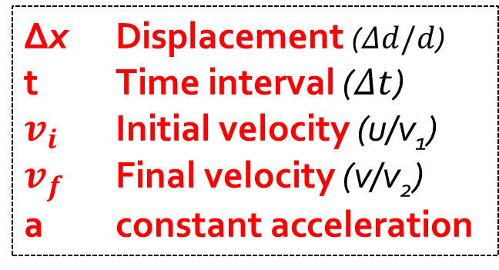
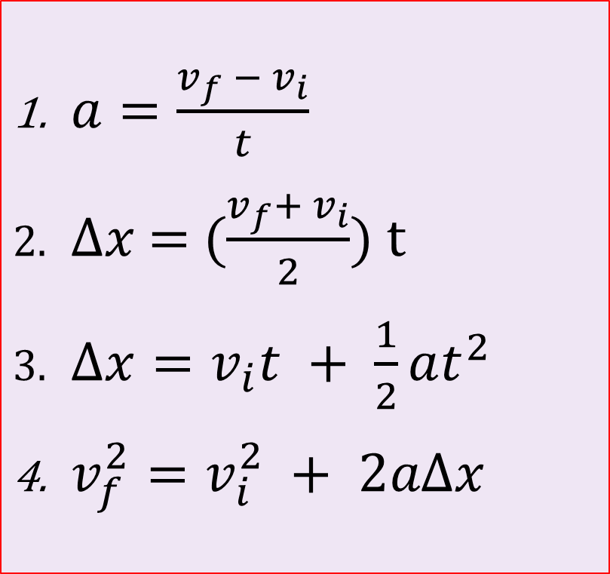
Kinematics Equations
Relate the 5 kinematic variables:
[Where did these formulas come from?]
Δx Displacement ($Δd/d$)
t Time interval ($Δt$)
$v_{i}$ Initial velocity (u/v₁)
$v_{f }$ Final velocity (v/v₂)
a constant acceleration
$a=\frac{v_{f} − v_{i}}{t}$
$Δx$ = ($\frac{v_{f}+ v_{i}}{2}$) t
$Δx=v_{i}t + \frac{1}{2}at^{2}$
$v_{f}^{2}=v_{i}^{2} + 2aΔx$
From earlier physics.
Syllabus
Only accurate if the acceleration is constant.
5 kinematic variables:
  Each equation has only 4.
  You need to know 3 to find any 4th using 1 of the equations.
    If you don’t have 3 then either:
      You have read the question wrong.
      The question is impossible.
All variables must refer to the same direction.
Syllabus
Syllabus.
You need to memorise these.
[Wait, what?]
Warning: Forgetting to include a -tive sign for direction is one of the most common sources of error when using kinematic formulas.

Slide 8

Kinematics Equations (PhysicsEH - youtube) https://www.youtube.com/watch?v=hD0ineZXpcw

Slide 9
How to properly use GFEMA:
G: givens – write down every value that the problem gives you with a symbol and units, separated by commas
  Right: G: m = 5 kg, v = 13 m/s, t = 10 s
  Wrong G: 5 kg 13 m/s 10 s
    If you don’t have 3 of the 5 kinematic variables once you have written down your givens then either:
      You have read the question wrong.
        e.g. from rest means v_{i} = 0 m/s
      The question is impossible.
F: find – write down the variable of the quantity you are looking for
  Right: F: a
  Wrong: F: the acceleration of the car

Slide 10
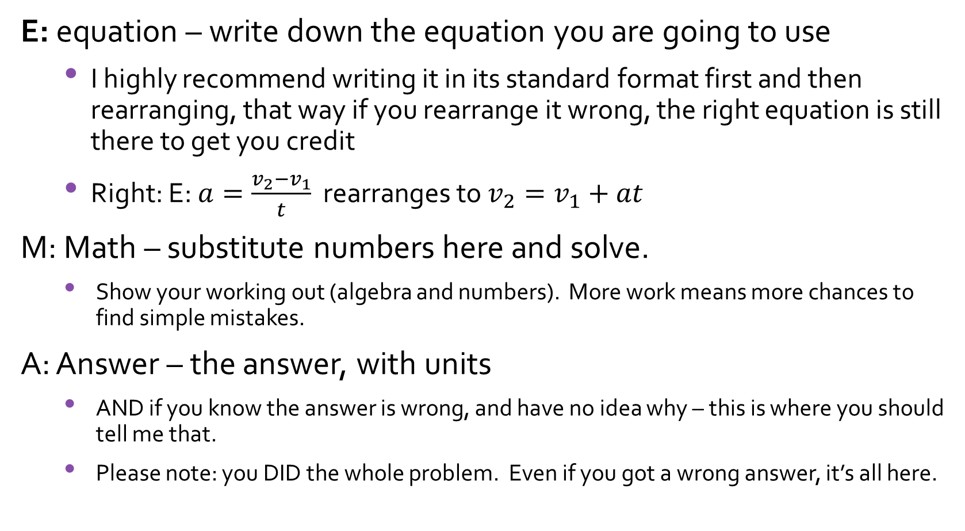
How to properly use GFEMA: a review
E: equation – write down the equation you are going to use
  I highly recommend writing it in its standard format first and then rearranging, that way if you rearrange it wrong, the right equation is still there to get you credit
  Right: E: $a=\frac{v_{2}−v_{1}}{t}$ rearranges to $v_{2}=v_{1}+at$
M: Math – substitute numbers here and solve.
    Show your working out (algebra and numbers). More work means more chances to find simple mistakes.
  A: Answer – the answer, with units
    AND if you know the answer is wrong, and have no idea why – this is where you should tell me that.
    Please note: you DID the whole problem. Even if you got a wrong answer, it’s all here.

Slide 11
Sample Problems and Solutions
http://www.physicsclassroom.com/class/1DKin/Lesson-6/Sample-Problems-and-Solutions
http://www.solvephysics.com/problems_kinematics.shtml
http://www.redknightphysics.com/kinematicsProbs.php
https://www.khanacademy.org/science/physics/one-dimensional-motion/kinematic-formulas/e/setting-up-problems-with-constant-acceleration
https://www.khanacademy.org/science/physics/one-dimensional-motion/kinematic-formulas/e/kinematic-formulas-in-one-dimension
https://brilliant.org/wiki/velocity-and-acceleration-problem-solving-easy/

