Slide 1
Review of Previous Lesson
State as many Vocabulary words and Learning Objectives that you remember from the last lesson as you can.
Now complete the content learning objectives.
Remember to grade yourself from 0 – 3.

Slide 2
Acceleration - Time Graphs

Slide 3
Vocabulary
Content: | Start | End
velocity
time
area
curve
slope / gradient
measured
graph
axes
read
acceleration

Slide 4
Vocabulary
Language: | Start | End
calculate
under
construct
appropriate

Slide 5
Learning Objectives
Content: | Start | End
Construct and read a velocity time graph.
Calculate the acceleration (slope) and displacement (area under the curve) from a velocity time graph.
Match the action of an object with the appropriately shaped graph.

Slide 6
Learning Objectives
Language: | Start | End
Read and interpret instructions and questions.

Slide 7
Acceleration - Time Graphs
Pre-Lab
Draw a rough sketch of what you think a Acceleration - Time graph will look like for your “journey” from the last presentation (“Displacement (Position)-Time Graphs Presentation”).
  Explain to your group why you believe your graph will look like this.
  Some students will now explain why they believe their graph will look like this.

Slide 8
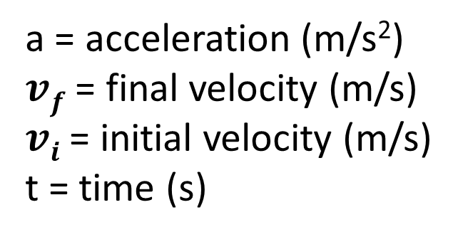
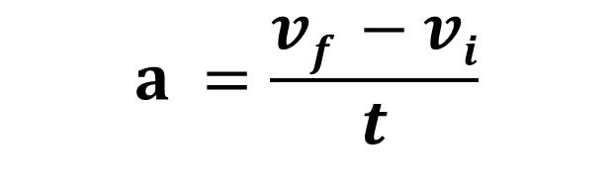
a = acceleration (m/s²)
$vf$ = final velocity (m/s)
$vi$ = initial velocity (m/s)
t = time (s)
$$a =\frac{vf −vi}{t}$$

Slide 9
Graphing Rules
Title
Draw and label axes with units.
  Dependent variable on the horizontal x-axis and the independent variable on the vertical y-axis.
Identify minimum (usually 0 but not always) and maximum values needed on both axes.
Choose a suitable scale to fill the paper.
  In 2, 4, 5, 10, 20, 50, 100 etc..
Plot the points.
Decide if the graph is a curve, several straight lines or one straight line (line of best fit) and construct the graph.

Slide 10
Acceleration - Time Graphs
Construct a Acceleration - Time Graph for this journey.

Slide 11
Acceleration - Time Graphs
If we look at the velocities during each stage and consider the velocity changes as instantaneous (although this not actually possible) we will not have any acceleration (as the slopes on such a velocity time graph are all zero) so we will have a graph that looks like this:

Slide 12
Velocity - Time Graph - Specimen
Forwards (F) / W
Stage | Distance (m) | Time (s) | Velocity (m/s)
A | 2 | 1 | -2
Velocity (m/s)
Backwards (B) / E
B | 5 | 2 | +2.5
C | 0 | 3 | 0
5
Dotted lines show instantaneous velocity changes.
They are not solid as this is not actually possible.
D | 3 | 2 | -1.5
B
C
Time (s)
0
5
10
2m, slow
3 m, fast
D
D
A
A
B
C
5 m, fast
3s
-5

Slide 13
Acceleration - Time Graph - Specimen
Forwards (F) / W
Stage | Initial Velocity (m/s) | Final Velocity (m/s) | Time (s) | Acceleration (m/s²)
Acceleration (m/s)
A | -2 | -2 | 1 | 0
Backwards (B) / E
B | 2.5 | 2.5 | 2 | 0
5
C | 0 | 0 | 3 | 0
D | -2.5 | -2.5 | 2 | 0
A
B
C
D
Time (s)
0
5
10
2m, slow
3 m, fast
D
A
B
C
5 m, fast
3s
-5

Slide 14
Acceleration - Time Graphs
Note that if we look at the velocities during each stage and estimate or “best guess” the times to accelerate and deaccelerate, we will have a graph that looks like this:
To save time we will only look at the first stage of your journey.

Slide 15
Velocity - Graph - Specimen
Stage | Distance (m) | Time (s) | Average Velocity (m/s)
Forwards (F) / W
A | 2 | 0.2 | -2
 |  | 0.6
 |  | 0.2
Velocity (m/s)
Backwards (B) / E
5
Note that negative acceleration here shows decreasing velocity in the positive direction.
B | 5 | 0.2 | +2.5
 |  | 1.6
 |  | 0.2
Constant velocity
Accelerate
Decelerate
Time (s)
0
Backwards
Forwards
Decelerate
5
Accelerate
2m, slow
Constant velocity
A
A
B
5 m, fast
-5
Note that negative acceleration here shows increasing velocity in the negative direction.

Slide 16
Acceleration - Graph - Specimen
Forwards (F) / W
Stage | Initial Velocity (m/s) | Final Velocity (m/s) | Time (s) | Acceleration (m/s²)
Decelerate
Acceleration (m/s)
A
0 | -2 | 0.2 | -10
Backwards (B) / E
-2 | -2 | 0.6 | 0
10
-2 | 0 | 0.2 | 10
A
No acceleration
Constant velocity
Time (s)
0
Backwards
Forwards
0.5
1.0
2m, slow
A
Accelerate
-10

Slide 17

Distance (position) to Velocity Time Graph Physics Help
https://www.youtube.com/watch?v=EZXLkAYjmR0

Slide 18
Acceleration - Time Graphs
Does your actual graph look similar to the rough sketch you drew earlier?
  If not, what are the differences and why do you think you got it wrong? Explain what you didn’t understand and what you now understand.
    If you do not know why you were wrong, please ask questions.

Slide 19
Interpreting Acceleration - Time Graphs
In each section of the journey, is the acceleration steady or is it changing? How do you know?
Are there any negative slopes or gradients on the graph? What do they mean?
What is given by the area under an Acceleration - Time Graph?
How do you know if the person is speeding up or slowing down?
How can you tell if the person is traveling away from or towards the start point?
What is the scale on the vertical axis?

Slide 20
Interpreting Acceleration - Time Graphs
Label the graph showing the:
  The acceleration at the end of each stage.
  The acceleration at different points within stages.
  The change in velocity for each stage.
  The change in velocity at the end of each stage from the beginning.
  The change in velocity at different points within stages from the beginning.
  If someone starts at a velocity of a specified velocity (you choose), the object’s velocity at each stage and at different points within stages.
      What are the differences? Explain.

Slide 21
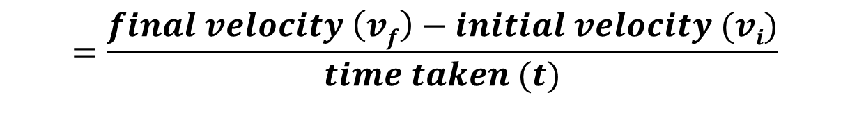


acceleration$(a) =\frac{final velocity \left(v\right)−initial velocity (u)}{time taken (t)}$
$$=\frac{final velocity \left(vf\right)−initial velocity (vi)}{time taken (t)}$$
$$=\frac{change in velocity (\text{Δ}\text{v})}{time taken (t)}$$

Slide 22
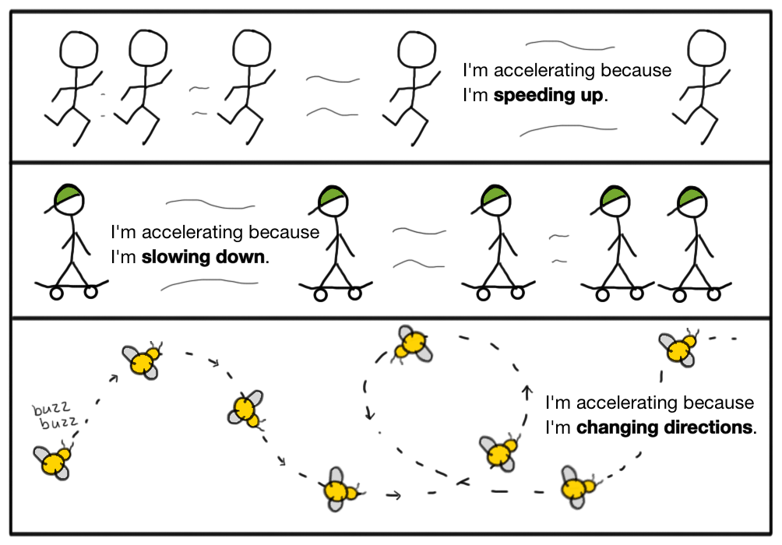
What is acceleration?
https://www.khanacademy.org/science/physics/one-dimensional-motion/acceleration-tutorial/a/acceleration-article

Slide 23
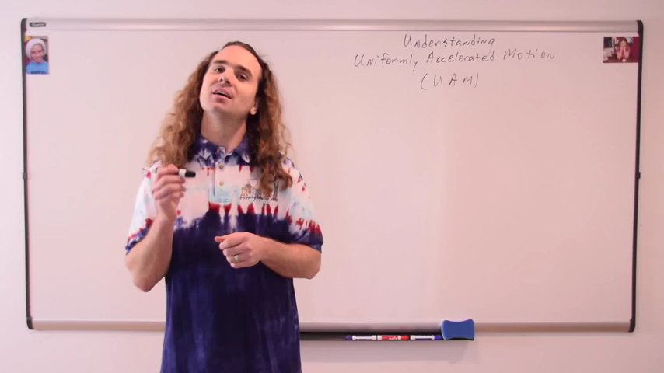
Experimentally Graphing Uniformly Accelerated Motion
Flipping Physics (youtube)

Slide 24
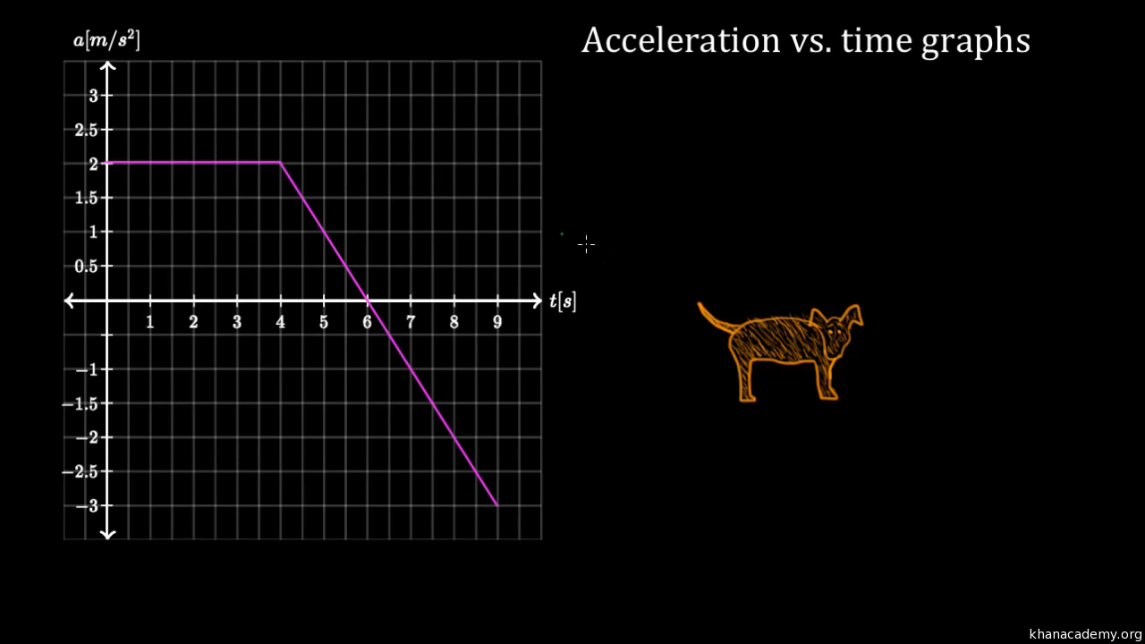
https://www.khanacademy.org/science/physics/one-dimensional-motion/acceleration-tutorial/v/acceleration-vs-time-graphs

Slide 25
What are acceleration vs. time graphs?
https://www.khanacademy.org/science/physics/one-dimensional-motion/acceleration-tutorial/a/what-are-acceleration-vs-time-graphs

Slide 26

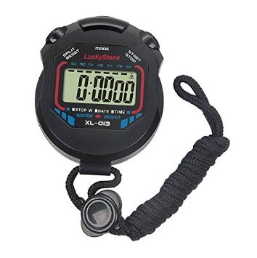
Accelerated Motion
Remember this experiment?
ball
Inclined rail
10cm
20cm
30cm
Measure the time taken to reach each of the marks.
Draw a displacement (position) time graph.

Slide 27
Acceleration - Time Graphs
Pre-Lab
Draw a rough sketch of what you think an Acceleration - Time graph will look like for the “accelerated motion” from the presentation (“Displacement (Position)-Time Graphs Presentation”) .

Slide 28
Accelerated Motion
Acceleration - Time Graphs
Using your results from the earlier experiment create a table with the data needed to create an Acceleration - Time graph for Accelerated Motion.
Create an Acceleration - Time graph for Accelerated Motion.

Slide 29
Acceleration - Time Graphs
Does your actual graph look similar to the rough sketch you drew earlier?
  If not, what are the differences and why do you think you got it wrong? Explain what you didn’t understand and what you now understand.
    If you do not know why you were wrong, please ask questions.

Slide 30
Interpreting Acceleration - Time Graphs
In each section of the journey, is the acceleration steady or is it changing? How do you know?
Are there any negative slopes or gradients on the graph? What do they mean?
What is given by the area under an Acceleration - Time Graph?
How do you know if the person is speeding up or slowing down?
How can you tell if the person is traveling away from or towards the start point?
What is the scale on the vertical axis?

Slide 31
Interpreting Acceleration - Time Graphs
Label the graph showing the:
  The acceleration at the end of each stage.
  The acceleration at different points within stages.
  The change in velocity for each stage.
  The change in velocity at the end of each stage from the beginning.
  The change in velocity at different points within stages from the beginning.
  If someone starts at a velocity of a specified velocity (you choose), the object’s velocity at each stage and at different points within stages.
      What are the differences? Explain.

Slide 32
Understanding Uniformly Accelerated Motion
Flipping Physics (youtube)

Slide 33
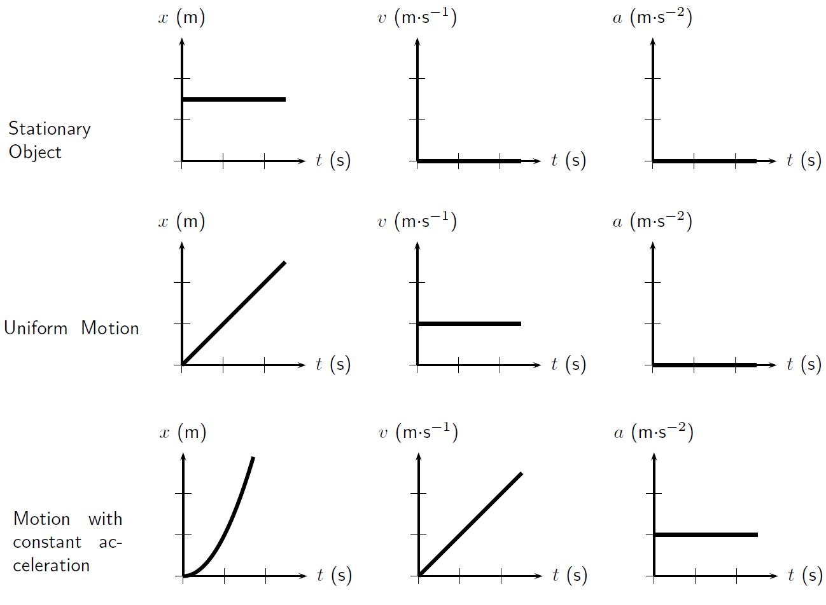
Reading Graphs

Slide 34
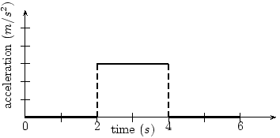
Plenary
Each mark on the acceleration axis is 2 m/s².
Each mark on the time axis is 4 s.
What is the acceleration of the object at:
  4 seconds?
  10 seconds?

Slide 35
Plenary
Each mark on the acceleration axis is 2 m/s².
Each mark on the time axis is 4 s.
2. If the object starts at a velocity of 10 m/s, what is the object’s velocity at:
4 seconds?
12 seconds?

Slide 36
Plenary
Each mark on the acceleration axis is 2 m/s².
Each mark on the time axis is 4 s.
3. Between 4 seconds and 6 seconds, what is true of the object?
It is at rest
It is speeding up
It is slowing down
It is maintaining a constant velocity

Slide 37
Plenary
Each mark on the acceleration axis is 2 m/s².
Each mark on the time axis is 4 s.
4. Between 8 seconds and 12 seconds, what is true of the object?
It is at rest
It is speeding up
It is slowing down
It is maintaining a constant velocity

Slide 38
Plenary
Each mark on the acceleration axis is 2 m/s².
Each mark on the time axis is 4 s.
5. If the object moves with a negative velocity for the journey, which is true?
It is moving faster.
It is moving more slowly.
It hasn’t changed speed.
It is at rest the whole time.

Slide 39
Plenary
Position, Velocity, and Acceleration vs. Time Graphs
  https://www.geogebra.org/m/pdNj3DgD

Slide 40
Plenary
Match the following graphs to there correct “stories”.

Slide 41
Grade yourself.
Grade yourself on the vocabulary and learning objectives of the lesson.

