Slide 1
Review of Previous Lesson
State as many Vocabulary words and Learning Objectives that you remember from the last lesson as you can.
Now complete the content learning objectives.
Remember to grade yourself from 0 – 3.

Slide 2
Displacement (Position) - Time Graphs

Slide 3
Vocabulary
Content: | Start | End
vertical
horizontal
graph
displacement
position
read
time
measured
axes
velocity
slope / gradient
acceleration

Slide 4
Vocabulary
Language: | Start | End
locate
identify
construct
calculate
match
action
appropriate

Slide 5
Learning Objectives
Content: | Start | End
Locate values on the vertical axis that correspond to a value on the horizontal axis of graphs.
Identify what is being measured on the axes of a graph.
Identify a positive or negative slope by looking at graphs.
Construct and read a position time graph.
Calculate the velocity (slope) of a position time graph.
Match the action of an object with the appropriately shaped position time graph.

Slide 6
Learning Objectives
Language: | Start | End
Read and interpret instructions and questions.
8 Ba 22/08/2017

Slide 7
Displacement (Position) - Time Graphs
Pre-Lab
In groups design a path for someone to follow.
  straight lines
  direction changes with compass directions (N, S, W, E)
  distances (<= 5m, whole numbers)
  labelled very slow, slow, fast, very fast (for large distances only)
  Includes some pauses for some seconds (<=5).
  Label each stage with a letter.
    Pauses are also stages.
  ends at the start
  Write all this in a “story”
    Example:
      … walks slowly West for 2m, then turns North and runs fast for 5 m, then stops to rest for 3 seconds, ….
Example:
C
D
3s
B
5 m, N, fast
A
2m, W, slow

Slide 8
Displacement (Position) - Time Graphs
Pre-Lab
Draw a rough sketch of what you think the Displacement (Position) - Time graph will look like for the journey you have planned.
  Explain to your group why you believe your graph will look like this.
  Some students will now explain why they believe their graph will look like this.

Slide 9
Displacement (Position) - Time Graphs
Pre-Lab
State the possible sources of errors.
List the equipment you think you may need.
State any problems and possible solutions you think you may encounter trying to construct a Displacement (Position) - Time graph for the journey you have planned.
Create a table to record the data you think you will need to create a Displacement (Position) - Time Graph.

Slide 10
Displacement (Position) - Time Graphs
Lets go outside, complete the journey and measure the data needed to construct a Displacement (Position) - Time graph for your journey.

Slide 11
Displacement (Position) - Time Graphs
Create a Displacement (Position) - Time graph for your journey.

Slide 12

Displacement (Position) - Time Graphs
Did you repeat and then average measurements to reduce the affects of errors?
  You should have!
Please comment in your notes:
  Did you repeat and then average measurements to reduce the affects of errors?
    If yes, why did you do so.
    If no, why should have done so

Slide 13
Displacement (Position) - Time Graphs
Share your results with your group.
  Everyone in your group needs a table with the data.
  Your table should look something like this:
Headings with units should also contain their units.
Stage | Distance (m) | Time 1 (s) | Time 2 (s) | Time 3 (s) | Average Time (s) | Direction
A
B
C
D
E
F
G
H

Slide 14
Graphing Rules
Title
Draw and label axes with units.
  Dependent variable on the horizontal x-axis and the independent variable on the vertical y-axis.
Identify minimum (usually 0 but not always) and maximum values needed on both axes.
Choose a suitable scale to fill the paper.
  In 2, 4, 5, 10, 20, 50, 100 etc..
Plot the points.
Decide if the graph is a curve, several straight lines or one straight line (line of best fit) and construct the graph.

Slide 15
Interpreting Displacement (Position) - Time Graphs
What are we ignoring or pretending is happening on this displacement – Time Graph? How did you identify which direction is positive and which is negative? Can you represent all 4 directions on one graph?
  You cannot! You can only represent 2 opposite directions (N/S or E/W).
  1 dimensional motion
  You would need 2 graphs to represent all 4 directions.
  Each graph will represent the motion in 1 dimension only:
    N/S & E/W , often we say N is + & S is – and E is + and W is – (however there is no reason why these cannot be reversed).
    What will any movement in one dimension look like on the other dimension’s graph?
      No motion as far as that dimension is concerned so it will look like a pause.

Slide 16
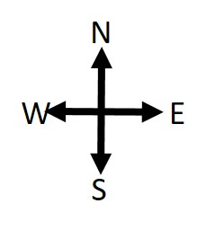
Displacement (Position) - Graph - Specimen
Stage | Distance (m) | Time (s) | Direction
W
A | 2 | 1 | W
Displacement (m)
B | 5 | 2 | N
E
C | 0 | 3 | -
5
D | 5 | 2 | E
E | 2 | 1 | N
B
C
F | 1 | 1 | E
A
G | 7 | 2 | S
Time (s)
0
H | 4 | 1 | W
5
D
10
F
H
E
C 3s pause
D
E
F
G
G
B
-5
A
H

Slide 17
Interpreting Displacement (Position) - Time Graphs
Does your actual graph look similar to the rough sketch you drew earlier?
  If not, what are the differences and why do you think you got it wrong? Explain what you didn’t understand and what you now understand.
    If you do not know why you were wrong, please ask questions.

Slide 18
Interpreting Displacement (Position) - Time Graphs
In each section of the journey, is the speed steady or is it changing? How do you know?
Are there any negative slopes or gradients on the graph? What do they mean?
How can you tell if the person is traveling away from or towards the start point?
How can you calculate the velocity during a stage?
What is the scale on the vertical axis?

Slide 19
Interpreting Displacement (Position) - Time Graphs
Distance travelled at the end of each stage (from the start).
Displacement travelled at the end of each stage (from the start).
Time taken at the end of each stage (from the start).
Distance travelled during each stage.
Time taken for each stage.
Total displacement and time taken for the whole journey.
Average Speed at the end of each stage.
The instantaneous speed at the end of each stage.
The instantaneous velocity at the end of each stage.
Average Velocity (m/s) at the end of each stage.
The overall average velocity for the whole journey.
The instantaneous speed at different points during each stage.
  You can choose these points yourself.
The instantaneous velocity at different points during each stage.
  You can choose these points yourself.
    What are the differences? Explain.

Slide 20


$$s=\frac{d}{t}$$
s = speed (m/s)
d = distance (m)
t = time (s)
$$v =\frac{d}{t}$$
v = velocity (m/s)
d = displacement (m)
t = time (s)

Slide 21
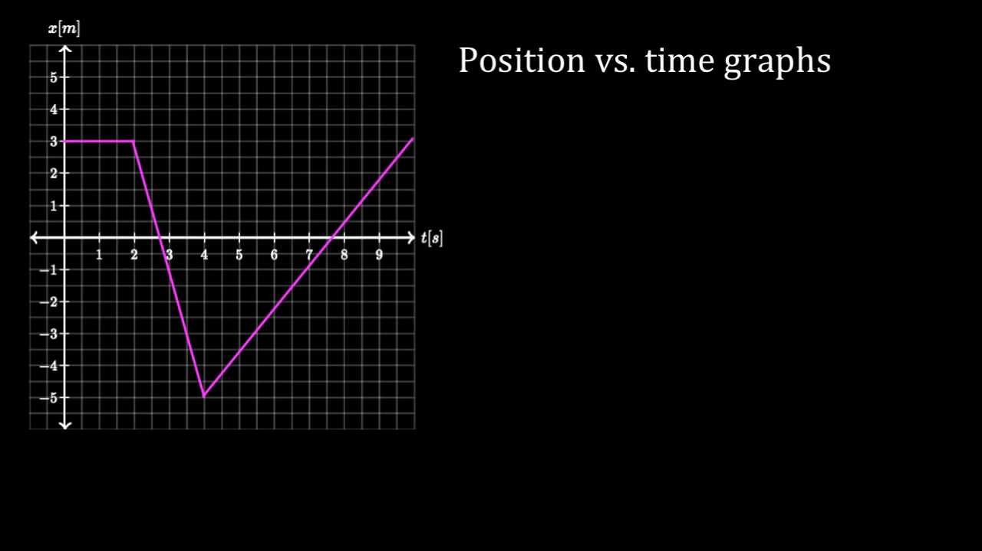
https://www.khanacademy.org/science/physics/one-dimensional-motion/displacement-velocity-time/v/position-vs-time-graphs

Slide 22
Interpreting Displacement (Position) - Time Graphs
Realism:
  What is the total displacement covered? Is this realistic for the time taken? Why?/Why not?
  Is the fastest speed realistic? Is the slowest speed realistic? Why?/Why not?

Slide 23
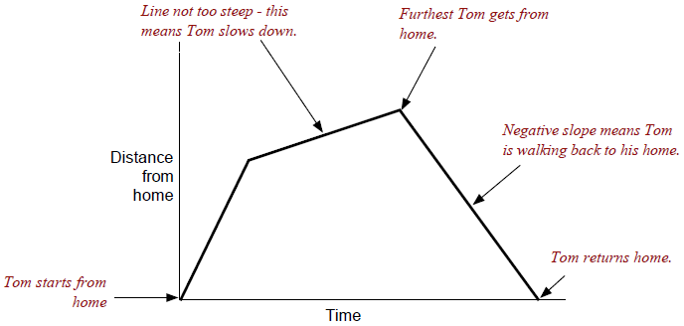
Interpreting Displacement (Position) - Time Graphs
Label the graph with any other observations you can think of.
  Example:
Write the story of the journey from the graph.
  How does this compare to the original story you wrote earlier?

Slide 24

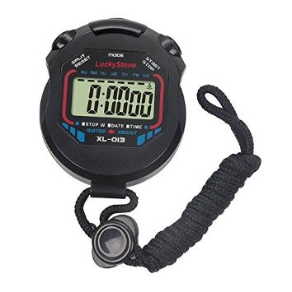
Accelerated Motion
ball
Inclined rail
10cm
20cm
30cm
Measure the time taken to reach each of the marks.

Slide 25
Accelerated Motion
Displacement (Position) - Time Graphs
Pre-Lab
Draw a rough sketch of what you think the Displacement (Position) - Time graph will look like for accelerated motion.

Slide 26
Accelerated Motion
Displacement (Position) - Time Graphs
Pre-Lab
State the possible sources of errors.
List the equipment you think you may need.
State any problems and possible solutions you think you may encounter trying to construct a Displacement (Position) - Time.
Create a table to record the data you think you will need to create a Displacement (Position) - Time Graph.

Slide 27
Accelerated Motion
Displacement (Position) - Time Graphs
Setup the experiment described on the previous slides and measure the data needed to construct a Displacement (Position) - Time graph for Accelerated Motion.

Slide 28
Accelerated Motion
Displacement (Position) - Time Graphs
Average Speed at different points.
Average Velocity (m/s) at different points.
The average speed at the end of the incline.
The average velocity at the end of the incline.
The instantaneous speed at different points.
The instantaneous velocity at different points.
What are the differences both between the answers above and the previous graph of a journey? Explain.
  You can choose the points yourself (at least 2).

Slide 29
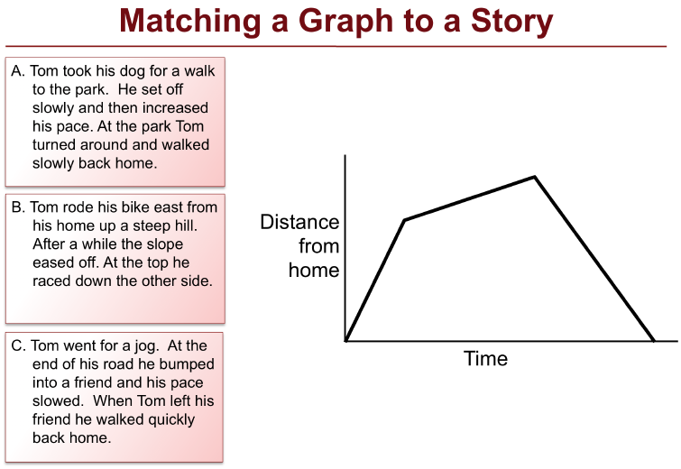
Plenary
Why?
Explain the reasons for your choice.

Slide 30
Plenary
Match each graph on the following slides to its appropriate story.

Slide 31
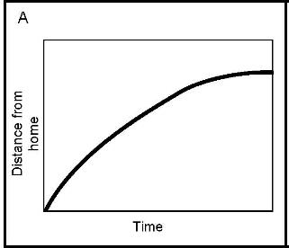
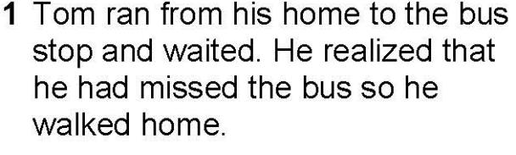
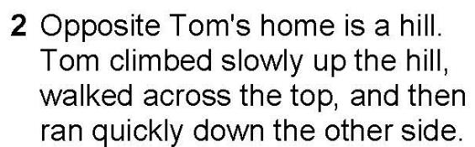
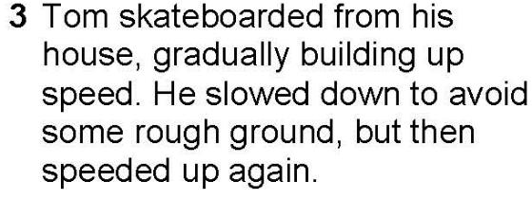
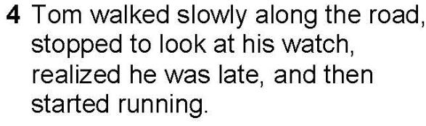
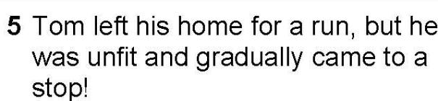
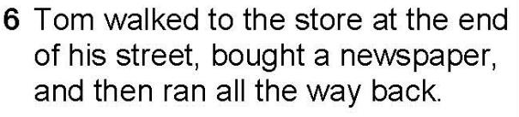
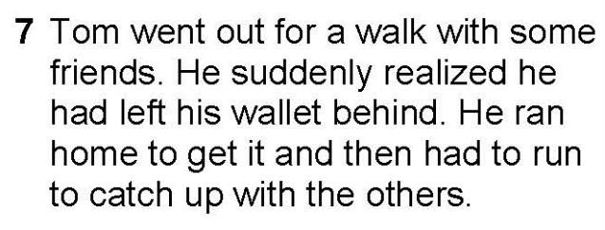
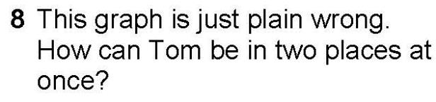
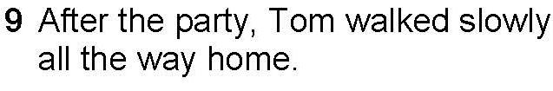

Plenary

Slide 32
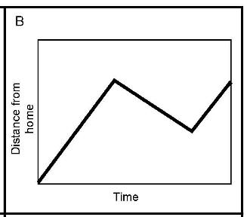
Plenary

Slide 33
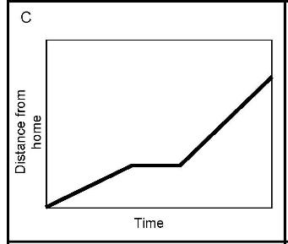
Plenary

Slide 34
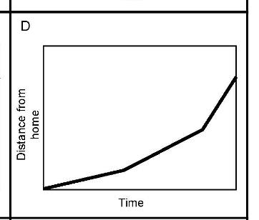
Plenary

Slide 35
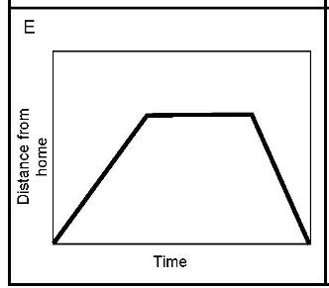
Plenary

Slide 36
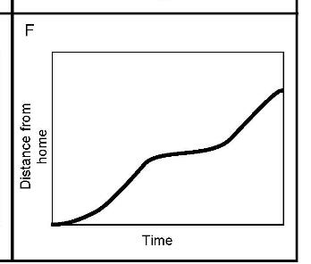
Plenary

Slide 37
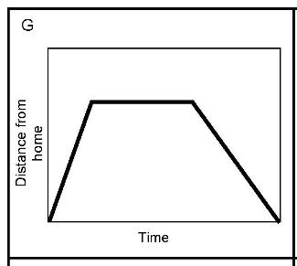
Plenary

Slide 38
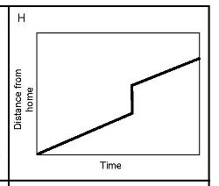
Plenary

Slide 39
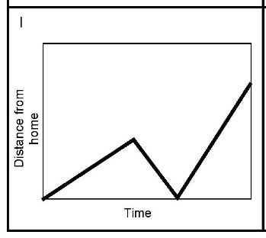
Plenary

Slide 40
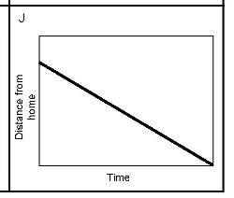
Plenary

Slide 41
Plenary
Match each graph on the following slides to its appropriate data table.

Slide 42
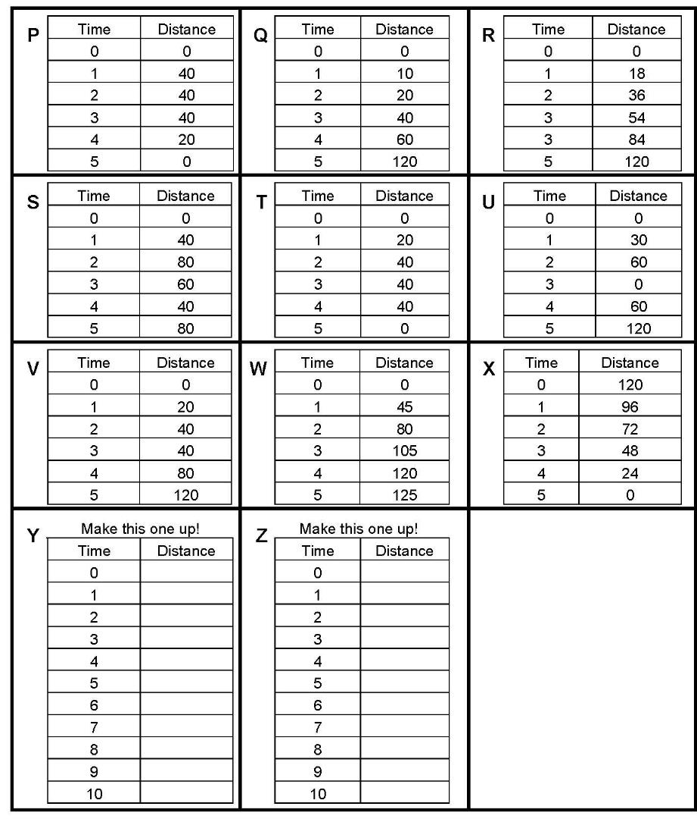
Plenary

Slide 44
Plenary

Slide 45
Plenary

Slide 46
Plenary

Slide 47
Plenary

Slide 48
Plenary
F

Slide 49
Plenary
G

Slide 50
Plenary
H

Slide 51
Plenary
I

Slide 52
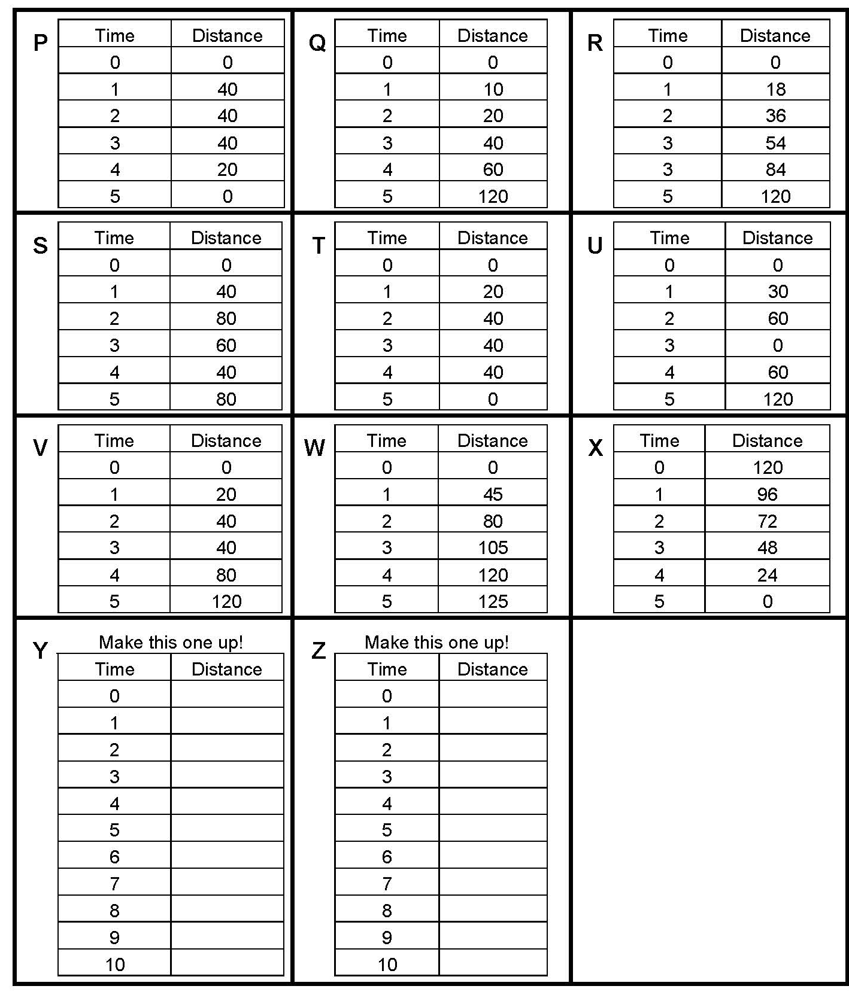
Plenary
J

Slide 53
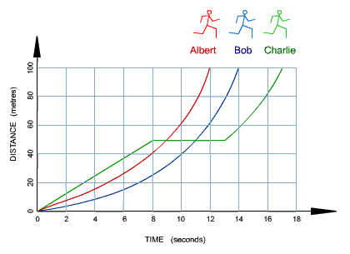
Plenary
Albert
Bob
Charlie
Look at the graph above. It shows how three runners ran a 100-meter race.
Which runner won the race? Explain your answer.
Which runner stopped for a rest? Explain your answer.
How long did Bob take to complete the race? Explain your answer.
Calculate Albert's average speed. (Figure the distance and the time first!)

Slide 54
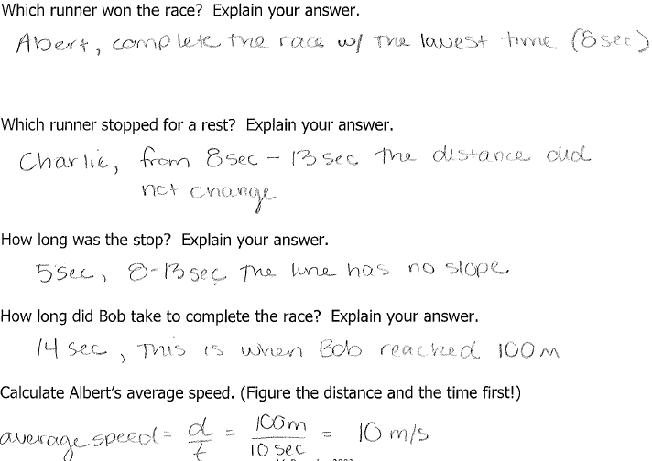

Slide 55
Plenary
How do you calculate the speed and velocity on a curved Displacement (Position) – Time Graph?
  https://www.khanacademy.org/science/physics/one-dimensional-motion/displacement-velocity-time/v/instantaneous-speed-and-velocity
  https://www.khanacademy.org/science/physics/one-dimensional-motion/displacement-velocity-time/a/position-vs-time-graphs

Slide 56
Plenary
What do you think a Displacement (Position) – Time Graph will look like for circular motion?
    http://interactagram.com/physics/kinamatics/circularMotion/

Slide 57
Grade yourself.
Grade yourself on the vocabulary and learning objectives of the lesson.

