Slide 1
Review of Previous Lesson
State as many Vocabulary words and Learning Objectives that you remember from the last lesson as you can.
Remember to grade yourself from 0 - 3.

Slide 2
Wave Properties & Motion
Waves

Slide 3
Vocabulary
Content: | Start | End
vibration
oscillation
equilibrium
restoring force
medium
energy transfer
frequency
period
compression
rarefaction

Slide 4
Vocabulary
Content: | Start | End
crest
trough
amplitude
wavelength
longitudinal
transverse
wave speed

Slide 5
Learning Objectives
Content: | Start | End
Identify and explain relationship between a vibration and wave.
Describe the steps in vibration.
Recognise that only energy is transferred in wave motion.
Understand and correctly apply a wave speed’s dependence on media only.
Calculate the speed of a wave given its wavelength and frequency or graphical depiction of a wave.
Transverse or longitudinal, categorise examples of each, know sound and light classifications.

Slide 6


Resting / Equilibrium position:
  The position assumed by an object when it is not moving.
  An object is at rest/equilibrium if the forces acting on it are balanced or add up to a net force of 0 N.
http://www.physicsclassroom.com/class/waves/Lesson-0/Vibrational-Motion

Slide 7
What Causes Objects to Vibrate?
If a force is applied to an object, its equilibrium will be disturbed and the object may begin to wiggle, shake, vibrate or oscillate.
http://www.physicsclassroom.com/class/waves/Lesson-0/Vibrational-Motion

Slide 8
What Causes Objects to Vibrate?
With a continuous input of energy the vibration would keep going, without, it eventually stop as the mechanical energy of the object is lost to other objects.
http://www.physicsclassroom.com/class/waves/Lesson-0/Vibrational-Motion

Slide 9
The Restoring Force
As the object is displaced past its equilibrium position, a force capable of slowing it down and stopping it exists.
  This force that slows the object down as it moves away from its equilibrium position is known as a Restoring Force.
  The Restoring Force acts upon the vibrating object to move it back to its original equilibrium position.
http://www.physicsclassroom.com/class/waves/Lesson-0/Vibrational-Motion
http://commons.wikimedia.org/wiki/File:Simple_harmonic_oscillator.gif

Slide 10
If there are balanced forces acting upon the object at the equilibrium position, then why does the object sway past this position? Why doesn't the object stop the first time it returns to the equilibrium position?
Newton's first law of motion/inertia.
  An object which is moving will continue its motion if the forces acting on it are balanced.
  Balanced forces do not stop moving objects.
http://www.physicsclassroom.com/class/waves/Lesson-0/Vibrational-Motion

Slide 11
Steps in Vibration
Push/Pull or Stretch/Compress.
Accelerates towards resting/equilibrium position.
Reaches resting/equilibrium position.
Decelerates from resting/equilibrium position due to restoring force pulling it back towards resting/equilibrium position.
Reaches other end of vibration and repeats from 2.
http://www.physicsclassroom.com/class/waves/Lesson-0/Vibrational-Motion
http://commons.wikimedia.org/wiki/File:Simple_harmonic_oscillator.gif

Slide 12
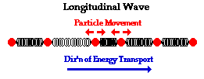
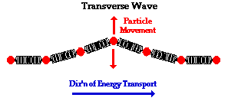
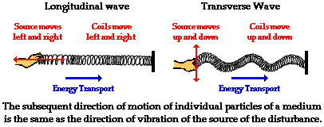
What is a Wave?
http://www.physicsclassroom.com/class/waves/Lesson-1/What-is-a-Wave
A vibration or oscillation that travels through a medium from one location to another location, which transfers energy without the movement of matter.

Slide 13
What is a Medium?
http://www.physicsclassroom.com/class/waves/Lesson-1/What-is-a-Wave
The substance or material that carries the wave.
Not the wave and it doesn't make the wave; it only carries or transports the wave from its source to other locations.
In the case below, the medium through that the wave travels is the slinky coils.
e.g. Sound Waves
e.g. Light Waves

Slide 14

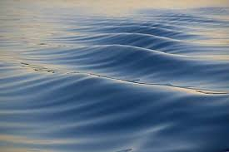
What is the Medium?
http://www.physicsclassroom.com/class/waves/Lesson-1/What-is-a-Wave
water

Slide 15
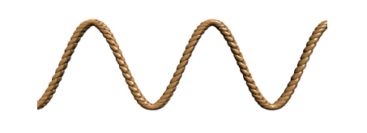
What is the Medium?
http://www.physicsclassroom.com/class/waves/Lesson-1/What-is-a-Wave
rope

Slide 16

What is the Medium?
http://www.physicsclassroom.com/class/waves/Lesson-1/What-is-a-Wave
air

Slide 17

No movement of matter
Each particle/part/coil vibrates about its resting/equilibrium position only, each part returns continuously to the same resting/equilibrium, it does not move along with the wave or energy.
http://www.physicsclassroom.com/class/waves/Lesson-1/What-is-a-Wave
http://www.physicsclassroom.com/mmedia/waves/lw.cfm

Slide 18

Energy transport with the movement of matter
Unlike wave phenomena, the bat must move from its starting location to the contact location in order to transport energy.
http://www.physicsclassroom.com/class/waves/Lesson-1/What-is-a-Wave

Slide 19
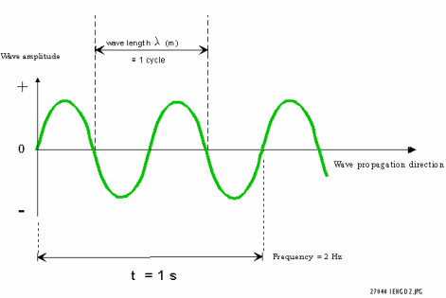

wavelength λ (m)
Wave amplitude
= 1 cycle
crest
Wave propagation direction
trough
d = 2m
Frequency (f) = 2 cycles in 1s
= 2 Hz
Period (T) = ½ s

Slide 20
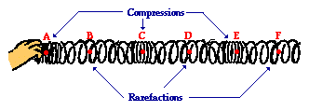
http://www.physicsclassroom.com/class/waves/Lesson-2/The-Anatomy-of-a-Wave

Slide 21
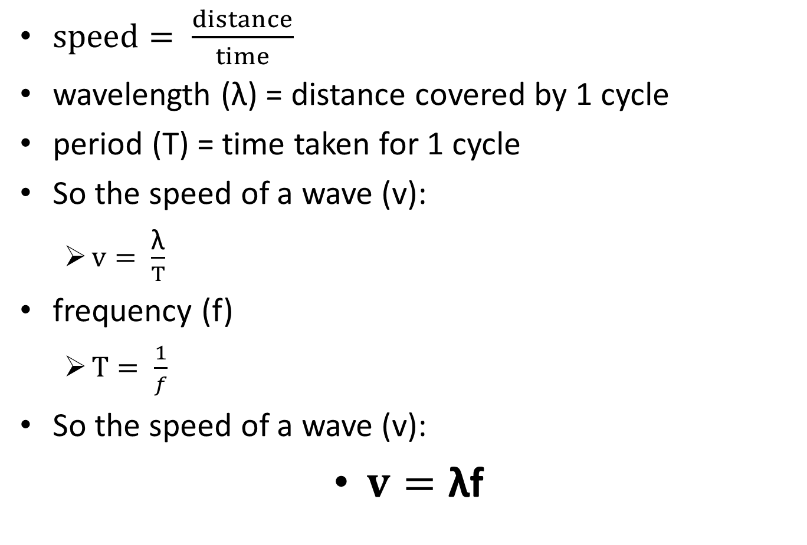
The Speed of a Wave
$speed= \frac{distance}{time}$
wavelength (λ) = distance covered by 1 cycle
period (T) = time taken for 1 cycle
So the speed of a wave (v):
  $v= \frac{\text{λ}}{T}$
frequency (f)
  $T= \frac{1}{f}$
So the speed of a wave (v):
$v=\text{λ}$f

Slide 22
What changes a wave’s speed?
Possible factors?
  frequency, amplitude, wavelength, medium?
https://phet.colorado.edu/sims/html/wave-on-a-string/latest/wave-on-a-string_en.html
As frequency increases the wavelength decreases and vice versa. As 𝐯 = λf, f and λ have no effect on 𝐯.
Conclusion:
  Wave speed depends only on the medium.

Slide 23

GCSE Science Revision - Types of Waves
JamJarMMX https://www.youtube.com/watch?v=w2s2fZr8sqQ

Slide 24
Problems & Solutions:
http://www.physicsclassroom.com/class/waves/Lesson-0/Properties-of-Periodic-Motion
http://www.physicsclassroom.com/class/waves/Lesson-1/What-is-a-Wave
http://www.physicsclassroom.com/class/waves/Lesson-1/Categories-of-Waves
http://www.physicsclassroom.com/class/waves/Lesson-2/The-Anatomy-of-a-Wave
http://www.physicsclassroom.com/class/waves/Lesson-2/Frequency-and-Period-of-a-Wave
http://www.physicsclassroom.com/Class/waves/U10L2d.cfm#lab
http://www.physicsclassroom.com/class/waves/Lesson-2/The-Wave-Equation

Slide 25
Grade yourself.
Grade yourself on the vocabulary and learning objectives of the presentation.

