Slide 1
Review of Previous Lesson
State as many Vocabulary words and Learning Objectives that you remember from the last lesson as you can.
Now complete the content learning objectives.
Remember to grade yourself from 0 – 3.

Slide 2
Electromagnetic & Mechanical Waves

Slide 3
Learning Objectives
Content: | Start | End
Identify and differentiate between the two classifications of waves: electromagnetic or mechanical

Slide 4
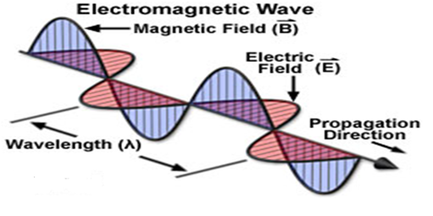
Electromagnetic Wave

Slide 5
Difference Between Mechanical and Electromagnetic Waves
Electromagnetic Waves:
  Can travel through a medium (e.g. air, water etc…) but they do not need to.
  Can travel through a vacuum.
Mechanical Waves:
  Must have a medium to travel through.
  Cannot travel through a vacuum.
  e.g. Sound, water waves, etc…

Slide 6
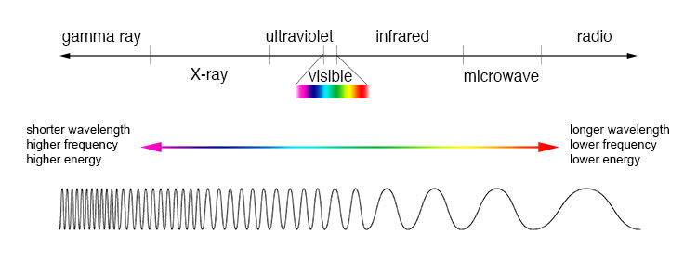
Electromagnetic Spectrum
https://imagine.gsfc.nasa.gov/Images/science/EM_spectrum_compare_level1_lg.jpg

Slide 7
Raging Martians Invaded Venus Using X-ray Guns
The electromagnetic spectrum, in terms of increasing frequency is:
  Radio waves, Microwaves, Infrared, Visible light, Ultraviolet, X-Rays, Gamma Rays

Slide 8

ROY G BIV
http://www.physicsclassroom.com/Class/light/u12l2a.cfm#p3
Dispersion of visible light produces the colours red (R), orange (O), yellow (Y), green (G), blue (B), and violet (V).
It is because of this that visible light is sometimes referred to as ROY G. BIV.
  (Incidentally, the indigo is not actually observed in the spectrum but is traditionally added to the list so that there is a vowel in Roy's last name.)

Slide 9

Electromagnetic Waves
(Bozeman Science) https://www.youtube.com/watch?v=WNkB8IY-k04
Dora noticed that the first time the electromagnetic spectrum is shown in the video, the order is incorrect. In decreasing frequency it should be: Gamma Rays, X-Rays, Ultraviolet, Visible light, Infrared, Microwaves, Radio waves.

Slide 10
Plenary:
Electromagnetic Waves:
  http://www.physicsclassroom.com/Class/light/u12l2a.cfm
  http://www.ducksters.com/science/quiz/types_of_electromagnetic_waves_questions.php
  https://www.proprofs.com/quiz-school/story.php?title=electromagnetic-spectrum-quiz
  https://quizizz.com/admin/quiz/5730e5caa1c4f029abdf5a6f
  https://quizizz.com/admin/quiz/570bcef93469f3622b5b54fc

