Slide 1
Review of Previous Lesson
State as many Vocabulary words and Learning Objectives that you remember from the last lesson as you can.
Remember to grade yourself from 0 - 3.

Slide 2
Electric Fields
Electrostatics

Slide 3
Learning Objectives
Content: | Start | End
Recognize field lines represent the force experienced by a positively charged particle.
Diagram the electric field between two charged particles using field line conventions.
Compare and contrast the force experienced by and motion of a charged particle in an electric field based on field lines.
Explain the cause of electric fields.
Qualitatively discuss electric field strength based on number of field lines and field line density.

Slide 4

Electric field definition
Khan Academy https://www.khanacademy.org/science/physics/electric-charge-electric-force-and-voltage/electric-field/v/electric-field-definition

Slide 5

Electric field direction
Khan Academy https://www.khanacademy.org/science/physics/electric-charge-electric-force-and-voltage/electric-field/v/electric-field-direction

Slide 6
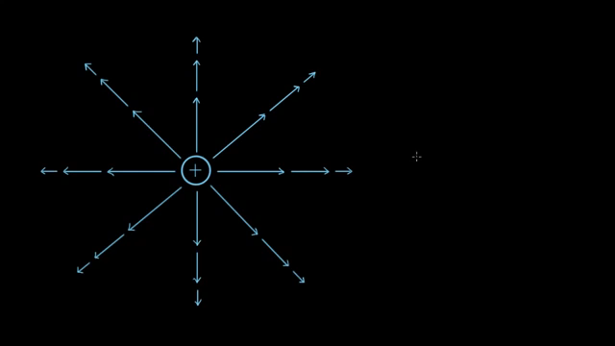
Magnitude of electric field created by a charge
Khan Academy https://www.khanacademy.org/science/physics/electric-charge-electric-force-and-voltage/electric-field/v/magnitude-of-electric-field-created-by-a-charge

Slide 7
Electric Field Simulator
http://www.physicsclassroom.com/Physics-Interactives/Static-Electricity/Electric-Field-Lines/Electric-Field-Lines-Interactive

Slide 8
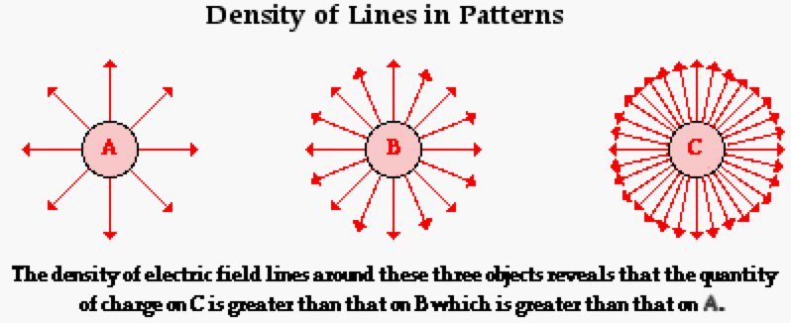
Which has the largest quantity of charge? A, B or C?
Which has the smallest quantity of charge?
http://www.physicsclassroom.com/class/estatics/Lesson-4/Electric-Field-Lines

Slide 9
http://www.physicsclassroom.com/class/estatics/Lesson-4/Electric-Field-Lines

Slide 10
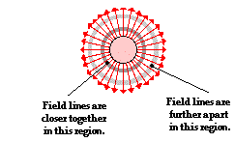
Where is the electric field the greatest?
http://www.physicsclassroom.com/class/estatics/Lesson-4/Electric-Field-Lines

Slide 11
http://www.physicsclassroom.com/class/estatics/Lesson-4/Electric-Field-Lines

Slide 12
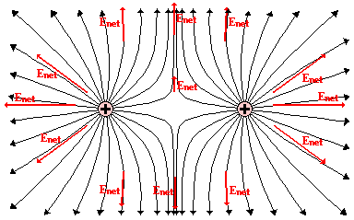
What charges and how much relative charge are shown here?
http://www.physicsclassroom.com/class/estatics/Lesson-4/Electric-Field-Lines

Slide 13
Two Equal Positive Charges
http://www.physicsclassroom.com/class/estatics/Lesson-4/Electric-Field-Lines

Slide 14
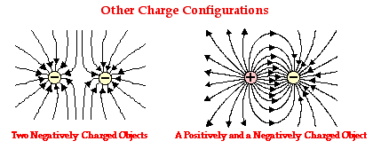
What charges and how much relative charge are shown here?
http://www.physicsclassroom.com/class/estatics/Lesson-4/Electric-Field-Lines

Slide 15
http://www.physicsclassroom.com/class/estatics/Lesson-4/Electric-Field-Lines

Slide 16
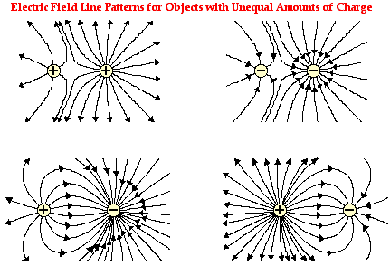
What charges and how much relative charge are shown here?
http://www.physicsclassroom.com/class/estatics/Lesson-4/Electric-Field-Lines

Slide 17
http://www.physicsclassroom.com/class/estatics/Lesson-4/Electric-Field-Lines

Slide 18
Problems & Solutions:
Electric Field Lines:
  http://www.physicsclassroom.com/class/estatics/Lesson-4/Electric-Field-Lines
  http://www.mcqlearn.com/physics/g10/electric-field-and-intensity-mcqs.php
  http://www.mcqslearn.com/a-level/physics/mcq/electric-field.php
  https://physics.info/electric-field/practice.shtml
Electric Field Formulae:
  https://www.introduction-to-physics.com/electric-field-quiz.html
  https://www.physics247.com/quiz/efieldquiz1.html
  https://quizizz.com/admin/quiz/572308d99e0f97a95d8af9a0
Electric Field Lines & Formulae:
  https://quizizz.com/admin/quiz/590b277aed579e1000584449

Slide 19
Grade yourself.
Grade yourself on the vocabulary and learning objectives of the presentation.

