Slide 1
Review of Previous Lesson
State as many Vocabulary words and Learning Objectives that you remember from the last lesson as you can.
Remember to grade yourself from 0 - 3.

Slide 2
Coulomb's Law
Electrostatics

Slide 3
Learning Objectives
Content: | Start | End
State Coulomb’s Law.
Calculate the force between two charged objects using Coulomb’s Law in scientific notation.
Apply proportionality reasoning to determine force: distance doubled, force quartered.
Define electric force.
Identify and explain how the electric force acts on various charges including magnitude and direction.
Recognize F₁₂ = F₂₁

Slide 4
Language Learning Objectives
Content: | Start | End
State in writing.
Calculate
Apply
Define verbally and in writing.
Identify and explain verbally and in writing.
Recognise

Slide 5

Electrostatics (part 1): Introduction to Coulomb's Law
Khan Academy https://www.khanacademy.org/science/physics/electric-charge-electric-force-and-voltage/charge-electric-force/v/coulombs-law

Slide 6
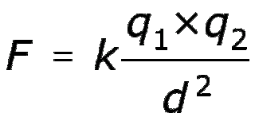
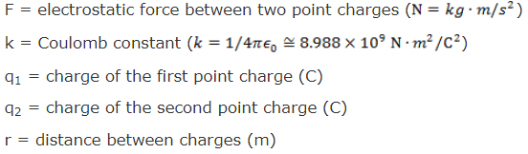
Coulomb’s Law

Slide 7
Coulomb’s Law
http://www.physicsclassroom.com/Physics-Interactives/Static-Electricity/Coulomb-s-Law/Coulomb-s-Law-Interactive

Slide 8
Charge 1 = 1*10⁻⁹C, Distance = 1m, Increasing Charge 2
Use k = 9*10⁹
Charge 2 (C) | F_{e} (N)
1
2
3
4
5

Slide 9
Charge 1 = 1*10⁻⁹C, Distance = 1m, Increasing Charge 2
Use k = 9*10⁹
Is there an easier way to fill out the table without recalculating each time?
Draw a rough sketch of what you think a graph with Force (Y axis) and charge (X axis) will look like.
Draw a graph with Force (Y axis) and charge (X axis).
Charge 2 (C) | F_{e} (N)
1
2
3
4
5

Slide 10

F_{e} with Increasing Charge 2
F_{e} (N)
Charge 2 (C)

Slide 11
Charge 1 = 1C, Charge 2 = 1*10⁻⁹C
Increasing Distance
Use k = 9*10⁹
Distance (m) | F_{e} (N)
1
2
3
4
5

Slide 12
Charge 1 = 1C, Charge 2 = 1*10⁻⁹C
Increasing Distance
Use k = 9*10⁹
Is there an easier way to fill out the table without recalculating each time?
Draw a rough sketch of what you think a graph with Force (Y axis) and distance (X axis) will look like.
Draw a graph with Force (Y axis) and distance (X axis).
Distance (m) | F_{e} (N)
1
2
3
4
5

Slide 13

F_{e} with Increasing Distance
F_{e} (N)
Distance (m)

Slide 14
Problems & Solutions:
Coulomb’s Law:
  http://www.mcqslearn.com/a-level/physics/coulomb-law.php
  http://www.physicsclassroom.com/class/estatics/Lesson-3/Coulomb-s-Law
  http://www.softschools.com/formulas/physics/coulombs_law_formula/218/
  http://www.mcqslearn.com/applied/physics/coulomb-law.php
  http://www.mcqlearn.com/physics/g10/coulombs-law-mcqs.php
  http://www.physicsclassroom.com/reviews/Static-Electricity/Static-Electricity-Review-Questions-with-Links

Slide 15
Grade yourself.
Grade yourself on the vocabulary and learning objectives of the presentation.

