Slide 1
Review of Previous Lesson
State as many Vocabulary words and Learning Objectives that you remember from the last lesson as you can.
Remember to grade yourself from 0 - 3.

Slide 2
Conservation of Electric Charge
&
Charging Methods
Electrostatics

Slide 3
Learning Objectives
Content: | Start | End
Differentiate between insulators and conductors.
Discuss what determines conductivity of a material.
State the Conservation of Electric Charge.
Apply Conservation of Charge to various scenarios as support for electron motion.
Know electron motion for basic materials: rubber, plastic, hair, metal, etc.
Describe and diagram charge motion for each method of charging: Contact/Conduction, Friction, Induction.
Identify which method of charging was used given various scenarios.
Describe benefits of each charging method.

Slide 4

Conductors and Insulators
Khan Academy https://www.khanacademy.org/science/physics/electric-charge-electric-force-and-voltage/charge-electric-force/v/conductors-and-insulators

Slide 5
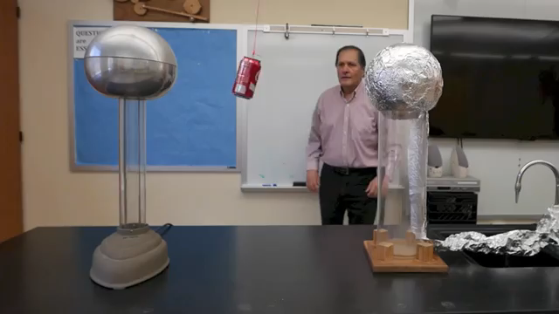
Static Electricity part two Conduction-Induction // Homemade Science with Bruce Yeany
Bruce Yeany https://www.youtube.com/watch?v=6y9k6G4r8Bs

Slide 6
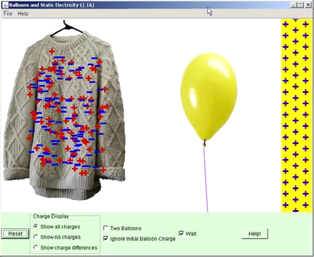
Law of conservation of Charge
RBCSScience https://www.youtube.com/watch?v=Kgc5lTAOM3E

Slide 7
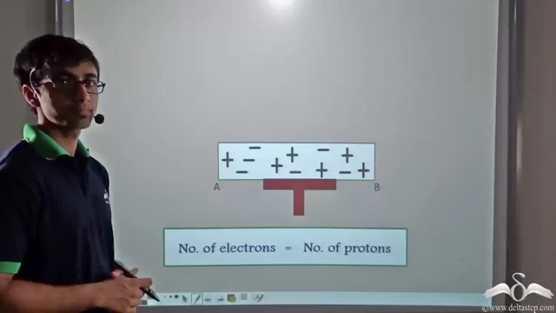
Charging by Induction
DeltaStep https://www.youtube.com/watch?v=nu1E_IPUpN0

Slide 8
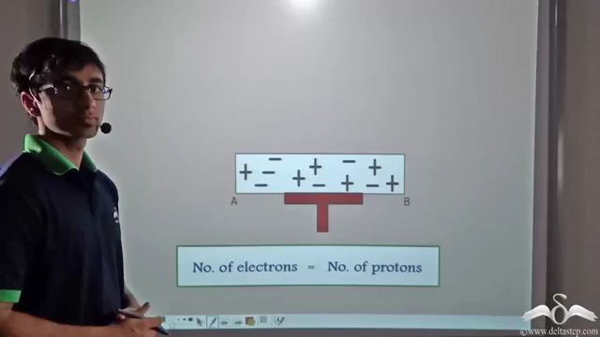
Charging by Conduction (Contact)
DeltaStep https://www.youtube.com/watch?v=cP7UvRNC5Zk

Slide 9
Problems & Solutions:
http://www.physicsclassroom.com/class/estatics/Lesson-2/Charging-by-Friction
http://www.physicsclassroom.com/class/estatics/Lesson-2/Charging-by-Induction
http://www.physicsclassroom.com/class/estatics/Lesson-2/Charging-by-Conduction
https://www.introduction-to-physics.com/charging-by-induction-quiz.html

Slide 10
Grade yourself.
Grade yourself on the vocabulary and learning objectives of the presentation.

