Slide 1
Review of Previous Lesson
State as many Vocabulary words and Learning Objectives that you remember from the last lesson as you can.
Complete the content learning objectives.
Remember to grade yourself from 0 – 3.

Slide 2
Metric Pre-fixes and Units

Slide 3
Vocabulary
Content: | Start | End
metric
imperial
units
base

Slide 4
Vocabulary
Language: | Start | End
command
convert

Slide 5
Learning Objectives
Content: | Start | End
Identify and state base units for various quantities.
Convert between prefixes.

Slide 6
Learning Objectives
Language: | Start | End
Verbally and in writing state and explain.

Slide 7
Base Units
Measurement | Unit | Symbol
distance | metre / meter | m
mass | kilogram | kg
time | second | s
electric current | ampere | A
temperature | kelvin | K
amount of substance | mole | mol
intensity of light | candela | cd

Slide 8
Base Units
In pairs, one thinks of a measurement, the other writes the unit and symbol on their whiteboard. Take turns.
  After 2 minutes reverse the game.

Slide 9
Derived Units
All other units are derived or “come from” the base units.
  https://en.wikipedia.org/wiki/SI_derived_unit
Derived quantity | Name | Symbol | Expression in terms of SI base units
force | newton | N | kg m s⁻²
energy, work, quantity of heat | joule | J | m² kg s⁻²
power, radiant flux | watt | W | m² kg s⁻³

Slide 10
Imperial Units
Measurement | Unit | Symbol
distance | foot | ft
mass | ounce | oz
weight | pound | lb
volume | cubic foot | ft³
temperature | Fahrenheit | f

Slide 11
Why is there a standard set of units for physics?
Units of measurement are the terms that we use to describe the size of something.
Without standard units of measurement, scientists would have a huge problem understanding what other scientists were saying.
  If I were to refer to a meter as "the length of my leg" and another scientists were to refer to it as "the length of a Saint Bernard dog", we would not be able to compare measurements.
The SI system of units gives us a standard set of units that we can agree on.

Slide 12
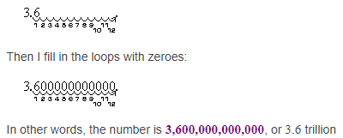
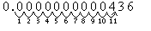
Scientific Notation
3.6 × 10¹² = ?
3,600,000,000,000, or 3.6 trillion
4.36 × 10⁻¹¹ = ?
0.0000000000436

Slide 13
Scientific Notation
After putting the number in Scientific Notation, just check that:
  The "digits" part is between 1 and 10 (it can be 1, but never 10).
  The "power" part shows exactly how many places to move the decimal point.

Slide 14
Scientific Notation
Warning: A negative on an exponent and a negative on a number mean two very different things! For instance:
  -0.00036 = -3.6 × 10⁻⁴
  0.00036 = 3.6 × 10⁻⁴
  36,000 = 3.6 × 10⁴
  -36,000 = -3.6 × 10⁴

Slide 15
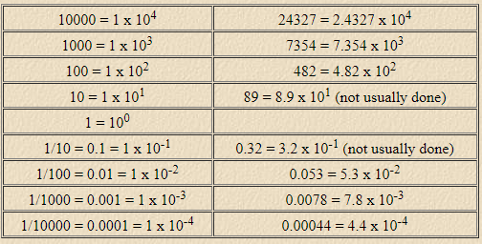
Scientific Notation

Slide 16
Scientific Notation Example
Write out the following in full decimal numbers:
  6.38 x 10⁵ m
  9.86 x 10⁻¹¹ K
= 638000 m
= 0.0000000000986 K

Slide 17
Scientific Notation Example
Convert the following to scientific notation:
  - 0.000000874 kg
  - 127823.6 N
= -8.74 * 10⁻⁷ kg
= -1.278236 * 10⁵ N

Slide 18
Metric Prefixes
We use prefixes to make reporting numbers easier
Example
  The wavelength is 0.000000673 m
  The wavelength is 673 nm

Slide 19
Metric Prefixes
If you move up, the numbers become larger than 1
Tera
The base unit is NO prefix
e.g. g, l, m, …
Giga
Mega
Kilo
Hecto
Deca
Base
If you move down, the numbers become smaller than 1
Deci
Centi
Milli
Micro
Nano
Pico

Slide 20
Metric Prefixes
You do not need to copy this column if you are confident you understand the relationship between it and its exponential.
You need to memorize these!
Prefix | Symbol | Numerical | Exponential
Tera | T | 1,000,000,000,000 | 10¹² | Trillion
Giga | G | 1,000,000,000 | 10⁹ | Billion
Mega | M | 1,000,000 | 10⁶ | Million
Kilo | k | 1,000 | 10³ | Thousand
Hecto | h | 100 | 10² | Hundred
Deca | da | 10 | 10¹ | Ten
Base |  | 1 | 10⁰
Deci | d | 0.1 | 10⁻¹ | Tenth
Centi | c | 0.01 | 10⁻² | Hundredth
Milli | m | 0.001 | 10⁻³ | Thousandth
Micro | μ | 0.000001 | 10⁻⁶ | Millionth
Nano | n | 0.000000001 | 10⁻⁹ | Billionth
Pico | p | 0.000000000001 | 10⁻¹² | Trillionth

Slide 21
Metric Prefixes
If you move up, the numbers become larger than 1
The base unit is NO prefix
e.g. g, l, m, …
10¹²
Tera
10⁹
Giga
10⁶
/1000
Mega
10³
/1000
Kilo
10²
/1000
Hecto
10¹
/10
Deca
If you move down, the numbers become smaller than 1
10⁰
/10
Base
10⁻¹
/10
Deci
10⁻²
Centi
10⁻³
*10
Milli
*10
10⁻⁶
*10
Micro
10⁻⁹
Nano
*1000
10-¹²
Pico
*1000
*1000

Slide 22
Metric Prefixes
In pairs, one thinks of a prefix, the other writes the symbol and exponential on their whiteboard. Take turns.
  After 2 minutes reverse the game.

Slide 23
Unit Conversions
Divide the exponentials of the symbol or prefix.
  exponential of the number to convert from
  exponential of the number to convert to
Then multiply the result by the number you have been given.
Example:
  Convert 2 nm = ? dam
    nm 10⁻⁹, dam 10¹
    10⁻⁹/10¹ = 10⁽⁻⁹⁻¹⁾ = 10⁻¹⁰
    2 * 10⁻¹⁰ = 0.00000000020
Note:
1. + exponents when * numbers with the same base.
2. - the exponents when / numbers with the same base.

Slide 24
Unit Conversions
If you are converting to/from base then just multiply or divide by the power of 10 respectively.
  Example:
    To convert from kg (10³) to g * 1000
      6 kg = 6 * 1000 g = 6000 g
    To convert from g to kg (10³) / 1000
      5 g = 5 / 1000 kg = 0.005 kg
    To convert from g to μg (10⁻⁶) / 10⁻⁶ or * 10⁶
      8 g = 8 * 10⁶ μg
      10⁰ / 10⁻⁶ = 10⁰ ⁻ ⁻⁶ = 10⁰ ⁺ ⁶ = 10⁶
Note:
Positive - Negative = Positive + Positive = Positive

Slide 25
Unit Conversions
How many meters are in 1543 mm?
1543 mm = ________________m
1.543
Milli | m | 0.001 | 10⁻³ | Thousandth

Slide 26
Unit Conversions
6.32 * 10⁻³
6.32 m = ____________ km
9872447 m = ______________ Mm
647821 nm = _______________dam
0.00632
Kilo | k | 1,000 | 10³ | Thousand
9.872447
9872447. * 10⁻⁶ = 9.872447
      (10⁰ / 10⁶ = 10⁰ ⁻ ⁶ = 10⁻⁶)
Mega | M | 1,000,000 | 10⁶ | Million
6.47821 * 10⁻⁵
647821. * 10⁻¹⁰
      (10⁻⁹ / 10¹ = 10⁻⁹ ⁻ ¹ = 10⁻¹⁰)
Nano | n | 0.000000001 | 10⁻⁹ | Billionth
Deca | da | 10 | 10¹ | Ten

Slide 27
0.024 m = _________________ μm
1.574 hm = ________________dam
7.54 Tm = _______________Gm
2.4 * 10⁴
0.024 * 10⁶ = 2.4 * 10⁻² * 10⁶ = 24000
      (10⁰ / 10⁻⁶ = 10⁰ ⁻ ⁻⁶ = 10⁰ ⁺ ⁶ = 10⁶)
Micro | μ | 0.000001 | 10⁻⁶ | Millionth
15.74
      1.574 * 10² / 10¹ = 1.574 * 10² ⁻ ¹ = 1.574 * 10¹
Hecto | h | 100 | 10² | Hundred
Deca | da | 10 | 10¹ | Ten
7540
      7.54 * 10¹² / 10⁹ = 7.54 * 10¹² ⁻ ⁹ = 7.54 * 10³
Tera | T | 1,000,000,000,000 | 10¹² | Trillion
Giga | G | 1,000,000,000 | 10⁹ | Billion

Slide 28
Accuracy
Accuracy: the nearness of a value to the standard or true value
An accurate measuring device will provide measurements near the accepted value

Slide 29
Accuracy
Inaccurate measurements may be corrected through instrument calibration
  Scale reads 1 kg when empty
  Stopwatch takes half a second to stop when clicked
Example: your weight 50 kg, but the scale says 60 kg. By adding 10 kg to the inaccurate readings, biases can be corrected

Slide 30
Precision
Precision: The degree to which several measurements provide answers very close to each other
The less “scatter” of data, the more precise the measuring
Example: hitting the outer ring of the target every time

Slide 31
Precision
Precision measures the spread of data
Imprecise measurements have a large spread
Example: your scale gives you measurements of 120 kg, 117 kg, 124 kg, and 114 kg when you measure your weight 4 times in a row

Slide 32
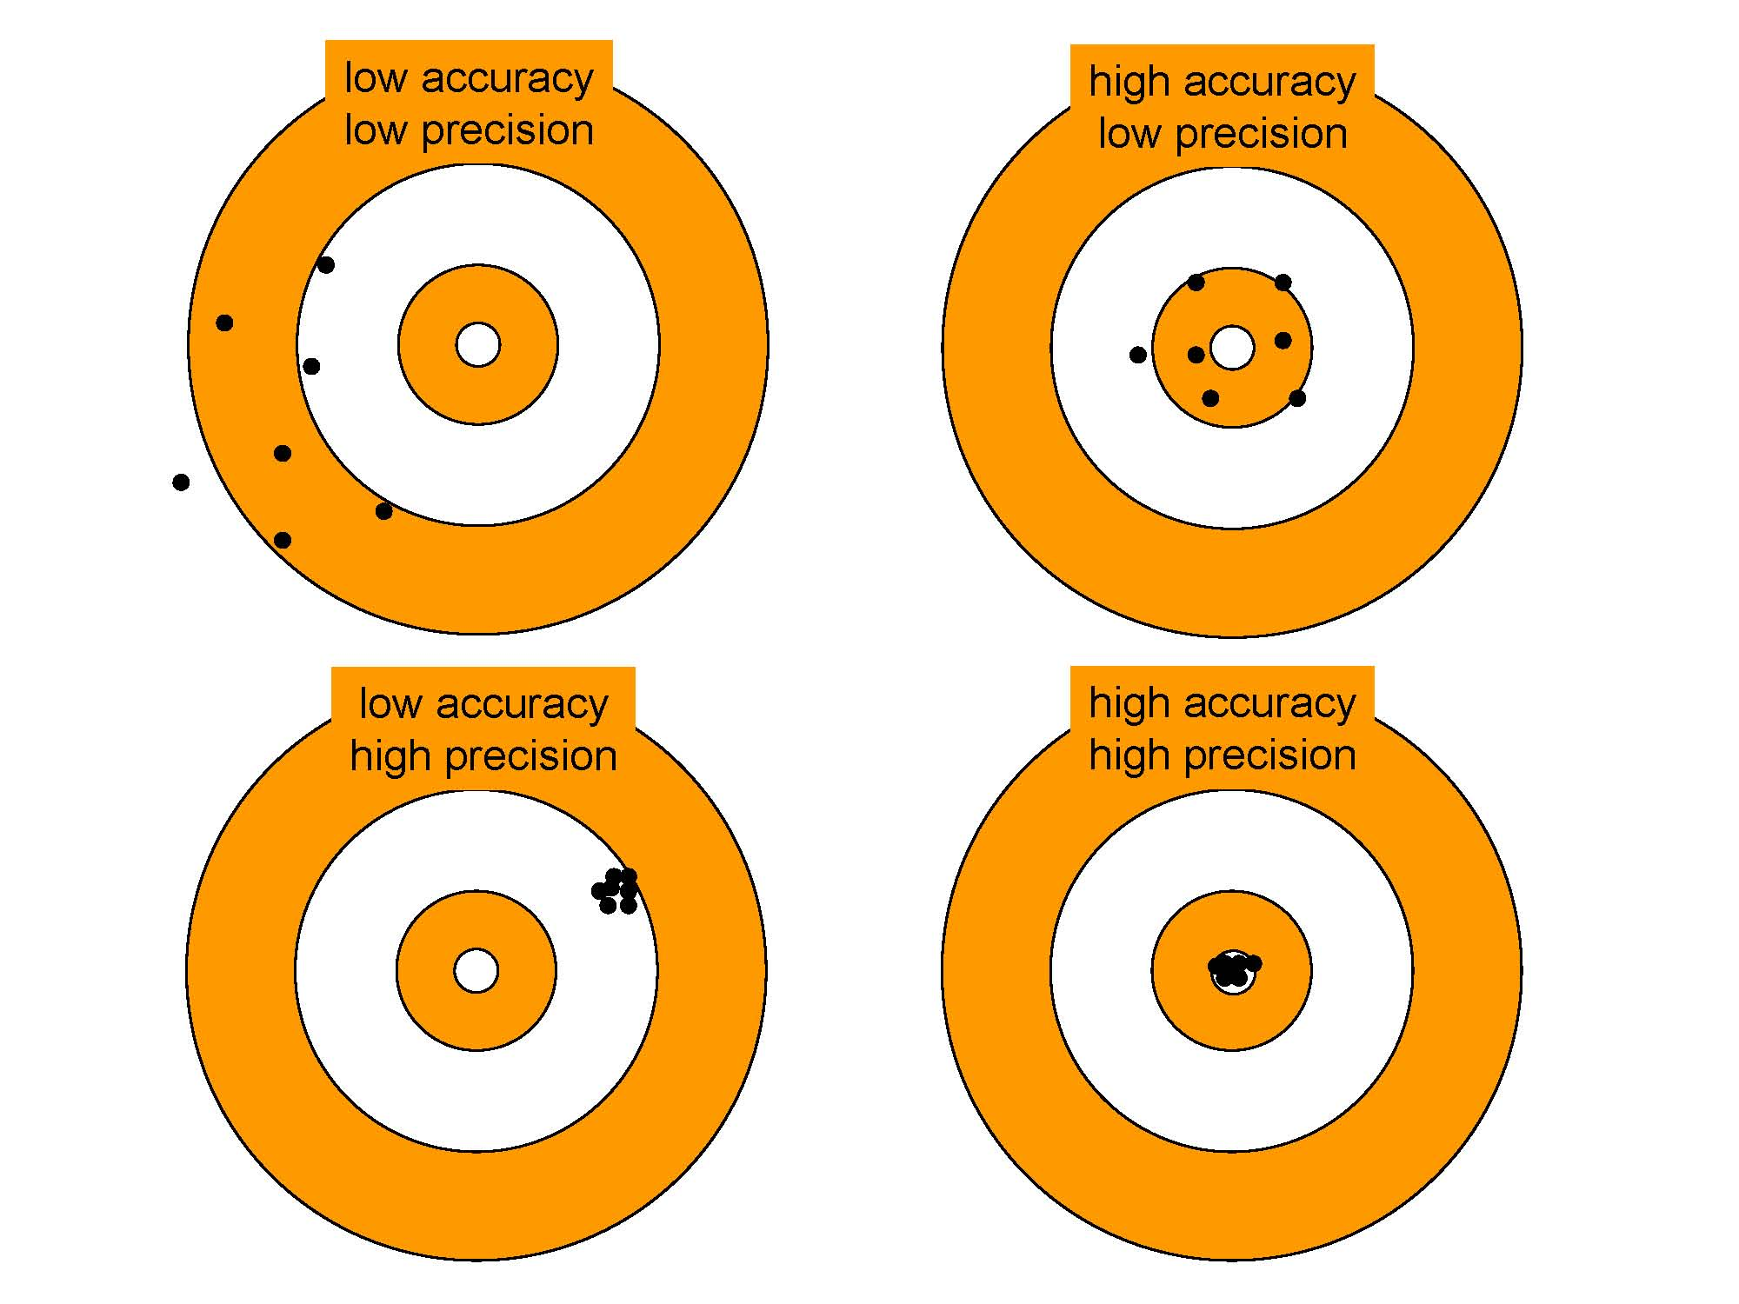
Accuracy vs. Precision
Far from target
Close to target
Large spread
Large spread
Close to target
Far from target
Small spread
Small spread

Slide 33
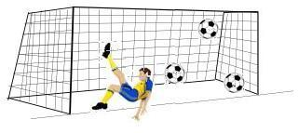
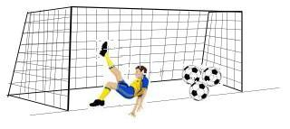
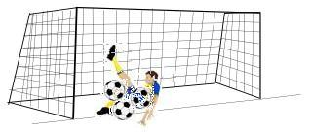
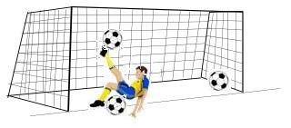
The shooter is aiming for the back right corner of the net. Which shows high accuracy and high precision?
b
a
c
d

Slide 34
The shooter is aiming for the back right corner of the net. Which shows high accuracy and low precision?
b
a
c
d

Slide 35
Plenary
In pairs give your partner a sample conversion to perform.
Choose one of your lowest graded words from the vocabulary of this lesson and create a vocabulary word map.
Definition in your own words. | Synonyms
Use it meaningfully in a sentence. | Draw a picture of it.
Vocabulary Word

Slide 36
Grade yourself.
Grade yourself on the vocabulary and learning objectives of the lesson.

