Slide 1
Review of Previous Lesson
State as many Vocabulary words and Learning Objectives that you remember from the last lesson as you can.
Now complete the content learning objectives.
Remember to grade yourself from 0 – 3.

Slide 2
Displacement (Position) - Time Graphs – 1D

Slide 3
Vocabulary
Content: | Start | End
vertical
horizontal
graph
displacement
position
read
time
measured
axes
velocity
slope / gradient
acceleration

Slide 4
Vocabulary
Language: | Start | End
locate
identify
construct
calculate
match
action
appropriate

Slide 5

Learning Objectives
Content: | Start | End
1. Locate values on the vertical axis that correspond to a value on the horizontal axis of graphs.
2. Identify what is being measured on the axes of a graph.
3. Identify a positive or negative slope by looking at graphs.
4. Construct and read a position time graph.
5. Calculate the velocity (slope) of a position time graph.
6. Match the action of an object with the appropriately shaped position time graph.
Which ones have we covered already?
Which one/s did we cover in our last lesson?
Please discuss and write the numbers on your whiteboards.

Slide 6
Learning Objectives
Language: | Start | End
Read and interpret instructions and questions.
8 Ba 22/08/2017

Slide 7
Displacement (Position) - Time Graphs
Pre-Lab
In groups design a journey for someone to follow.
  straight lines in 1 dimension
    Forwards and backwards on a straight line.
  distances (<= 5m, whole numbers)
  labelled very slow, slow, fast, very fast (for large distances only)
  Includes some pauses for some seconds (<=5).
  Label each stage with a letter.
    Pauses are also stages.
  ends at the start
  Write all this in a “story”
    Example:
      … walks slowly backward for 2m, then turns around and runs forward fast for 5 m, then stops to rest for 3 seconds, ….
Example:
D
2m, slow
3 m, fast
A
B
C
5 m, fast
3s

Slide 8
Displacement (Position) - Time Graphs
Pre-Lab
Draw a rough sketch of what you think the Displacement (Position) - Time graph will look like for the journey you have planned.
  Explain to your group why you believe your graph will look like this.
  Some students will now explain why they believe their graph will look like this.

Slide 9
Displacement (Position) - Time Graphs
Pre-Lab
State the possible sources of errors.
List the equipment you think you may need.
State any problems and possible solutions you think you may encounter trying to construct a Displacement (Position) - Time graph for the journey you have planned.
Create a table to record the data you think you will need to create a Displacement (Position) - Time Graph.

Slide 10
Displacement (Position) - Time Graphs
Lets go outside, complete the journey and measure the data needed to construct a Displacement (Position) - Time graph for your journey.

Slide 11
Displacement (Position) - Time Graphs
Share the results in your groups.
Create a Displacement (Position) - Time graph for your journey.

Slide 12
Displacement (Position) - Time Graphs
Share your results with your group.
  Everyone in your group needs a table with the data.
  Your table should look something like this:
Headings with units should also contain their units.
Stage | Distance (m) | Time 1 (s) | Time 2 (s) | Time 3 (s) | Average Time (s) | Direction (Backwards/Forwards)
A
B
C
D
E
F
G
H

Slide 13

Displacement (Position) - Time Graphs
Did you repeat and then average measurements to reduce the effects of errors?
  You should have!
Please comment in your notes:
  Did you repeat and then average measurements to reduce the effects of errors?
    If yes, why did you do so.
    If no, why should have done so

Slide 14
Graphing Rules
Title
Draw and label axes with units.
  Dependent variable on the horizontal x-axis and the independent variable on the vertical y-axis.
Identify minimum (usually 0 but not always) and maximum values needed on both axes.
Choose a suitable scale to fill the paper.
  In 2, 4, 5, 10, 20, 50, 100 etc..
Plot the points.
Decide if the graph is a curve, several straight lines or one straight line (line of best fit) and construct the graph.

Slide 15
Interpreting Displacement (Position) - Time Graphs
Does your actual graph look similar to the rough sketch you drew earlier?
  If not, what are the differences and why do you think you got it wrong? Explain what you didn’t understand and what you now understand.
    If you do not know why you were wrong, please ask questions.

Slide 16
Interpreting Displacement (Position) - Time Graphs
In each section of the journey, is the speed steady or is it changing? How do you know?
Are there any negative slopes or gradients on the graph? What do they mean?
How can you tell if the person is traveling away from or towards the start point?
How do you calculate the velocity during each stage?
What is the scale on the vertical axis?

Slide 17
Displacement (Position) - Graph - Specimen
Forwards
Stage | Distance (m) | Time (s) | Direction (Backwards/Forwards)
A | 2 | 1 | Backwards
Displacement (m)
B | 5 | 2 | Forwards
Backwards
C | 0 | 3 | -
5
D | 3 | 2 | Backwards
C
D
B
0
Backwards
Forwards
5
10
Time (s)
A
2m, slow
3 m, fast
D
A
B
C
5 m, fast
3s
-5

Slide 18
Interpreting Displacement (Position) - Time Graphs
Distance travelled at the end of each stage (from the start).
Displacement travelled at the end of each stage (from the start).
Time taken at the end of each stage (from the start).
Distance travelled during each stage.
Time taken for each stage.
Total displacement and time taken for the whole journey.
Average Speed at the end of each stage.
The instantaneous speed at the end of each stage.
Average Velocity (m/s) at the end of each stage.
The overall average velocity for the whole journey.
The instantaneous velocity at the end of each stage.
The instantaneous speed at different points during each stage.
  You can choose these points yourself.
The instantaneous velocity at different points during each stage.
  You can choose these points yourself.
    What are the differences? Explain.

Slide 19


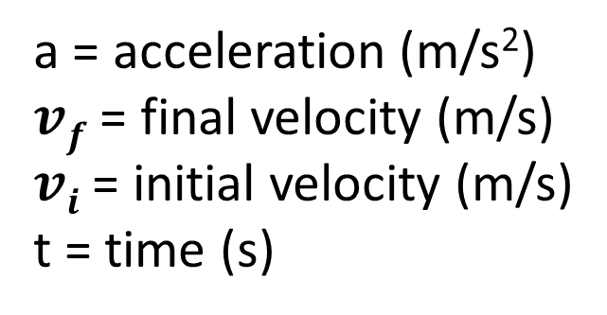
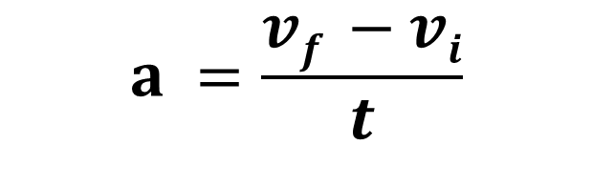
$$s=\frac{d}{t}$$
s = speed (m/s)
d = distance (m)
t = time (s)
$$v =\frac{d}{t}$$
v = velocity (m/s)
d = displacement (m)
t = time (s)
a = acceleration (m/s²)
$vf$ = final velocity (m/s)
$vi$ = initial velocity (m/s)
t = time (s)
$$a =\frac{vf −vi}{t}$$

Slide 20
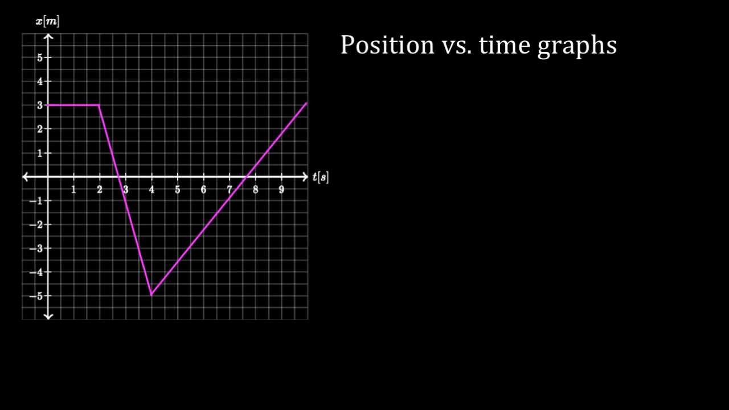
https://www.khanacademy.org/science/physics/one-dimensional-motion/displacement-velocity-time/v/position-vs-time-graphs

Slide 21
Interpreting Displacement (Position) - Time Graphs
Realism:
  What is the total displacement covered? Is this realistic for the time taken? Why?/Why not?
  Is the fastest speed realistic? Is the slowest speed realistic? Why?/Why not?

Slide 22
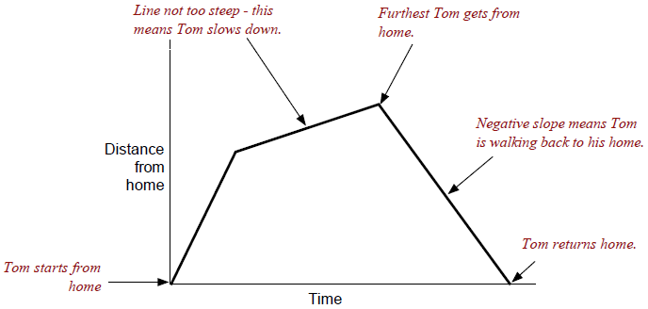
Interpreting Displacement (Position) - Time Graphs
Label the graph with any other observations you can think of.
  Example:
Write the story of the journey from the graph.
  How does this compare to the original story you wrote earlier?

Slide 23

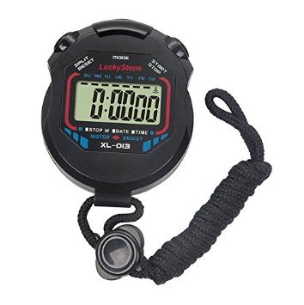
Accelerated Motion
ball
Inclined rail
10cm
20cm
30cm
Measure the time taken to reach each of the marks.

Slide 24
Accelerated Motion
Displacement (Position) - Time Graphs
Pre-Lab
Draw a rough sketch of what you think the Displacement (Position) - Time graph will look like for accelerated motion.

Slide 25
Accelerated Motion
Displacement (Position) - Time Graphs
Pre-Lab
State the possible sources of errors.
List the equipment you think you may need.
State any problems and possible solutions you think you may encounter trying to construct a Displacement (Position) - Time.
Create a table to record the data you think you will need to create a Displacement (Position) - Time Graph.

Slide 26
Accelerated Motion
Displacement (Position) - Time Graphs
Setup the experiment described on the previous slides and measure the data needed to construct a Displacement (Position) - Time graph for Accelerated Motion.

Slide 27
Accelerated Motion
Displacement (Position) - Time Graphs
Average Speed at different points.
Average Velocity (m/s) at different points.
The average speed at the end of the incline.
The average velocity at the end of the incline.
The instantaneous speed at different points.
The instantaneous velocity at different points.
What are the differences both between the answers above and the previous graph of a journey? Explain.
  You can choose the points yourself (at least 2).

Slide 28
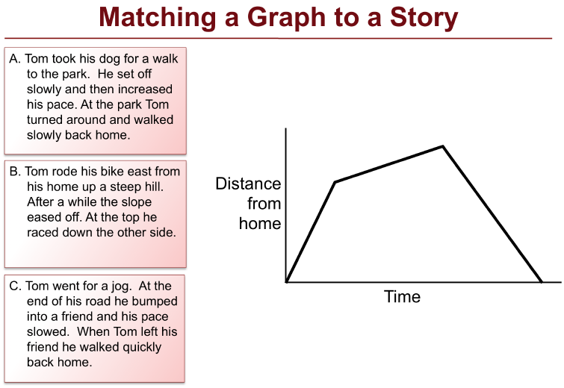
Plenary
Why?
Explain the reasons for your choice.

Slide 29
Plenary
Match each graph on the following slides to its appropriate story.

Slide 30
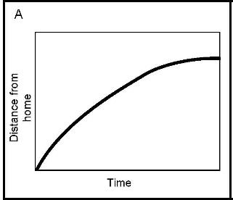
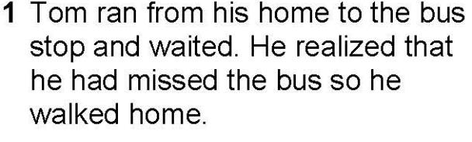
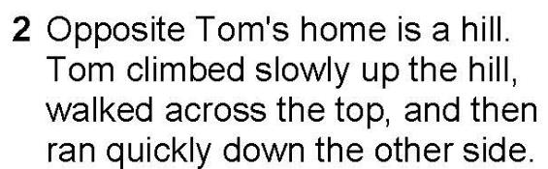
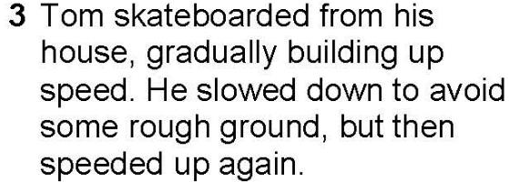
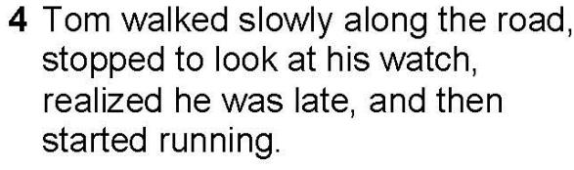
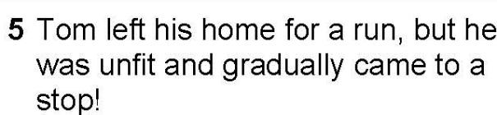
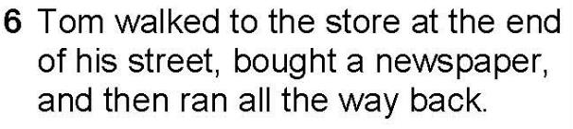
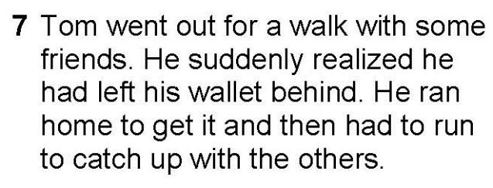
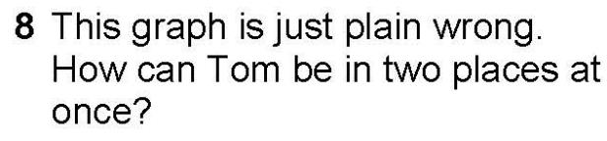
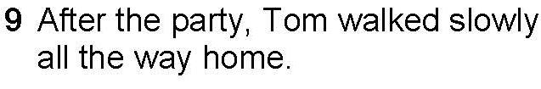

Plenary

Slide 31
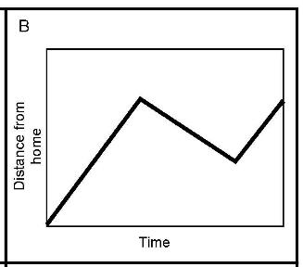
Plenary

Slide 32
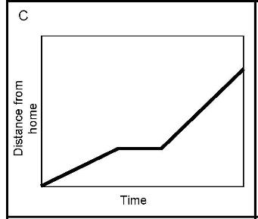
Plenary

Slide 33
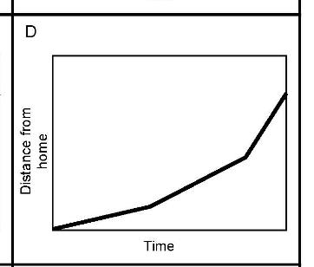
Plenary

Slide 34
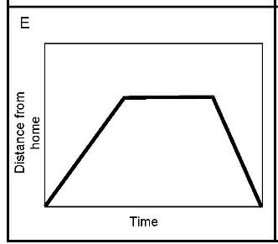
Plenary

Slide 35
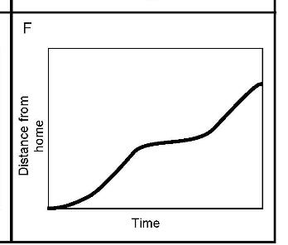
Plenary
F

Slide 36
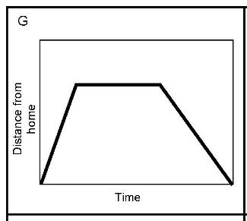
Plenary
G

Slide 37
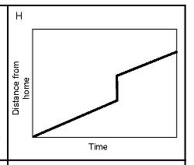
Plenary
H

Slide 38
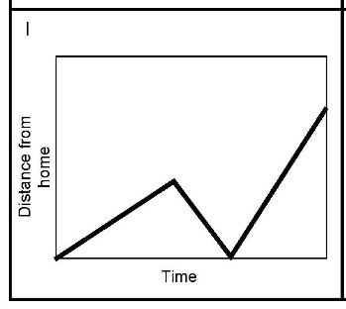
Plenary
I

Slide 39
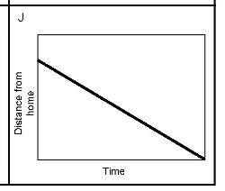
Plenary
J

Slide 40
Plenary
Match each graph on the following slides to its appropriate data table.

Slide 41
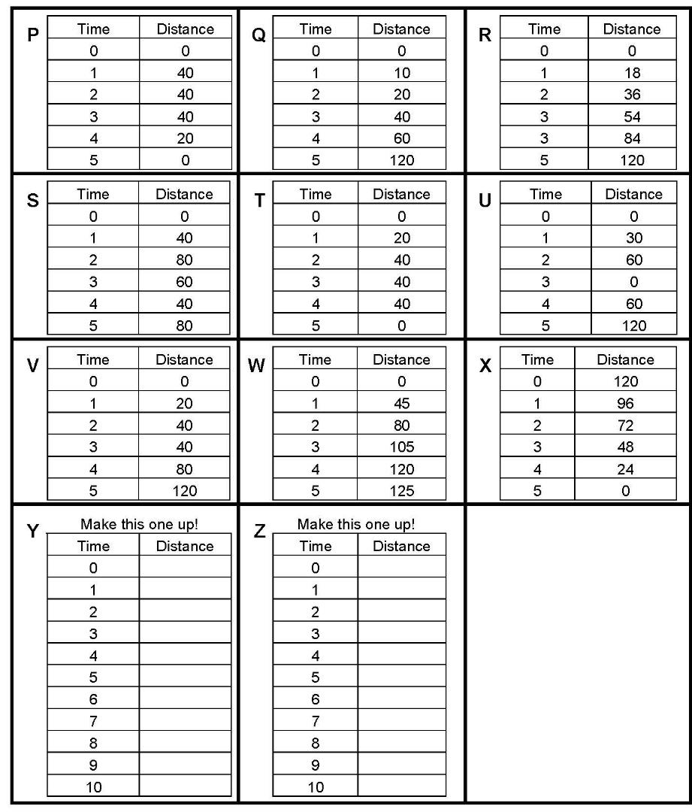
Plenary

Slide 43
Plenary

Slide 44
Plenary

Slide 45
Plenary

Slide 46
Plenary

Slide 47
Plenary

Slide 48
Plenary

Slide 49
Plenary

Slide 50
Plenary

Slide 51
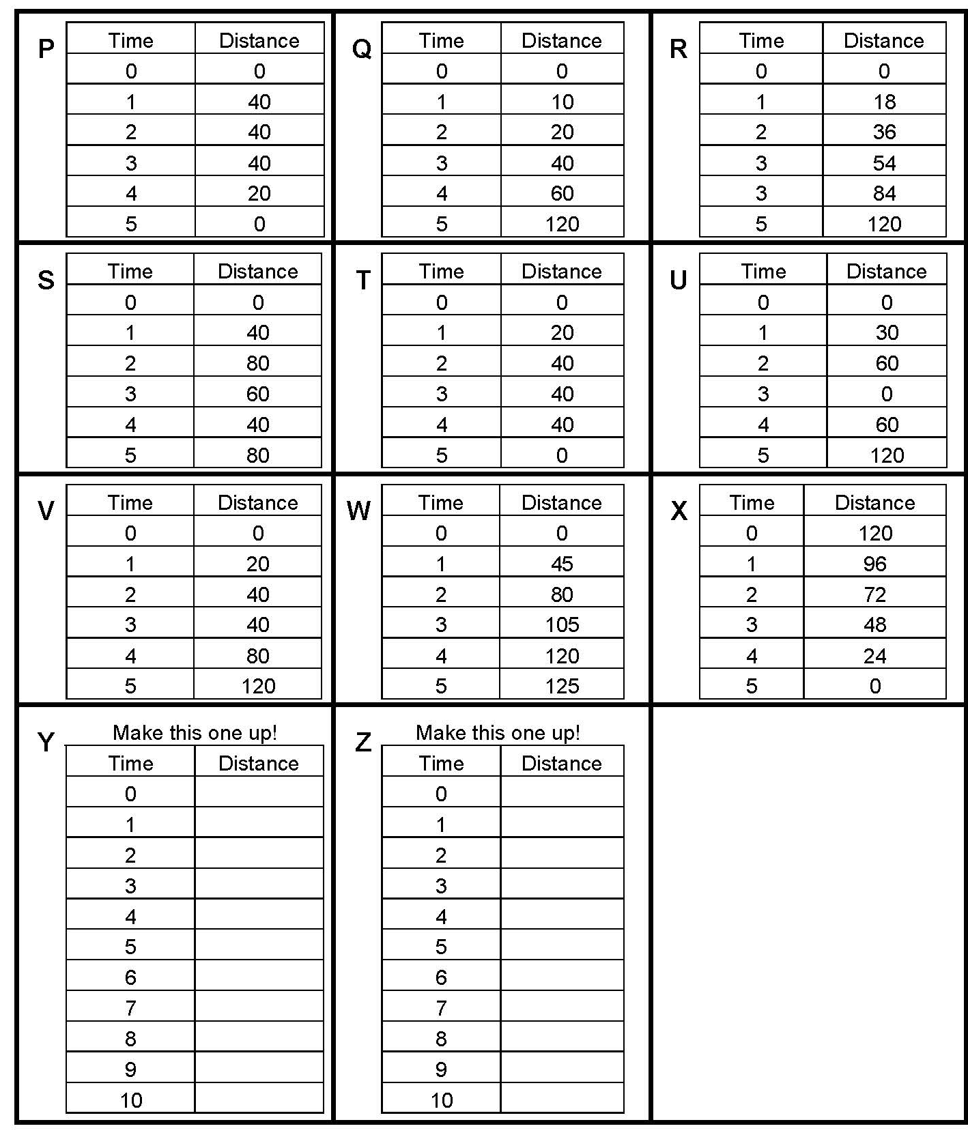
Plenary

Slide 52
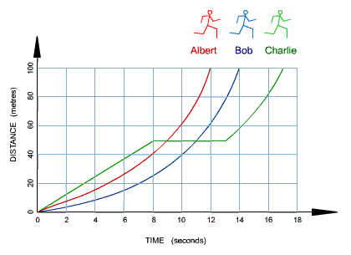
Plenary
Albert
Bob
Charlie
Look at the graph above. It shows how three runners ran a 100-meter race.
Which runner won the race? Explain your answer.
Which runner stopped for a rest? Explain your answer.
How long did Bob take to complete the race? Explain your answer.
Calculate Albert's average speed. (Figure the distance and the time first!)

Slide 53
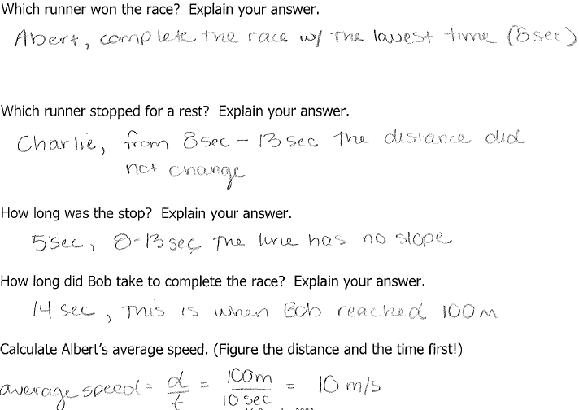

Slide 54
Plenary
How do you calculate the speed and velocity on a curved Displacement (Position) – Time Graph?
  https://www.khanacademy.org/science/physics/one-dimensional-motion/displacement-velocity-time/v/instantaneous-speed-and-velocity
  https://www.khanacademy.org/science/physics/one-dimensional-motion/displacement-velocity-time/a/position-vs-time-graphs

Slide 55
Grade yourself.
Grade yourself on the vocabulary and learning objectives of the lesson.

