Slide 1
Review of Previous Lesson
State as many Vocabulary words and Learning Objectives that you remember from the last lesson as you can.
Remember to grade yourself from 0 - 3.

Slide 2
Experimental Variables

Slide 3
Vocabulary
Content: | Start | End
variables
independent
dependent
control
fair testing
average
parallax
Discuss
Copy and fill in the table.
Grade yourself.

Slide 4
Vocabulary
Language: | Start | End
state
repeat
Discuss
Copy and fill in the table.
Grade yourself.

Slide 5
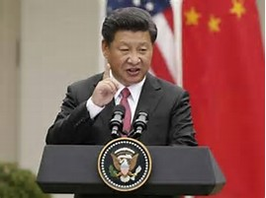
Command Words
Basically the most important words in a question as they tell you what you need to do.
Without them you will not know what to do to answer the question.
When answering a question start with identifying the command words, if you are reading, underline the command words with solid lines.

Slide 6

Content / Keywords
These are important Physics words.
You need to underline Content words with dotted lines.

Slide 7
Learning Objectives
Content: | Start | End
State the 3 main types of variables and an example of each one.
State possible errors in example experiments and explain how to avoid them.
Explain the need for repeating and averaging measurements.
Discuss
Copy and fill in the table.
Grade yourself.
Write a key.
Underline Command and Content words.

Slide 8
Learning Objectives
Language: | Start | End
Verbally and in writing state and explain.
Verbally explain the term “command words” and explain its importance.
Verbally explain the term “Content words”.
Discuss
Copy and fill in the table.
Grade yourself.
Underline Command and Content words.

Slide 9
Variables
The “things” that can change in an experiment are called variables.
There are 3 main types.

Slide 10
Independent variable
Is the one that you want to change.
Fair Testing:
  Why just one?
    Well, if you changed more than one variable it would be hard to figure out which change is causing what you observe.

Slide 11
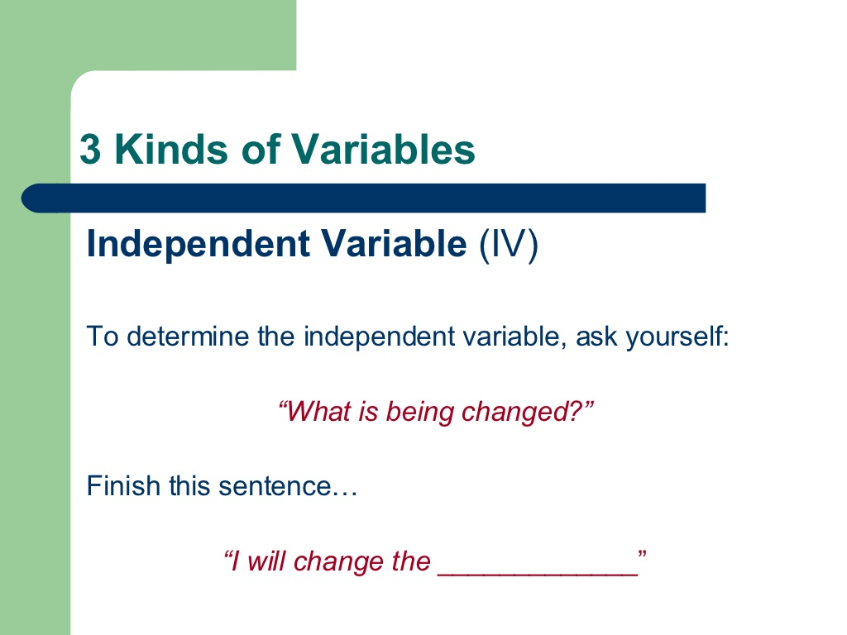
What do I want to change?

Slide 12

Independent variable
Do longer legged people tend to run faster?
What is the independent variable?
  Answer on a whiteboard. You may discuss with your colleagues but you must write an individual answer on a whiteboard.
    Length of legs

Slide 13
Independent variable
In pairs, one thinks of an experiment and explains to the other, the other states the independent variable for the experiment.

Slide 14
Dependent variable
Is the one that you measure.
Fair Testing:
  Why just one?
    Well, if you more than one variable changing it would be impossible to know whether or how the independent variable is actually causing the dependent variable to change or not (maybe one or more of the other variables which are also causes).
    Actually it is possible to have more than one dependent variable as long as you know for sure that each dependent variable has no effect on the others.

Slide 15


Slide 16
Dependent variable
Do longer legged people tend to run faster?
What is the dependent variable?
  Answer on a whiteboard. You may discuss with your colleagues but you must write an individual answer on a whiteboard.
    time
7 Mg 21/08/2017

Slide 17
Dependent variable
In pairs, one thinks of an experiment and explains to the other, the other states the dependent variable for the experiment.
7 Ca, 21/08/2017

Slide 18
Control variables
Things you don’t want to change.
Fair Testing:
  As explained earlier, most experiments allow only 2 variables (independent and dependent) to change. Everything else must be kept the same.

Slide 19


Slide 20
Control variables
Do longer legged people tend to run faster?
What are possible control variables?
  Answer on a whiteboard. You may discuss with your colleagues but you must write an individual answer on a whiteboard.
    weight, strength, body type, gender, …
7 Ru 22/08/2017, 8 Sr 21/08/2017

Slide 21
Control variables
In pairs, one thinks of an experiment and explains to the other, the other states the control variables for the experiment.

Slide 22


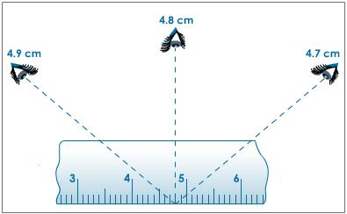
Experimental errors
Parallax errors:
Orient your line of sight directly above the measurement marking an imaginary vertical line connects your eye, the marking and the object.
  These can occur in almost every experiment.

Slide 23
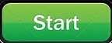

Experimental errors
Zero errors:
  These can occur in almost every experiment.
8 Ra, 21/08/17

Slide 24
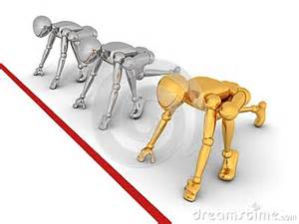
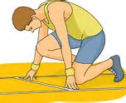
Experimental errors
Others depend on the experiment:
  Basically when controlled variables have not been thought of or accuracy errors.
  Do longer legged people tend to run faster?
    What possible errors can happen here?
      Distance variations / Accuracy of starting point

Slide 25

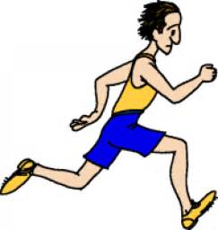
Experimental errors
Others depend on the experiment:
  Do longer legged people tend to run faster?
    What possible errors can happen here?
      Wet / Dry surfaces / Weather

Slide 26
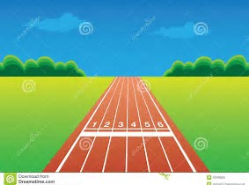

Experimental errors
Others depend on the experiment:
  Do longer legged people tend to run faster?
    Wind resistance

Slide 27

Experimental errors
Others depend on the experiment:
  Do longer legged people tend to run faster?
    Timing variations

Slide 28
Minimising errors
Errors can never be absolutely avoided though.
So repeating and then averaging measurements can reduce their effects.

Slide 29
Plenary
In pairs, one thinks of an experiment and explains to the other, the other states the variables for the experiment.
In pairs or groups explain to each other what you have learned.
Choose one of your lowest graded words from the vocabulary of this lesson and create a vocabulary word map.
Definition in your own words. | Synonyms
Use it meaningfully in a sentence. | Draw a picture of it.
Vocabulary Word

Slide 30
Grade yourself.
Grade yourself on the vocabulary and learning objectives of the last lesson.

