Slide 1



Use of Chinese 普通话
English must be used for general conversation.
If you need help you must first ask in English (with colleagues as well as the teacher).
If a colleague needs help, English must be used first to explain.
  Chinese can be used if English has been tried first and has not been understood.
When you can dream (not all the time though) in English then you really know English!
English

Slide 2

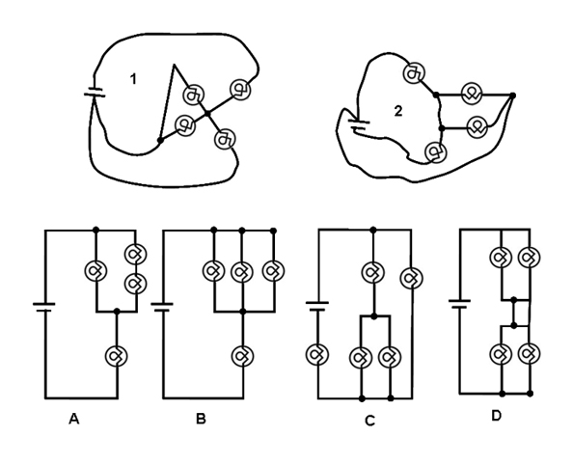


Organisation/Neatness
Titles centred and underlined with a ruler.
  All work must be titled but I may not always give you a title so you will have to think of a suitable one yourself.
Each piece of work is dated.
All straight lines on diagrams and graphs are drawn with a ruler.
All questions must be answered.
  If it is wrong, cross it out with one line
  only and correct.
    Failure is the mother of success …. 失败是成功之母 [失敗是成功之母]
No wasted space.
  No blank pages
  No unnecessary wasted space on pages.

Slide 3




Grading yourself
From 0 – 3:
  I know:
    0 - nothing.
    1 - a little.
    2 - it quite well / most of it.
    3 - it completely.
Be honest!

Slide 4
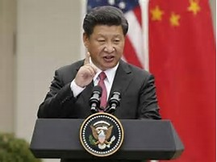
Command Words
Basically the most important words in a question as they tell you what you need to do.
Without them you will not know what to do to answer the question.
When answering a question start with identifying the command words, if you are reading, underline the Command words with solid lines.

Slide 5

Content / Keywords
These are important Physics words.
  However, today, as we are only discussing classroom rules and procedures, these will be just important words (other than the command words).
You need to underline Content words with dotted lines.

Slide 6
Key:
Before you copy questions and underline Command and Content words, make sure you write down a key like this:
Command words
Content words

Slide 7

Review of Previous Lesson
Answer questions posted on the board about the previous lesson content.
  Will be posted on the board.
  Copy the questions and underline the Command Words with solid lines and the content or keywords with dotted lines.
  Try not to use your notes from the previous lesson.
  If you have to then make sure you write “I needed to use my notes from the last lesson.”
    Be honest and make sure your grading below goes down from your last lesson to reflect this.
Grade yourself on the learning objectives from 0-3.
Should be always titled as “Review of Previous Lesson”.
Command words
Content words

Slide 8
Review of Previous Lesson
Title
State as many Vocabulary words and Learning Objectives that you remember from past years as you can.

Slide 9
Physics
Mr Lee

Slide 10
Vocabulary
Content: | Start | End
ruler, paper, graph, calculator, pen, pencil, hole punch, binder
rules
grade
percentage
course
Discuss
Copy and fill in the table.
Grade yourself.

Slide 11
Vocabulary
Language: | Start | End
verbally
command
physics
explain
describe
Discuss
Copy and fill in the table.
Grade yourself.

Slide 12
Learning Objectives
Content: | Start | End
Get to know your teacher!
Explain the class rules and lesson structure.
Describe how you will be graded.
Identify command and keywords.
Discuss
Copy and fill in the table.
Grade yourself.
Write a key.
Underline Command and Content words.
Command words
Content words

Slide 13
Learning Objectives
Content: | Start | End
Verbally explain.
Verbally describe.
Discuss
Copy and fill in the table.
Grade yourself.
Underline Command and Content words.

Slide 14
Learning Objectives
Content:
  Get to know your teacher!
  Explain the class rules and lesson structure.
  Describe how you will be graded.
  Identify command and keywords.
Language:
  Verbally:
    Explain
    Describe
We will discuss these objectives and then you will copy them down.

Slide 15
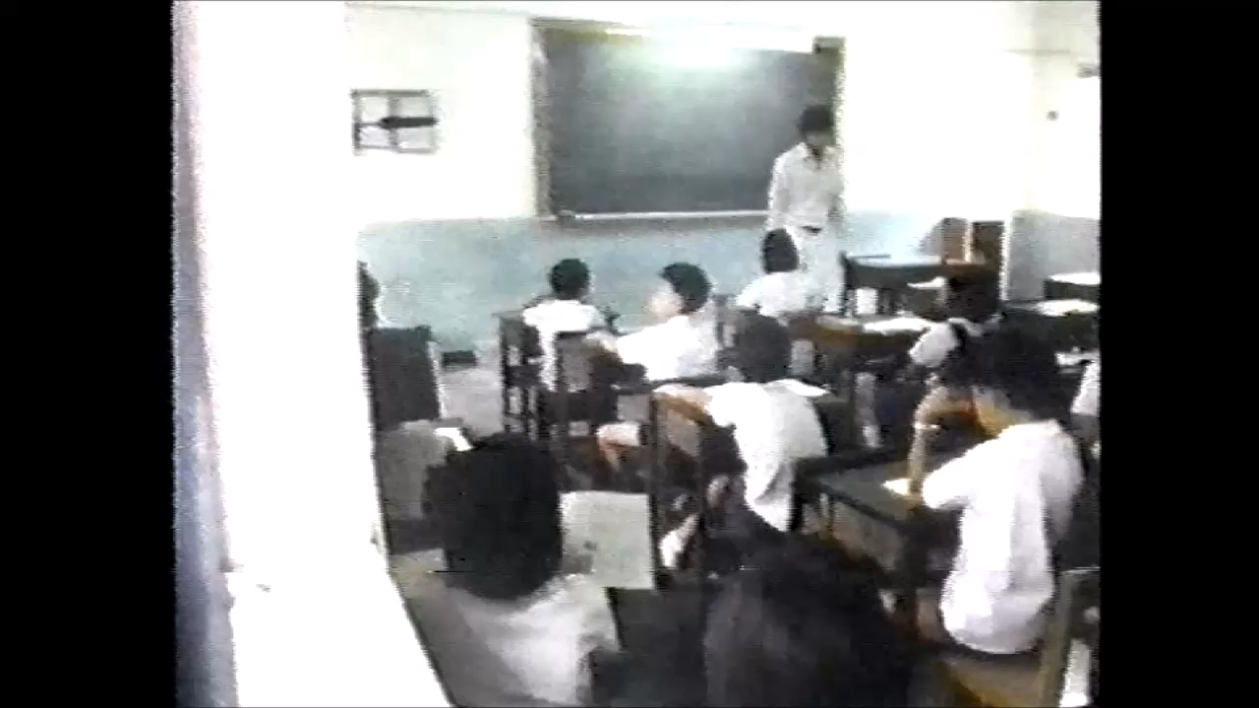
Language Immersion

Slide 16



Course Description
Continuation of all physics lessons you have ever had.
Review and elaborate on last year

Slide 17


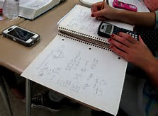


Updated Grading Policy
Class Tests & Quizzes (inc. the pre-comprehensive exam): 60%
  Grade 7:
    The Pre-comprehensive exam will replace a class test in Grading Period 3.
  Grade 8:
    The Pre-comprehensive exam is included in Trimester 2's Course Progress Grade and will replace a class test, so will be worth 30%.
Assignments (classwork/homework):
1. Accuracy 10%
2. Participation/Collaboration (in English) 10%
3. Organisation/Neatness 10%
Attendance/Punctuality/Equipment: 10%

Slide 18


Class Tests
~ Every 8 weeks.
Week advanced notice
May be cumulative
  They may cover only the content of the current grading period or they may also cover previous grading periods (including previous years).
    You have been warned!
Pre-Comp: Grade 7: 50% Grading Period 3 Grade 8: 25% Trimester 2
Comp: 50% total year grade

Slide 19


Quizzes
Held randomly!
May be cumulative
  They may cover only the content of the current grading period or they may also cover previous grading periods (including previous years).
    You have been warned!

Slide 20

Binders
Binder checks performed randomly for a grade.
All papers should be properly filed.
Graded:
1. Completion
2. Accuracy
3. Organisation/Neatness

Slide 21

Labs
Pre-lab or plan of the experiment.
  MUST be complete to participate in lab
  Graded:
    Completion
    Accuracy
    Organisation/Neatness

Slide 22

Homework
Assigned once or twice a week.
Will be posted on my website:
  tinyurl.com/mrleeedu
  shortcuturl.com/mrleeedu
Should take you no longer than 30 minutes, if they do then stop and let me know.
  I will make a judgement on whether you have a valid point or not. However, if I do not accept that it is too long I will expect you to finish but if I agree, you will either be given extra time or I will accept your homework as it is.
Graded:
1. Completion
2. Accuracy
3. Organisation/Neatness

Slide 23








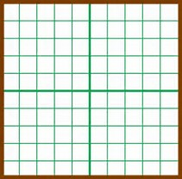

Required Class Equipment
Calculator
Binder
Loose-leaf paper
Graph paper
Hole punch
Divider tabs
Pencils and erasers
Pens
Ruler
White board marker
Equipment checks performed randomly for a grade.

Slide 24

Late Assignments
Homework is due at the beginning of class on the assigned date
No late assignments will be accepted, no credit given
The lowest assignment grade from each grading period will be dropped

Slide 25
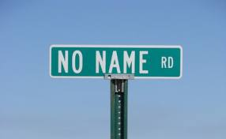
No Name Assignments
Homework turned in without a name will receive no credit.

Slide 26

Absences
Take advantage of the homework buddy.
Arrange to make up work ahead of time.
It is your responsibility to ask for missed work.
  I will try to regularly post presentations and work on my website:
    tinyurl.com/mrleeedu
    shortcuturl.com/mrleeedu
See Handbook for make up timelines.

Slide 27
Paper
Generally no notes or homework will be given on paper.
  If you do not write fast enough in lessons you will need to copy down from the presentations posted on my website.
  Homework will be posted on my website.
    You will be expected to copy down questions and answer. You are welcome to print yourself and put paper into your binders but think about the points on the next slide first.

Slide 28
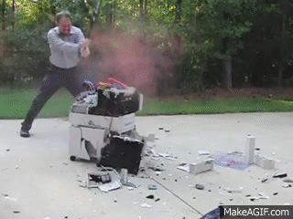


Paper
Why I don’t print?
  I don’t like printers and they don’t like me.
  Writing helps you think.
  Save the trees!

Slide 29

CJ ?
Required every class period.
Fill out daily.
I will check CJ’s daily.

Slide 30

Student Support
Hours:
  To be determined
I will also be available
  Times/dates posted on the board
If my room is open, you’re welcome to come in!

Slide 31

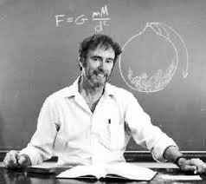
Textbook
Conceptual Physics
  Paul Hewitt

Slide 32
Additional Resources
The Internet! Here are some suggested sites:
  www.physicsclassroom.com/Class
  www.nature.com
  www.pbs.org
  http://phet.colorado.edu

Slide 33

Lesson Structure
Enter classroom
Review of Previous Lesson:
  Copy and answer questions / complete a task about the previous lesson.
    Create a key and underline the command words with solid lines and the content words with dotted lines.
  Grade yourself on the vocabulary and learning objectives from 0-3.
Read out and discuss vocabulary and learning objectives of Current Lesson.
Copy down title, vocabulary and learning objectives.
Grade yourself on the vocabulary and learning objectives from 0-3.
Introduction
Main
Plenary e.g. Vocabulary Word Map
  Underline the command and the content words as above in any written questions.
Fill out CJ
Grade yourself on the vocabulary and learning objectives from 0-3.
Do number 10 now.
Command words
Content words

