Slide 1
Data Transmission and
Networks
Transmission error checking & correcting

Slide 2
Learning Objectives
Discuss the use of check sums and parity bits to reduce transmission errors.

Slide 3
Transmission error checking and correcting
Errors are inevitable when transmitting a large number of bits.
Luckily there are only two possible mistakes that can occur:
  Either
  a 1 is received as a 0
  Or
  a 0 is received as a 1.

Slide 4
Echo Back
Send the data back again.
  If the data that is sent back is the same as the data that was sent in the first place then the original data must have reached its destination correctly, if not then it needs to be sent again.
Advantage:
  Very effective,
Disadvantage:
  Data has to be sent twice:
    Slow
    Needs duplex (or at least half duplex) transmission mode to allow data transfer in both directions.

Slide 5
ASCII (American Standard Code for Information Interchange)
Represents each character in a standard character set as a single byte binary code.
The standard code form that most PCs use to allow for communication between systems.
Usually uses a 7 bit binary code so can store 128 different characters and simple communications protocols.
Sufficient for all characters on a standard keyboard plus control codes.
This means that 1 bit is free to be used for something else.
  i.e. a parity bit – see the next few slides.

Slide 6
Parity bit
Used in every byte to force every byte to either have an odd or even number of 1s.
  The Number of 1s in a byte must always be either an odd number or an even number.
As long as both devices agree to either even or odd parity then this can be checked by the receiving device after each byte is received.

Slide 7
Parity Example
If odd parity is agreed between two devices then if a byte is received that has an even number of 1s, an error must have occurred.
  The sender wishes to send 1011000 ?
    ? is the parity bit which is not part of the data it wishes to send.
    As odd parity is used then it sets the parity bit to 0 to make the byte have an odd number of 1’s (3).
  So the sender sends 10110000
  When it is sent there is an error in transmission so that the last bit is received as a one.
  So, the byte received is 10110010
  This has 4 ones in it, which is an even number, so there must be an error.
  The receiving device would ask for it to be sent again.

Slide 8
Notes:
Even parity can equally well be used, as long as it has been agreed between the two devices.
If two mistakes are made in the same byte they will cancel each other out and the faulty data will be accepted.
  The solution to this is not part of this course.
Parity is not only used during data transfer between devices, but also when data is transferred between different parts of the CPU.

Slide 9
Summary of Bit Parity Method
Extra bit in each byte that does not transmit data.
Makes number of ones in a byte be always even or always odd.
Error in the transmission of a bit will make the even/odd wrong.
Problem of two errors in one byte not being found.

Slide 10
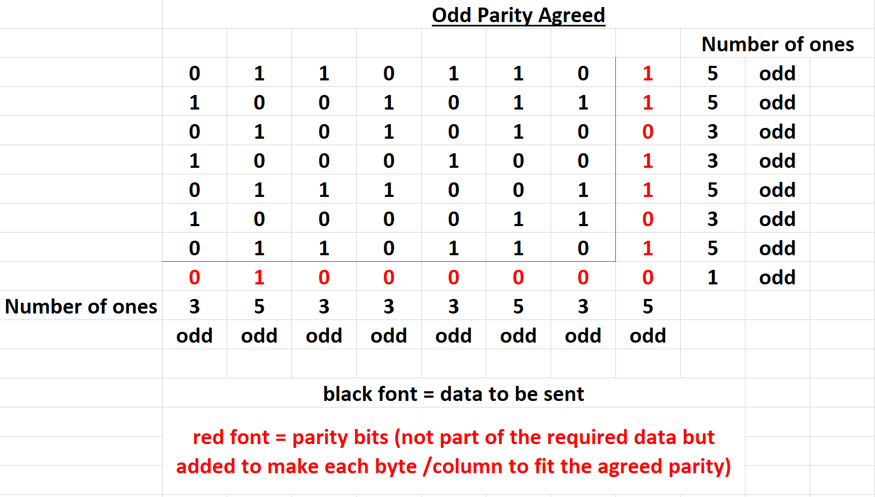
Parity Block

Slide 11
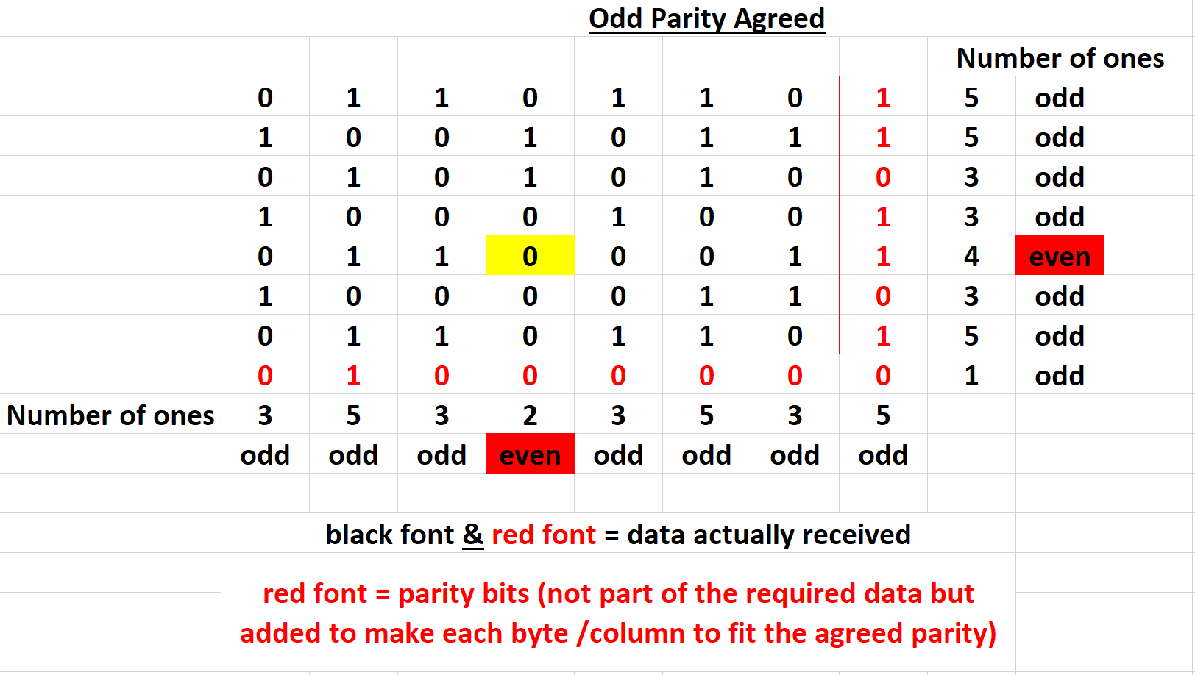
Parity Block
This should be a 1 and can be corrected by the receiver.

Slide 12
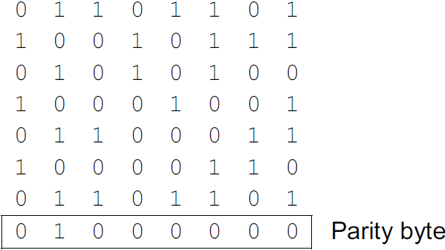
Parity Block
Odd parity is being used.
Byte number 5 has an even number of 1s therefore an error.
Column 4 has an even number of 1s.
Therefore the 0 in row 5, column 4 needs to be changed to 1.

Slide 13
Check Sum
Add all the bytes together that are being sent in a block of data.
  Data will normally be sent as a block of bytes rather than as individual bytes.
The carry, out of the byte, is not taken into account, so the answer is an 8 bit number, just like the bytes.
This is calculated before the data is sent, and then calculated again when it is received.
If there are no errors in the transmission, the two answers will match.

Slide 14
Plenary
Can you explain the use of check sums and parity bits to reduce transmission errors?

Slide 15
Summary of Parity Method
Extra bit on each data-byte that does not transmit data.
Makes number of ones in a byte be always even or always odd.
Error in the transmission of a bit will make the even/odd wrong.
Problem of two errors in one byte not being found.

Slide 16
Check Sum
Add all the bytes together that are being sent in a block of data.
  Data will normally be sent as a block of bytes rather than as individual bytes.
The carry, out of the byte, is not taken into account, so the answer is an 8 bit number, just like the bytes.
This is calculated before the data is sent, and then calculated again when it is received.
If there are no errors in the transmission, the two answers will match.

